Slide 1


Digital Identity: Federation, Integration and Deployment of Trusted Identity Solutions
Ryan Fox : JULY 19, 2014

Slide 2






WHO WE ARE
Leaders in Digital Identity Technology
Founded by two Army Rangers in 2010 to help brands offer special loyalty programs to affinity groups like: Military, Students, Influencers and Professionals
Capable of securing offers delivered online, in-store and via mobile
Consumer- centric network empowers a consumer to bring their own identity to third party apps in order to receive personalized offers.
CONFIDENTIAL & PROPRIETARY INFORMATION OF ID.me

Slide 3





AWARD WINNING SOLUTIONS
Our Accomplishments
Department of Commerce for a $2.8M grant as one of the five companies in America with the most advanced digital Identity technology
Finalist for 2013 Wall Street Journal Startup of the Year
Named US Chamber of Commerce & Spike TV’s “Most Veteran-Friendly Small Business in America” in 2013
March 2013 Raised Series A round of $10 million led by USAA, Silicon Valley Bank
Recognized in Entrepreneur Magazine’s 2014 edition of 100 Brilliant Companies
2014 Finalist for LinkShare Advertiser’s Choice Golden Link Award

Slide 4
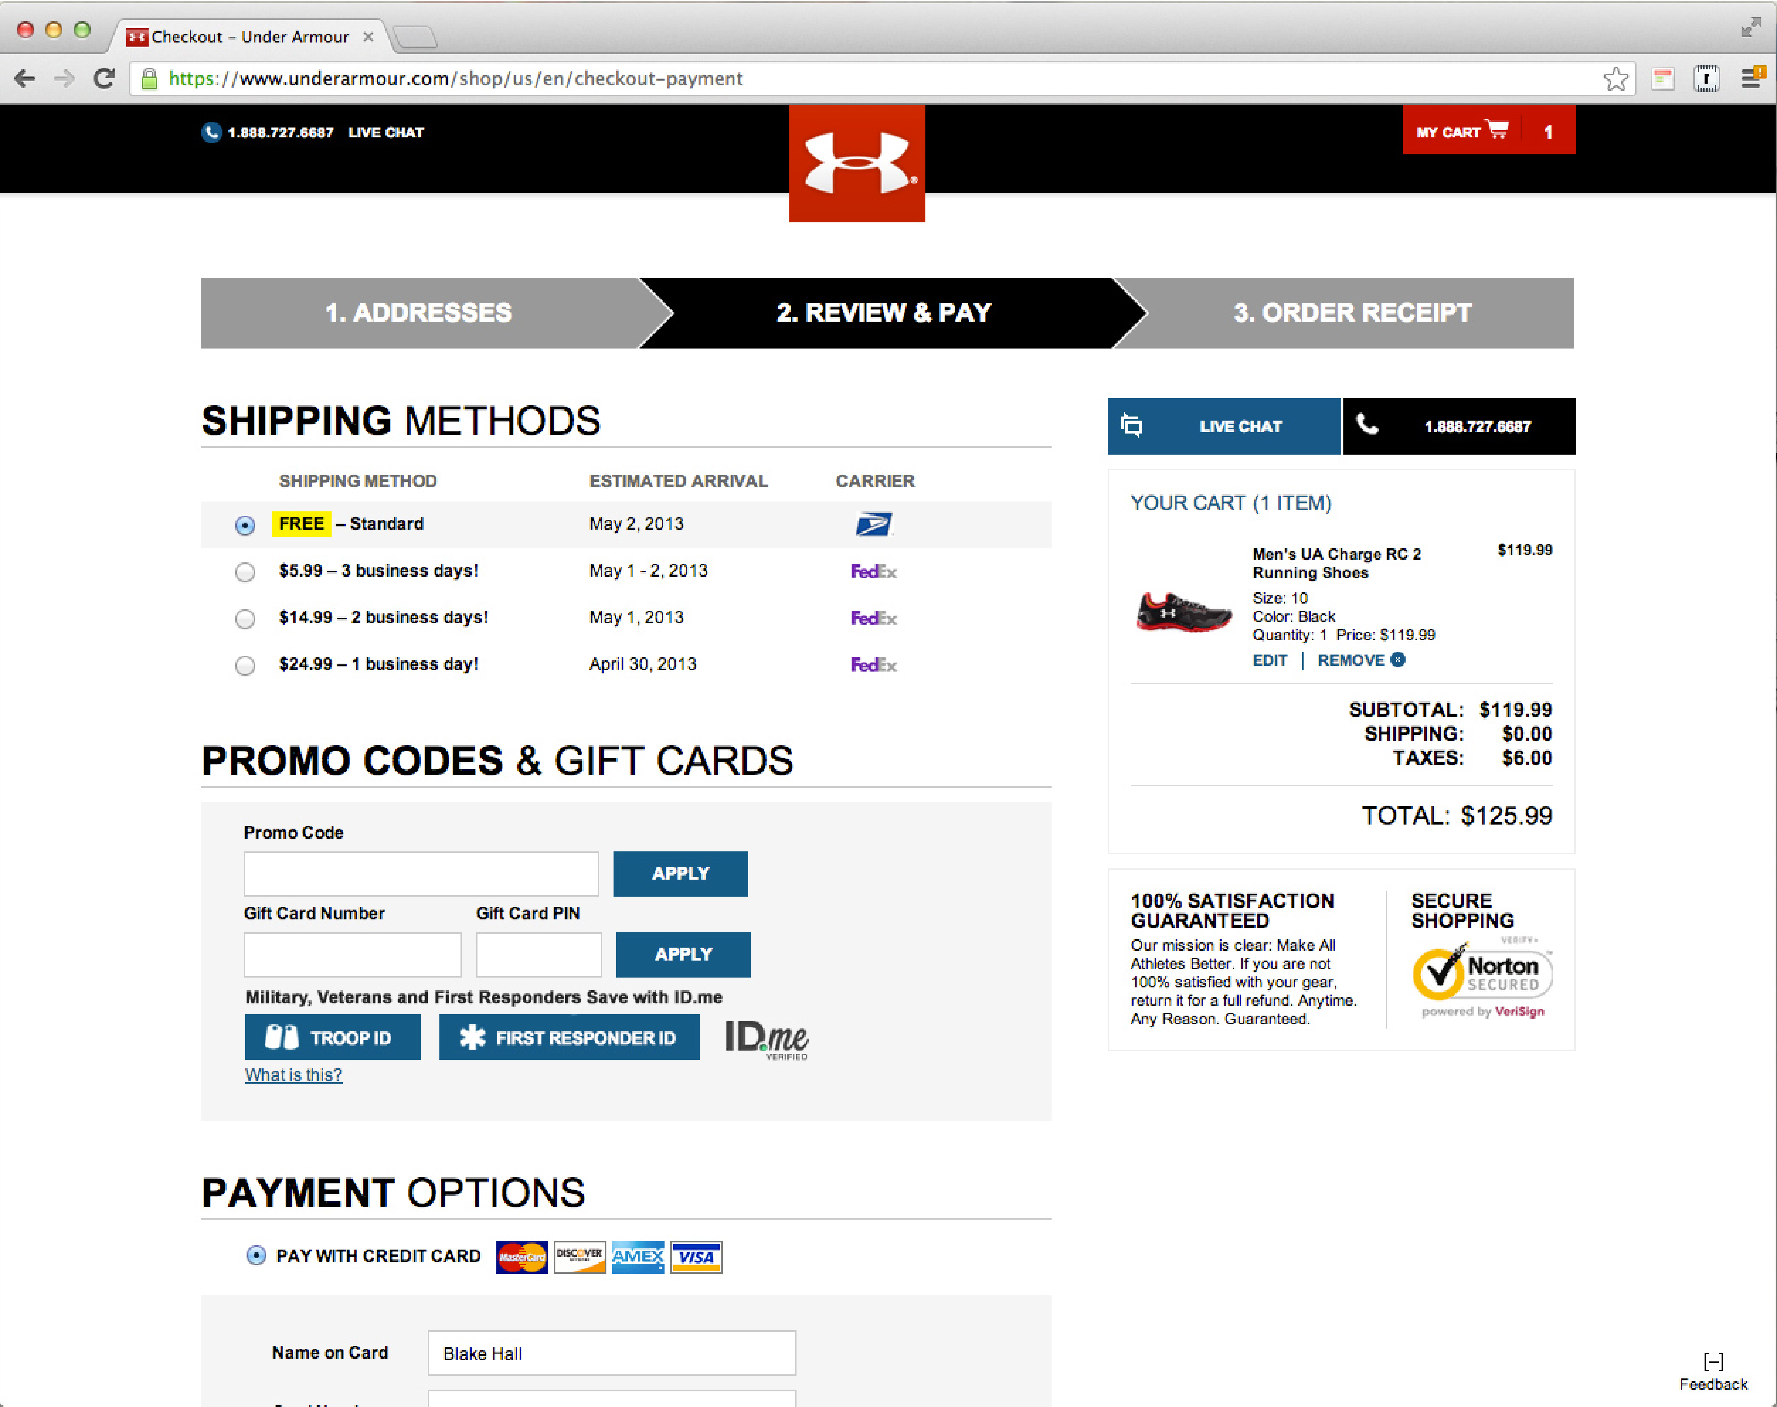


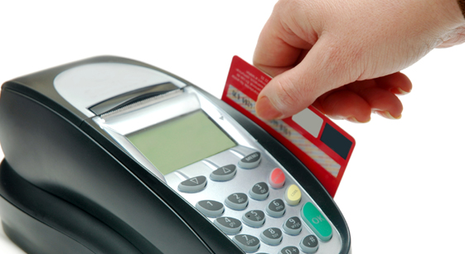
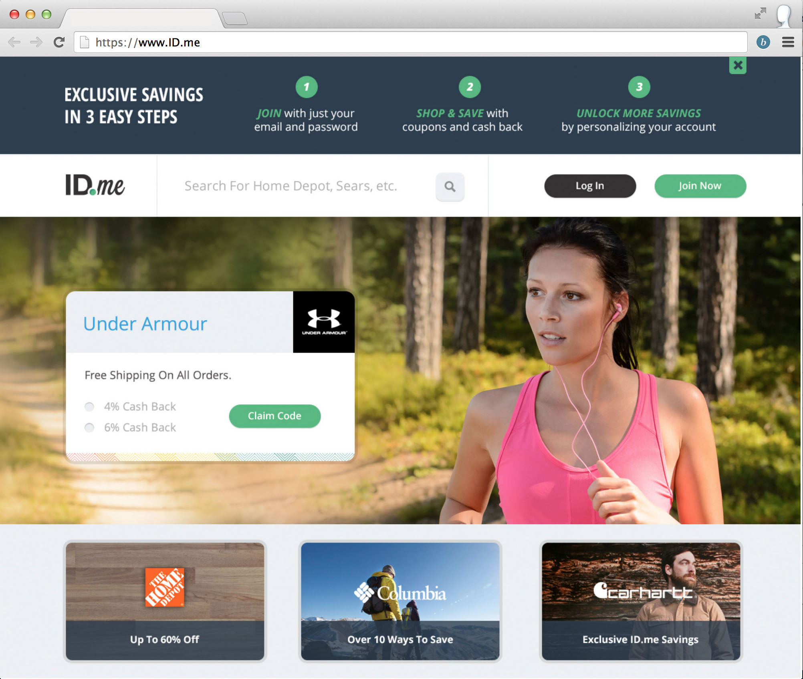
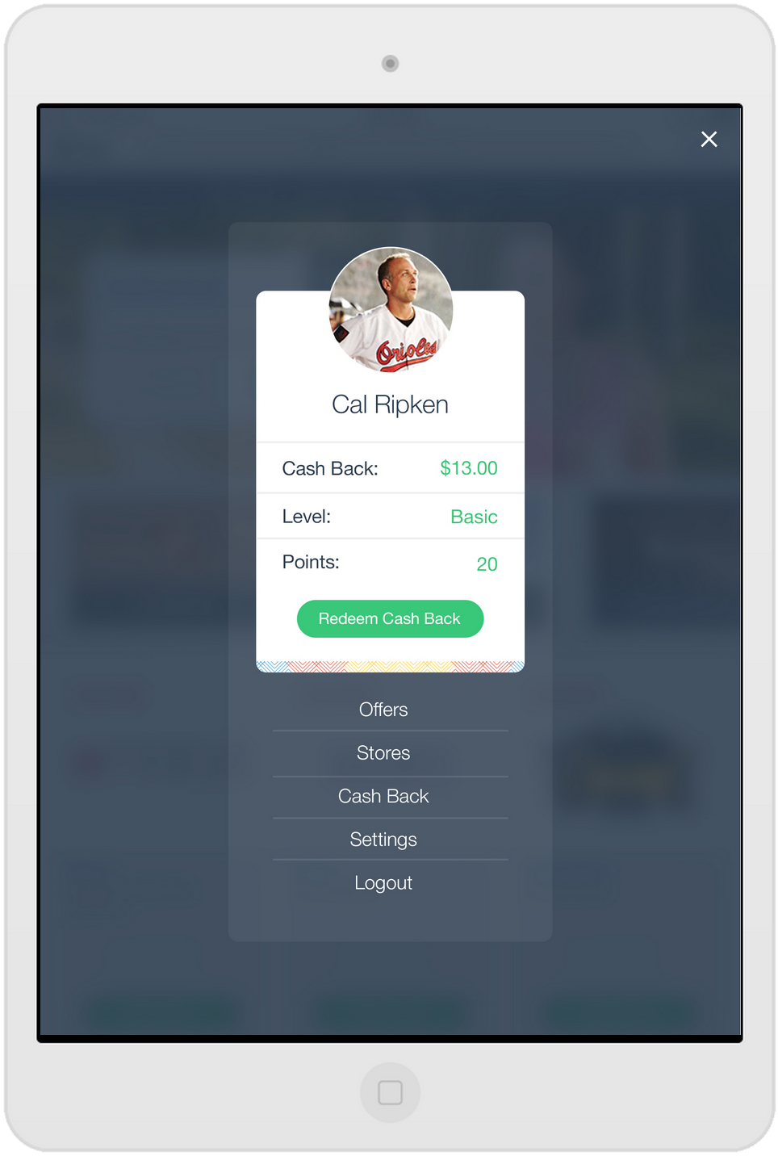


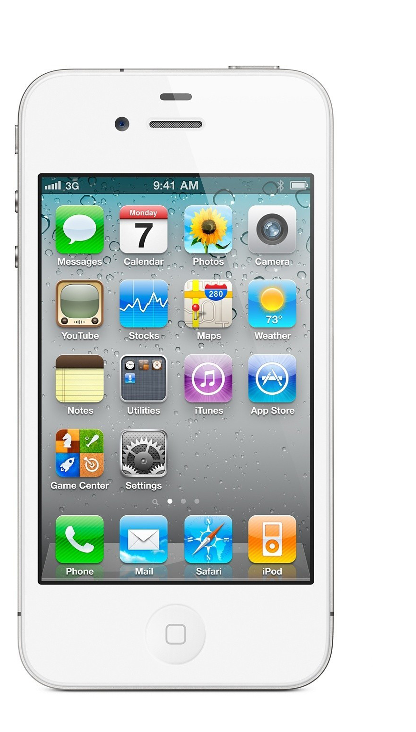
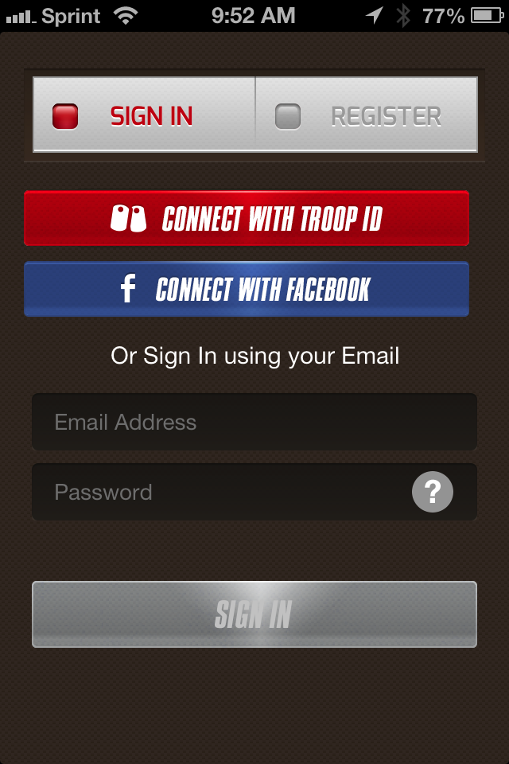
ID.me Operates as Digital Identity Bank
Allowing Users to Leverage their Identity Data as Renewable Currency
Interoperable
Secure
User Controlled
Privacy Enhancing
Affordable

Slide 5

Driving Adoption of Identity Solutions
Identity matters to everyone…
BUT - For different reasons…
…and based on context
Notes:
To state the obvious… Identity is a cross functional domain
The value in a B/G2B and B/G2E context is within in the CIO/CISO area of responsibility
The B/G2C value is within the marketing domain with existing security and efficiency as a latent need

Slide 6


Effective solutions must view their value through multiple lenses
Understanding business challenges is key…
Security / IT
E-commerce
Protect…
Enable…
Public Sector
Protect…
Notes:
Security IT:
Marketing BD
Public Sector

Slide 7
CASE STUDY
Under Armour Military Loyalty Program
Under Armour had a military discount program in-store but was unable to provide the program online because they couldn’t verify customer affinity
Under Armour integrated ID.me technology to create an omni-channel customer experience
Customer verifies affinity in real-time and claims discount directly in cart

Slide 8
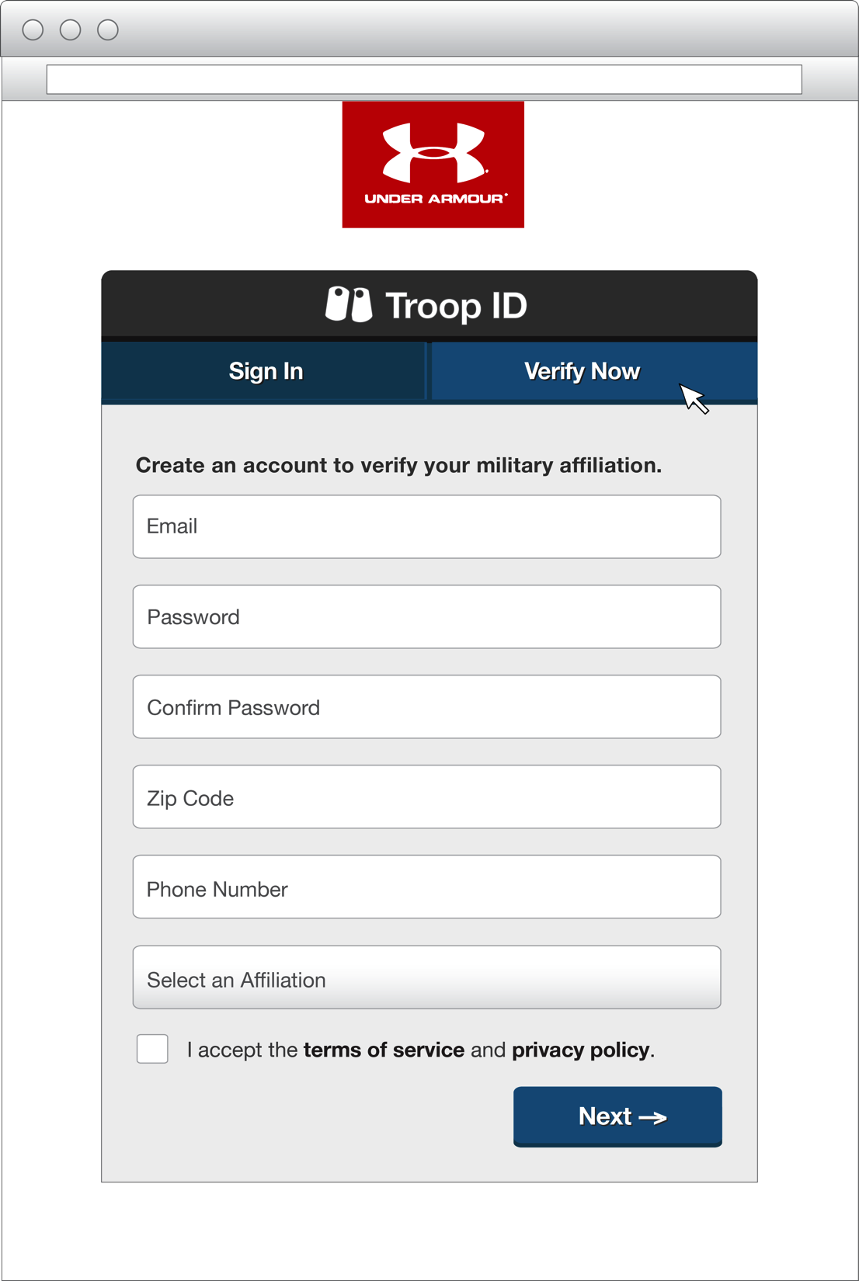
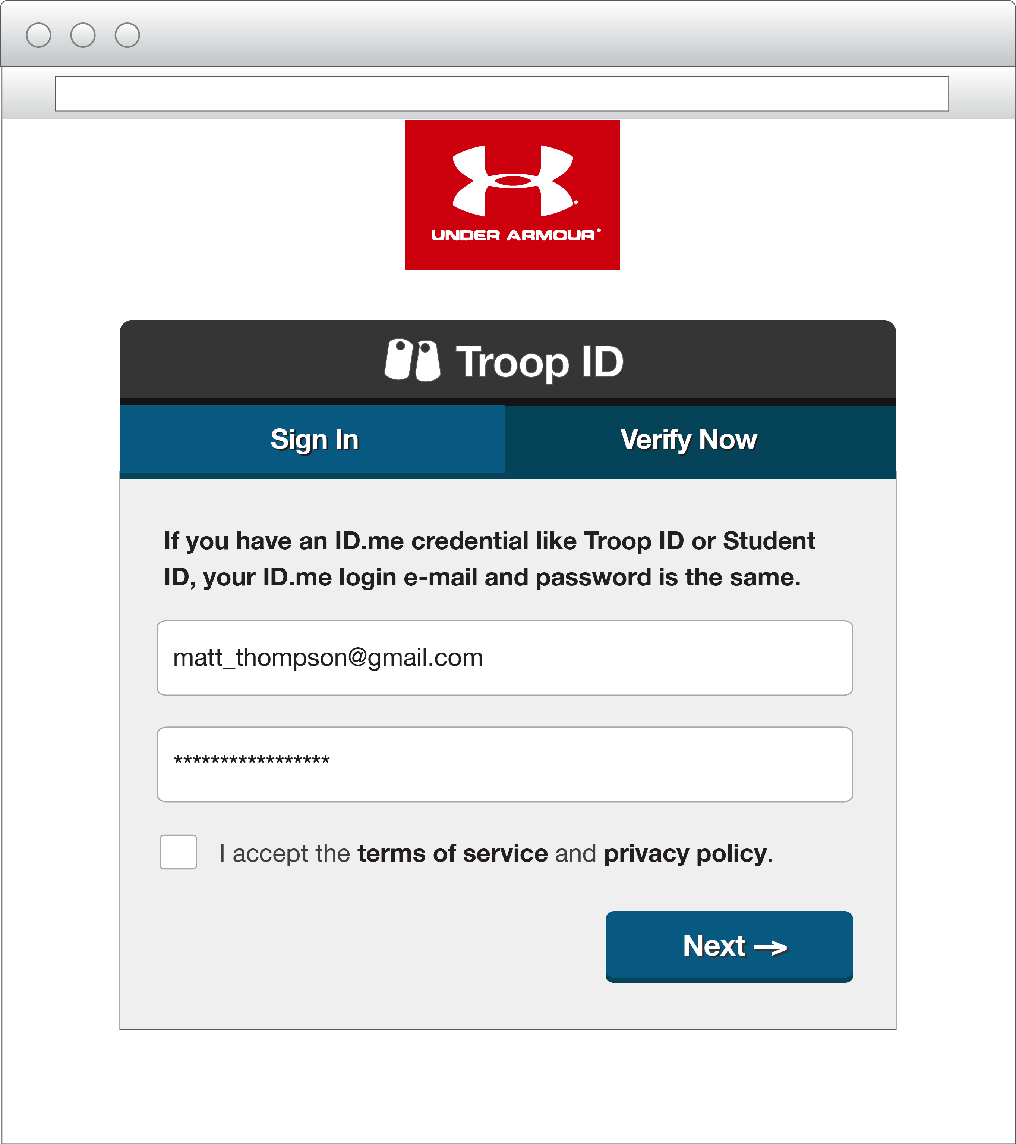
CHECK OUT INTEGRATION
Under Armour Example
1
Veteran sees button
on UnderArmour.com
2
Veteran verifies with ID.me to receive discount
3
Member claim is verified and credential is issued

Slide 9
Identity Alone Will Not Drive Adoption
It’s all about the attributes
Business value is often driven by the data/attributes associated with an identity
Network effect allows for the identity to be build out over time – reducing friction associated with user on-boarding
Identity = Unique Collection of Attributes

Slide 10

Interoperability and Trust….Kinda
Compensating controls associated with Levels of assurance leave ‘equivalency’ up for interpretation by each RP
Remote identity proofing technologies are very ‘configurable’
Protocol usage – mileage may vary
No RP enforcement (e.g., single log out)
Notes:
To state the obvious… Identity is a cross functional domain
The value in a B/G2B and B/G2E context is within in the CIO/CISO area of responsibility
The B/G2C value is within the marketing domain with existing security and efficiency as a latent need

Slide 11







Standards are only the beginning…
Underlying protocols are the first, foundational step
Developer adoption of the technology is a key barrier
Open source solutions must emerge that provide simple integrations for consumption of the trusted credentials – app deployment, gems, etc. will lower the barrier of entry

Slide 12
Questions…

