Slide 1
2017 Annual General Meeting
Ethics & Conformance Trust Marked
Held at Victor’s Residenz Hotel, Unterschleißheim, Munich
May 14th, 2018, 10.30am

Slide 2
Agenda
Call to order
Welcome, roll call (attendance sheet) and introductions
Anti-trust Statement (Clause 19 of the ByLaws)
Apologies Received: Julian Ranger, Mark Lizar, Nat Sakimura
President's report
Executive Director's report (incl finance, members, programs, infrastructure, policies)
Motion to accept the President’s and Executive Director’s reports as presented
Motion to accept the December 31 2017 financial statements as presented
Leadership Council Chair’s report: WGs, DGs, publications and downloads
Motion to accept the Leadership Council Chair’s report as presented
Questions to Directors & LC Chair
Close

Slide 3
Kantara Anti-Trust Statement
ARTICLE 19 COMPLIANCE WITH ANTITRUST LAWS
The Members will be combining unique experience and skills to foster identity community harmonization, interoperability, innovation and broad adoption through the development of open identity Technical Specifications, operational frameworks, education programs, deployment and usage best practices for privacy-respecting, secure access to online services. This purpose is believed by the Members to be more difficult to achieve through the independent efforts of each company. The Members are committed to fostering open competition. The Members understand that in certain lines of business they are direct competitors and that it is imperative that they and their representatives act in a manner which does not violate any applicable antitrust or competition laws pertaining to monopolistic or anti-competitive practices. Thus, all Members shall comply with all applicable antitrust and competition laws of all relevant jurisdictions. In addition, with the advice of counsel, the Board shall from time to time promulgate detailed Antitrust Compliance Guidelines for the consideration of the Members concerning their participation in the Corporation. These Guidelines are not intended to replace or displace each Member's own antitrust policies, but shall operate to guide the Members' participation in the Corporation. Members are not required to develop or market any offerings, and are not precluded from engaging in any business activities whatsoever, even if they are competitive with the activities conducted under these Bylaws.

Slide 4












Director’s Report - Kantara Initiative
US non-profit, founded 2009. Estonia non-profit, founded 2017 (licensee)
Strong ethics & societal purpose. Low barriers to participation. Passionate about giving control of identity and personal data back to individual owners
Mission: the global consortium improving trustworthy use of identity and personal data through innovation, standardization and good practice
Business model: Membership, Trust Framework Operator, Specification development, Publishing platform
Comprises global thought-leaders from Organizations & Individuals & Government agencies
Our Leadership
Our Liaisons (examples)
Notes:
DIACC: Digital Identification and Authentication Council of Canada whose mission is to push the Canadian digital economy agenda forward.
EEMA is a European Association for e-Identity and Security – a not for profit, European Think Tank including topics on identification, authentication, privacy, risk management, cyber security
Open Consent Group is a UK based Community Interest Company. A multi-standard and consent tech engineering group with a development sandbox.
PDEC, a non profit industry association has been a pioneer in the field of personal data

Slide 5
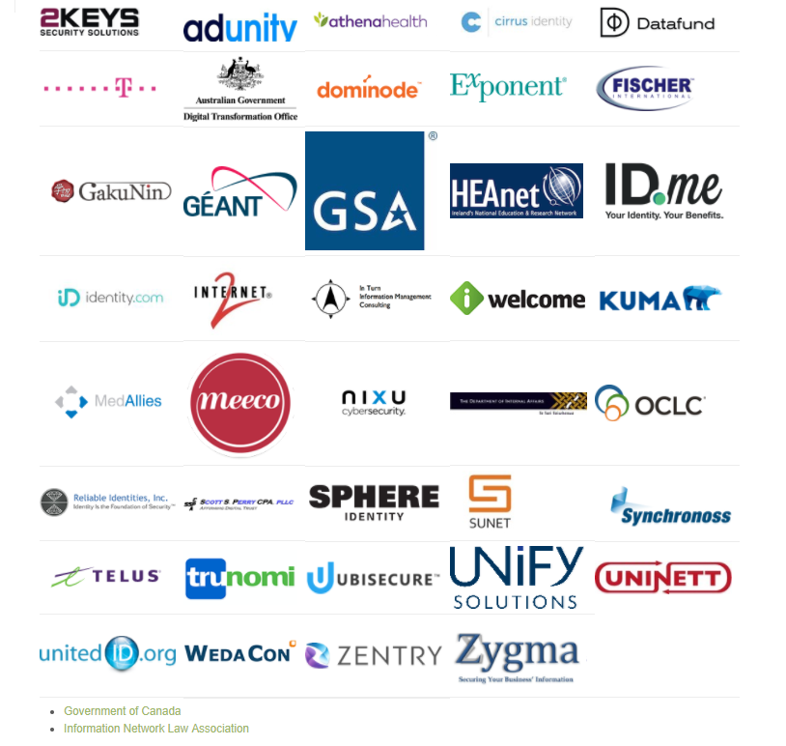
Kantara’s global membership & x10 non- member participants
…and our sizable band of dedicated individuals

Slide 6
Director’s Report - Kantara 2017 Financial Summary
Year End Performance
  Revenue $878K
    $418K Membership Dues; $425K KIPI Subaward Project; $10K ID Pro; $25.5K Sponsorship
  Expenses of $911K
    KIPI Grant expenses total $331K - $148K over budget; Ops expenses are $580K
  Net loss of ($33K)
  Current Cash Balance of $206K –
    2.7 months of total cash reserves
  Operating Cash Balance of $112K
    2.3 months of Operating cash reserves
      Operating Cash Balance (Less KIPI funds) of $94K

Slide 7
Director’s Report - FY17 vs. FY16 Balance Sheet

Slide 8
Director’s Report - Kantara 2017 Actual vs. Budget
Note: Standard practice for 501C6 entities is Audit every 3 years. For Kantara early 2019 for the 3 years ending 2018

Slide 9
Director’s Report - Total Members (Count) as of December 31, 2017
Total Members: 73

Slide 10
Director’s Report - Membership Retention as of December 31, 2017*
*This chart represents the rolling member retention rate over the past 12 months
Notes:
For those interested, the retention rate is calculated in the following manner: total members (as of the end of each month), minus 12 months of new members, divided by total number of members 12 months previous.

Slide 11
Director’s Report - New/Lost Members
Jan 1 – December 31, 2017
New Members | Dues Amount
Mary Hodder (comp 1 yr) | $0
Janelle Allen | $150
William Lowe | $150
Ubisecure | $2,500
Inflection Risk Solutions, LLC d/b/a Identity.com | $9,000
UHG/Optum | $21,500
Meeco | $2,500
Adunity | $2,500
WedaCon Informationstechnologien GmbH | $2,500
Total 2017 New Revenue: | $40,800
Lost Members | Dues Amount
Cogito Group | $2,500
Lars Johansson | $150
Unbound ID | $2,500
RedIRIS | $250
Cirrus Identity, Inc. | $2,500
Don Waugh | $150
Total 2017 Lost Revenue: | $8,050

Slide 12
Director’s Report – 2017 Highs
Revised Mission statement published
Established Kantara Europe in Estonia in January 2017
Incubating and releasing ID Pro
Revised and improved ByLaws and IPR Policies published
New Membership structure and fee schedule published
Strong member retention aided by improved PR, website etc
Identity Assurance Trust Framework Program extended to 800-63-3
KIPI R&D Program stabilized with 3 projects and net revenue earning
Great momentum in WGs and DGs in publishing multiple recommendations and reports, attracting high download volumes
Super supportive core member/chair team, staff team & LC Chair

Slide 13
Director’s Report - 2018 Outlook
Success in Europe – H2020 or some other way
More progress on regional chapters
Online joining & renewal via CiviCRM √
Growth in Assurance & Trust Framework Program – 800-63-3 & others – to offset the likely withdrawal of the Trust Framework Solutions arm of the GSA’s FICAM program
Merger and acquisition opportunities
Finish the Operating Procedures refresh!
Plenary ideas!

Slide 14
Agenda
Call to order
Welcome, roll call (attendance sheet) and introductions
Anti-trust Statement (Clause 19 of the ByLaws)
Apologies Received: Julian Ranger, Mark Lizar
President's report
Executive Director's report (incl finance, members, programs, infrastructure, policies)
Motion to accept the President’s and Executive Director’s reports as presented
Motion to accept the December 31 2017 financial statements as presented
Leadership Council Chair’s report: WGs, DGs, publications and downloads
Motion to accept the Leadership Council Chair’s report as presented
Questions to Directors & LC Chair
Close

Slide 15
2017 Leadership Council Report

Slide 16
The Groups On December 31, 2017
Blockchain and Smart Contracts DG
Identities of Things DG
Consent and Information Sharing WG
Consent Management Solutions WG
eGovernment WG
Federation Interoperability WG
Identity Assurance WG
Identity Relationship Management WG
Open Trust Taxonomy for OAuth2 WG
User Managed Access WG

Slide 17
Group Changes
Total count at December 2017
  2 Discussion Groups
  8 Work Groups
Changes
  1 new group: Consent Management Solutions WG
  2 groups concluded: Blockchain & Smart Contract DG; ID Pro DG
  2 groups declared dormant: Health ID Assurance WG; UMA Dev WG

Slide 18
Overview of 2017 Group Activities
2017 was a productive year for Kantara Groups
  2 new Reports published
  3 new Technical Specifications published
  Work substantially complete on several additional documents for publication early 2018
Tracked downloads as a rough proxy for interest in Kantara publications

Slide 19
Publication Downloads Count 2017

Slide 20
Most Popular Downloads of 2017

Slide 21
Outlook for 2018-2019
‘Reload’ work pipelines and roadmaps for all groups
Focus on meaningful work products and visibility of Kantara Groups
Introduce Balanced Scorecard method of defining objectives, initiatives and measures
Build off 2017 Publications toward implementations and interoperability
Launch new work projects and groups to address new demand for standards of practice and specifications for identity and personal data

Slide 22
Nurture. Develop. Operate. – that’s what we do
Ethics & Conformance Trust Marked
colin@kantarainitiative.org
Twitter:
@KantaraColin
@KantaraNews
Join us at https://kantarainitiative.org/membership/
Notes:
Enabling communities to verify high-value ID credentials for Trust.
Kantara Members have a wealth of experience: Identity Assurance, Privacy, Policy and Information Systems Assessment. We’re here to help your community ensure Federated Identity Systems are verified for trust.

