Slide 1
An NSTIC/IDESG Update a.k.a.
Is the One World Government coming for my Identity?
Ian Glazer
Delegate-at-Large, Management Council – IDESG
Board of Directors Member – IDESG Inc.
Senior Director, Identity – salesforce.com
@iglazer

Slide 2
Guide to the deck
Ian’s slides
NSTIC Program Office slides
IDESG slides

Slide 4
What NSTIC isn’t

Slide 5
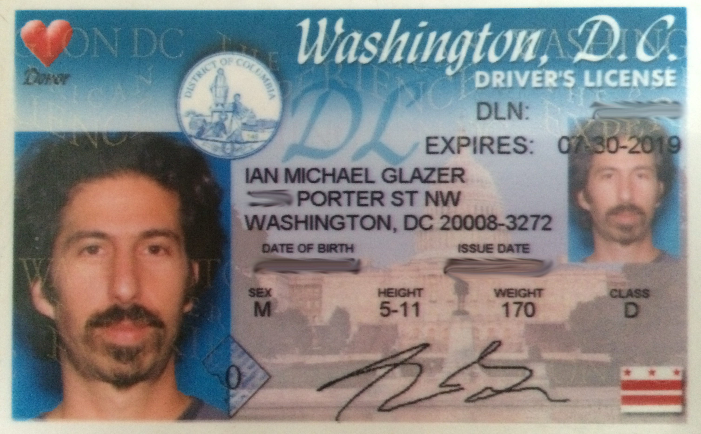
NSTIC is not a driver’s license for the Internet!
Internet

Slide 6


Slide 7
What is NSTIC?

Slide 8
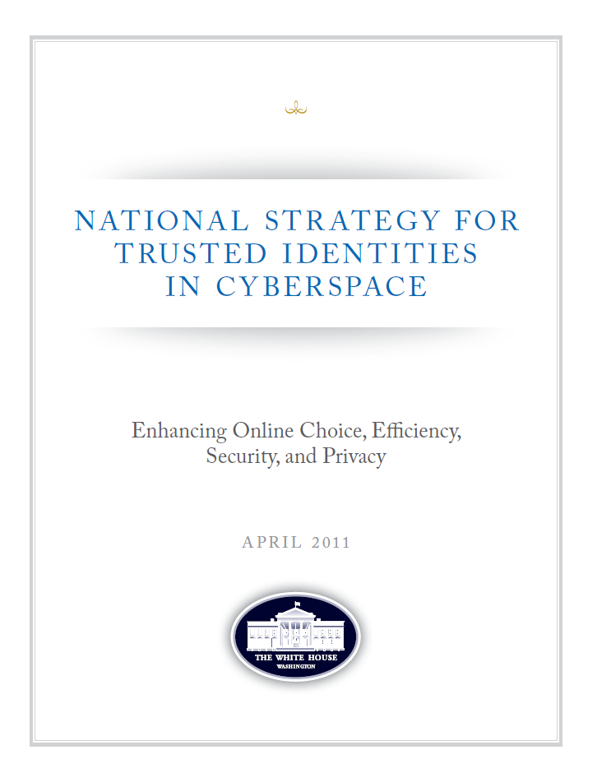
What is NSTIC?
Called for in President’s Cyberspace Policy Review (May 2009):
a “cybersecurity focused identity management vision and strategy…that addresses privacy and civil-liberties interests, leveraging privacy-enhancing technologies for the nation.”
Guiding Principles
  Privacy-Enhancing and Voluntary
  Secure and Resilient
  Interoperable
  Cost-Effective and Easy To Use
NSTIC calls for an Identity Ecosystem,
“an online environment where individuals
and organizations will be able to trust each other
because they follow agreed upon standards to obtain
and authenticate their digital identities.”

Slide 9
Principles Produce Progress
Privacy-Enhancing and Voluntary
Secure and Resilient
Interoperable
Cost-Effective and Easy To Use

Slide 10
Trusted Identities provide a foundation
Economic benefits
Enhanced security
TRUSTED IDENTITIES
Improved privacy standards
  Enable new types of transactions online
  Reduce costs for sensitive transactions
  Improve customer experiences
  Offer consumers more control over when and how data is revealed
  Share minimal amount of information
  Fight cybercrime and identity theft
  Increased consumer confidence

Slide 11
What does NSTIC call for?
Private sector will lead the effort
Private sector is in the best position to drive technologies and solutions…
…and ensure the Identity Ecosystem offers improved online trust and better customer experiences
Federal government will provide support
Help develop a private-sector led governance model
Facilitate and lead development of interoperable standards
Provide clarity on national policy and legal issues (i.e., liability and privacy)
Act as an early adopter to stimulate demand
Not a government-run identity program
Fund pilots to stimulate the marketplace

Slide 12
Why have a strategy in the first place?

Slide 13

Internet as Economic Engine
The bright spot in the US economy
Reduce transaction costs and inefficiencies
Expand every business’ reach
Moving more interactions online is the inevitable future

Slide 14
Usernames and passwords are broken
Most people have 25 different passwords, or use the same one over and over
Even strong passwords are vulnerable…criminals have many paths to easily capture “keys to the kingdom”
Rising costs of identity theft
    11.6M U.S. victims (+13% YoY) in 2011 at a cost of $37 billion
    67% increase in # of Americans impacted by data breaches in 2011
    (Source: Javelin Strategy & Research)
A common vector of attack
    Sony Playstation, Zappos, Lulzsec, LinkedIn, among dozens
    of 2011-12 breaches tied to passwords.

Slide 15
Identities are difficult to verify over the internet
Numerous government services still must be conducted in person or by mail, leading to continual rising costs for state, local and federal governments
Electronic health records could save billions, but can’t move forward without solving authentication challenge for providers and individuals
Many transactions, such as signing an auto loan or a mortgage, are still considered too risky to conduct online due to liability risks

Slide 16
The Status Quo is Meh
No market for identity
Poor choices of identity providers
  Who can and do monetize personal data
Meager controls for the individual
Inequitable use of personal data
Privacy is increasingly only for the well-to-do
If moving transactions online is inevitable, do we want the status quo to be the only way we get online services?

Slide 17
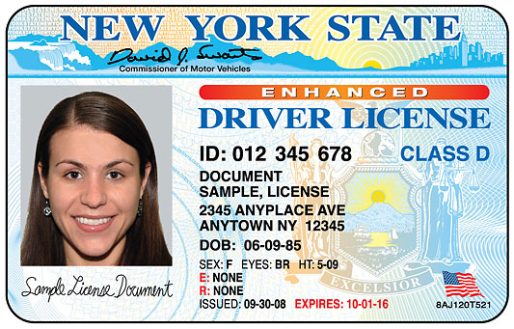

The Problem Today
Privacy remains a challenge
Individuals often must provide more personally identifiable information (PII) than necessary for a particular transaction
    This data is often stored, creating “honey pots” of information for cybercriminals to pursue
Individuals have few practical means to control use of their information

Slide 18
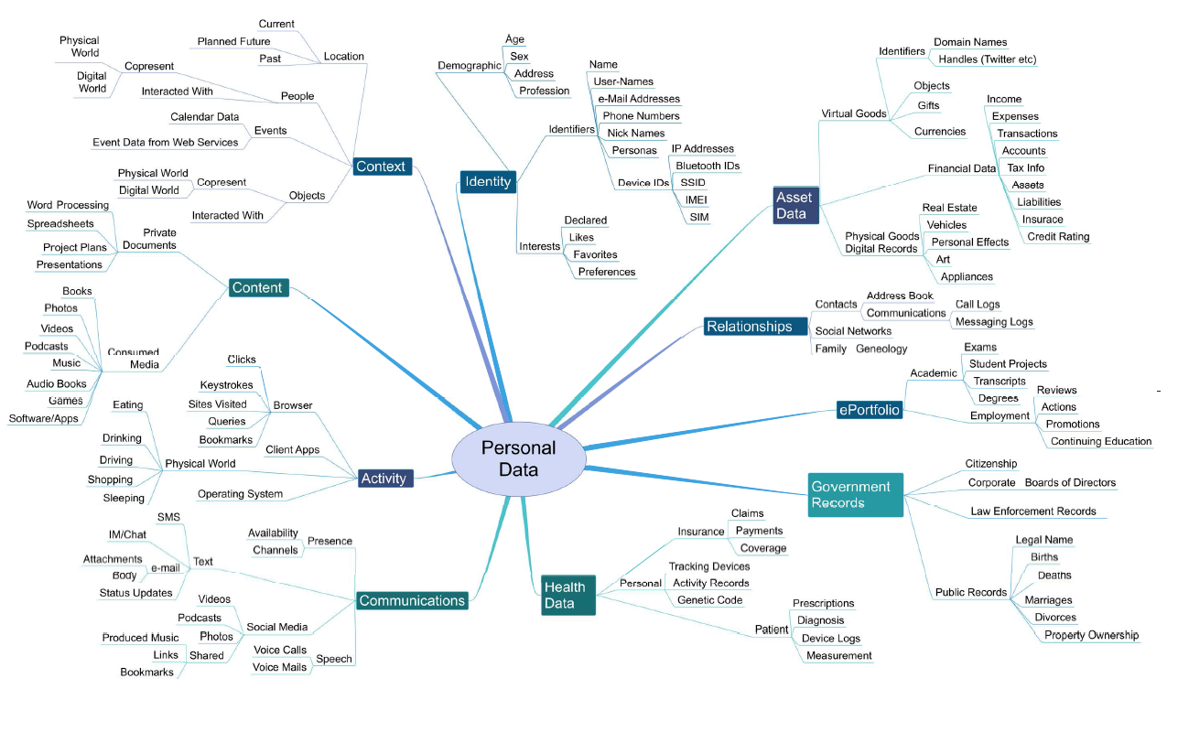
Privacy: Increasingly Complex as Volumes of Personal Data Grow
Source: World Economic Forum, “Rethinking Personal Data: Strengthening Trust,” May 2012

Slide 19
Trust matters to online business
$2 Trillion
$2.5 trillion
$1.5 Trillion
The total projected online retail sales across the G20 nations in 2016
What this number can grow to if consumers believe the Internet is more worthy of their trust
What this number will fall to if Trust is eroded
  Source: Rethinking Personal Data: Strengthening Trust. World Economic Forum, May 2012.

Slide 20
What is NSTIC working on?

Slide 21
Key Implementation Steps
Convene the Private Sector
August 2012: Launched privately-led Identity Ecosystem Steering Group (IDESG). Funded by NIST grant, IDESG tasked with crafting standards and policies for the Identity Ecosystem Framework http://www.idecosystem.org/
Fund Innovative Pilots to Advance the Ecosystem
Three rounds of pilot grants in 2012 and 2013; 10 pilots now active
Government as an early adopter to stimulate demand
Ensure government-wide alignment with the Federal Identity, Credential, and Access Management (FICAM) Roadmap
Solicitations took a challenge-based approach focused on addressing barriers the marketplace has not yet overcome
White House effort to create a Federal Cloud Credential Exchange (FCCX)
August 2013: USPS awards FCCX contract
October 2013: IDESG incorporates as 501(c)3, prepares to raise private funds
March 2014: FCCX rolls into pre-beta

Slide 22
5 NSTIC Pilots Awarded September 2012
AAMVA
Virginia/$1.6M
Focus: Develop public-private partnership to strengthen private-sector credentials with attributes from a state DMV
Daon
Virginia/$1.8M
Criterion
Virginia/$1.97M
Internet2
Michigan/$1.8M
Resilient
California/$2M
Focus: deploy smartphone based, multi-factor authentication to consumers
AARP, Purdue, eBay/Paypal are key relying parties
Virginia DMV, Inova, Microsoft, CA, AT&T are key partners
Focus: develop a viable business model for Identity Ecosystem and attribute exchange
Broadridge Financial, eBay, Google, Wal-Mart, AOL, Verizon, GE, Experian, Lexis Nexis, CA, are key partners
Focus: deploy smartphone based, multi-factor authentication across 3 major universities, integrate it with a privacy manager.
MIT, University of Texas, University of Utah are deployment sites
Focus: test
“privacy enhancing” infrastructure in health care and K-12 environments.
AMA, American College of Cardiology, LexisNexis, Neustar, Knowledgefactor are key partners
A major bank (not yet publicly named) will also be an RP

Slide 23
New NSTIC Pilots Awarded September 2013
Troop ID
(Virginia/$1.2M)
Focus: Develop and deploy smartphone-based, MFA solution for veterans and military community
PRIVO
(Virginia/$1.6M)
GTRI
(Georgia/$1.7M)
UnderArmour, USAA, AT&T, VA, Virginia DMV are among participants
Focus: deploy an NSTIC-aligned identity solution for children and families
Focus: Develop a “Trustmark Framework” that makes is easier for individuals and organizations to understand complex technical, privacy and security requirements and policies
NASCIO, NIEF are partners
TSCP
(Virginia/$1.2M)
Designed to address COPPA and unique issues it creates for online service firms
Partners include one of the largest online content providers and several large toy companies
Fidelity, Chicago Mercantile Exchange are partners.
Focus: enable people to use employer-issued MFA credential to access their retirement accounts at a brokerage.
Develop open-source Trust Framework Development Guidance document to support future cross-sector interoperability

Slide 24
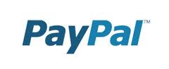


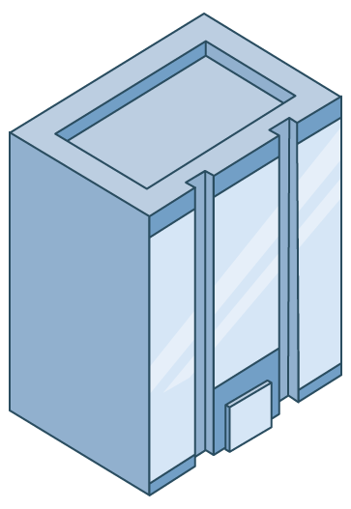














Federal Cloud Credential Exchange:
Current Agency Environment
Government
Citizens
Notes:
With Point-to-Point, each connection:
…takes weeks/months to establish
…consumes agency resources and incurs significant costs
…must be maintained perpetually
Software maintenance
Updates
Security patches
Version control
…does not ensure interoperability of tokens accepted by different agencies – citizens have to get multiple credentials
At LOA2+, agencies paying same entities to identity proof and credential the same citizens

Slide 25
FCCX: A better way
Government
Citizens
FCCX
Notes:
With Point-to-Point, each connection:
…takes weeks/months to establish
…consumes agency resources and incurs significant costs
…must be maintained perpetually
Software maintenance
Updates
Security patches
Version control
…does not ensure interoperability of tokens accepted by different agencies – citizens have to get multiple credentials
At LOA2+, agencies paying same entities to identity proof and credential the same citizens

Slide 26
What is the IDESG?

Slide 27
Mission
The Mission of the Identity Ecosystem Steering Group (IDESG) shall be to govern and administer the Identity Ecosystem Framework in a manner that stimulates the development and sustainability of the Identity Ecosystem. The IDESG will always operate in accordance with the NSTIC’s Guiding Principles.
GUIDING PRINCIPLES
Privacy-enhancing and voluntary.
Secure and resilient.
Interoperable.
Cost-effective and easy to use.

Slide 28
IDESG is working to create a world where people trust the security and privacy of online identification and confidently exchange personal information via the Internet.
  As an organization, IDESG seeks to address the critical issue of identity given our growing dependence and reliance on technology for our everyday lives.
  IDESG is committed to building an identity framework that is privacy-enhancing and voluntary; secure and resilient; interoperable; and cost-effective and easy-to-use for businesses, government and individuals.
  IDESG is turning the identity challenge into an opportunity to provide a holistic solution that balances the competing security and privacy needs of businesses, government and individuals.
IDESG is a government-inspired, commercially-led, member-driven organization that is serving the public good.
  IDESG will establish common solutions that drive trusted transactions to promote confidence, protect the consumers’ and organizations’ privacy and propel economic growth and innovation.
  IDESG will define the norms for verified identities used in the marketplace that increase confidence in transactions and promote privacy for business, government and individuals.
  IDESG is at the nexus of the technologically possible, politically desirable and publically accepted in terms of online identity
IDESG is at the heart of the identity solution, driving innovation and serving as a catalyst for industry and the economy.
  IDESG’s framework will allow seamless exchange of information, supporting a growing multi-billion dollar industry of the future.
  IDESG blends public sector objectives with the reality of industry, leading to innovative solutions for the challenges of tomorrow today.
  IDESG promotes peace of mind in online transactions, accelerating growth and new opportunities for online engagement.

Slide 29
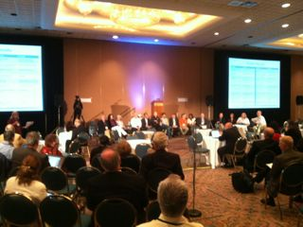
Where it all Began - Chicago, August 2012
The Identity Ecosystem Steering Group was established during a Kickoff Meeting held in Chicago from August 15-16, 2012.

Slide 30





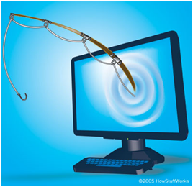

January 1, 2016
The Identity Ecosystem: Individuals can choose among multiple identity providers and digital credentials for convenient, secure, and privacy-enhancing transactions anywhere, anytime.
Apply for mortgage online with e-signature
Online shopping with minimal sharing of PII
Cost-effective
and easy to use
Privacy-enhancing Secure Interoperable
Trustworthy critical service delivery
Secure Sign-On to state website
Security ‘built-into’
system to
reduce user error
Privately post location
to her friends

Slide 31
Objectives
The activities and work products of the IDESG shall be conducted in support of the following objectives:
Ensuring that the Identity Ecosystem and Identity Ecosystem Framework conform to the four NSTIC Guiding Principles.
Administering the process for policy and standards development and adoption for the Identity Ecosystem Framework and, where necessary establishing policies standards for the Identity Ecosystem Framework.
Adopting and, where necessary, establishing standards for the Identity Ecosystem Framework.
Certifying that accreditation authorities validate adherence to the requirements of the Identity Ecosystem Framework.
Text taken from the Identity Ecosystem Steering Group (IDESG) 2013 Rules of Association.
Read more about the IDESG in its policy documents.

Slide 32
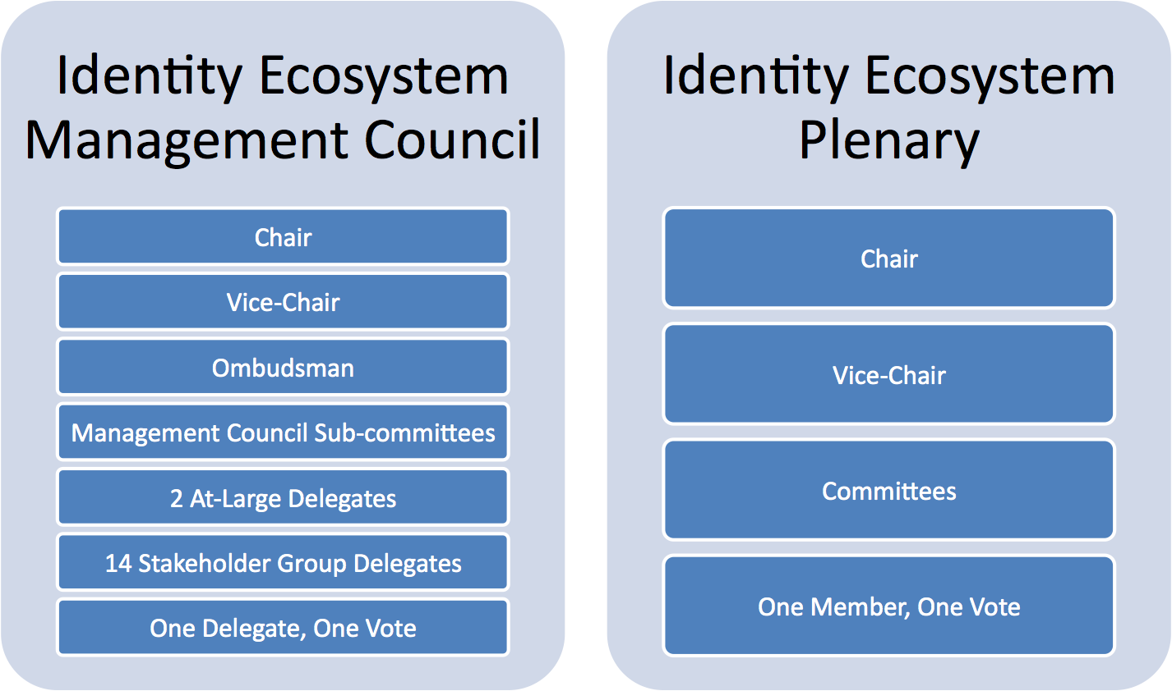
Organizational Structure

Slide 33
IDESG Committees
Committee | Objective(s)
Financial Services | Working to enable full participation of financial services stakeholders
Healthcare | Addressing the identity technology, policy and relationship (liability) requirements of the health care community
International Coordination | Coordinating engagement with relevant international identity standards bodies, initiatives, and policy bodies
Trust Framework & Trustmark | A forum for trust framework representatives and other interested parties to develop and manage a trustmark program
Policy Coordination | Inspiring awareness and reuse of successful policies, including operating rules, business process methods and risk allocation methods
Privacy Coordination | Identifying privacy issues and recommendations to remedy them.
Security | Responsible for recommending a Security Model
Standards Coordination | Identifying standards and frameworks that can support the stated key attributes of the Identity Ecosystem
User Experience | Evaluating technologies and identity solutions within the IE to confirm that they are easy-to-use and accessible for all potential users.
Notes:
Review committees from the slide.

Slide 34
What is the IDESG working on?

Slide 35
2014 IDESG Goal
Complete version 1 of the IEF by December 31, 2014
  Will allow a baseline to which self-attestations can occur
  Sets the stage for development of a comprehensive compliance and conformance program by December 31, 2015

Slide 36
Purpose
The IEF Development Plan (currently a draft) is intended to:
  Identify key IEF components
  Define 2014 component objectives
  Establish targets for component completion
  Facilitate project planning
  Support prioritization and resourcing
  Serve as guidance to committees and chairs

Slide 37
Framework Development Plan Components
Functional Model
Define Guiding Principle Requirements
Define Initial Risk Model(s)
IEF Compliance/Conformance Program
Implementation Tools

Slide 38
Use Cases
Frame the IDESG’s initial objectives and scope of work
Provide a basis for the development of IDESG work products
Drive consensus among IDESG plenary members about the characteristics of the ecosystem and identity ecosystem framework they are trying to bring into existence
Provide a method for the elicitation and capture the requirements of the various NSTIC constituencies
Make more concrete the application of the NSTIC guiding principles in terms of real- world scenarios
Serve as a test target against which IDESG work products can be evaluated
Serve as a guide for the collective efforts of the IDESG, to maintain a common focus and alignment
http://www.idecosystem.org/index.php?q=filedepot_download/944/1272
https://www.idecosystem.org/wiki/Use_Cases

Slide 39
Functional Elements Goals
Create a modular, flexible, and adaptive set of functional elements that can be effectively applied to the broadest possible collection of use cases, frameworks, and identity models.
  Establish functional elements in such a way that requirements can be written to them and assessed against them.
Thus, the Functional Elements should:
  Provide a basis set of functional elements that can be combined to support NSTIC pilot and IDESG Use Cases
  Be implementable by various Actors within the identity ecosystem to fulfil required Roles
  Help to delineate the responsibilities of various Actors in the identity ecosystem so that accountability for privacy/security/legal requirements is clear.
  Define the functional elements that can be assessed by certification providers to provide interoperable functional components.

Slide 40
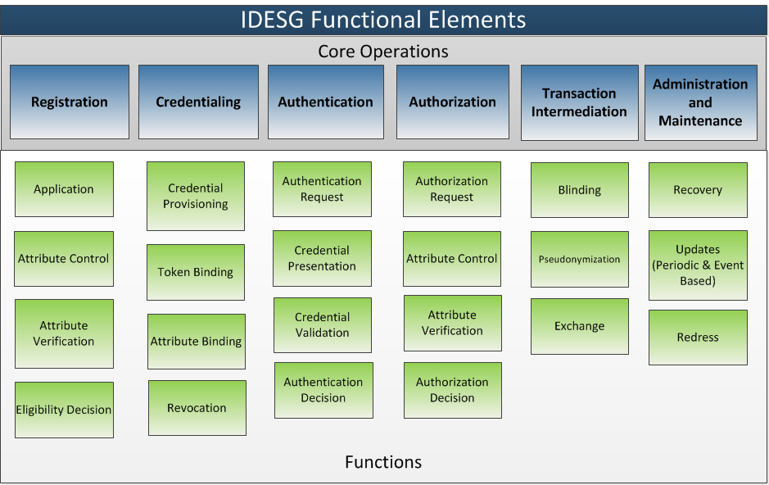
Functional Elements Diagram

Slide 41
Why and how to get involved

Slide 42
Why be involved
Help shape an alternative to / augmentation of the status quo
Aid in the creation of a true market for identity
Grow your business
Work with industry peers
Notes:
A true market includes rules of engagement, liability, clearly defined risks, etc

Slide 43
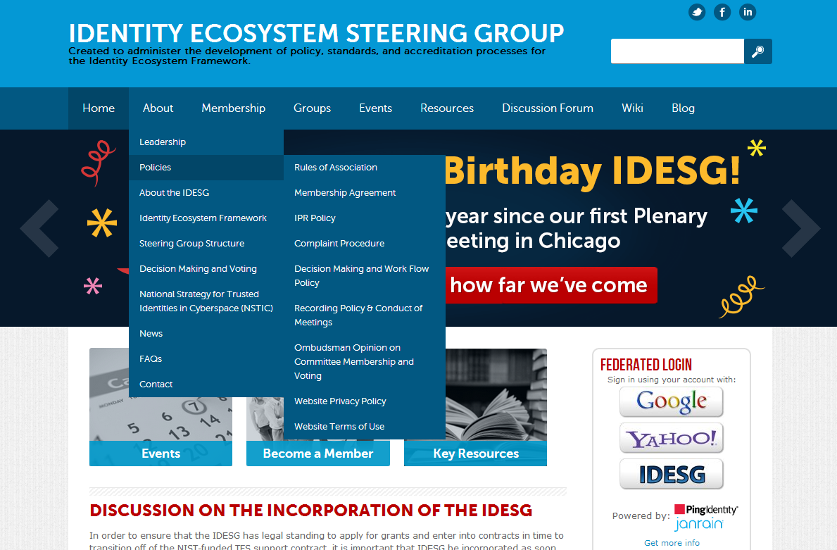
www.idecosystem.org
Rules of Association, Membership Agreements,
Policies, etc.
Can all be found under
About - Governance

Slide 44
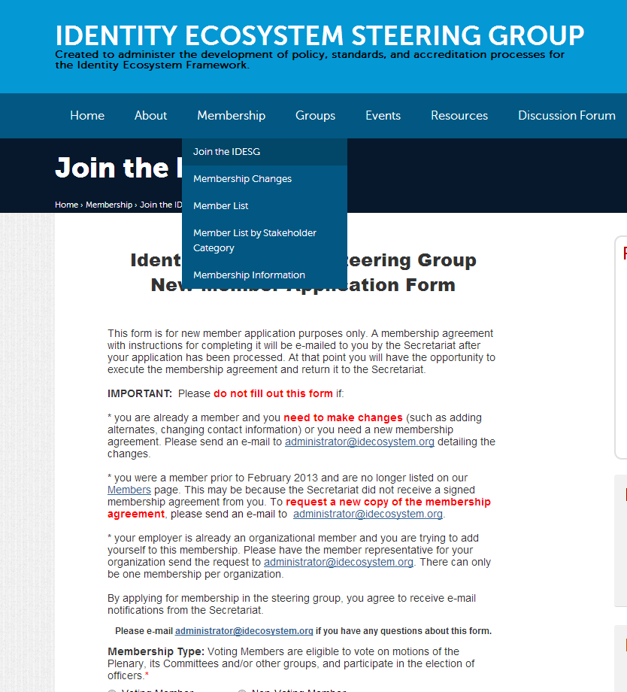
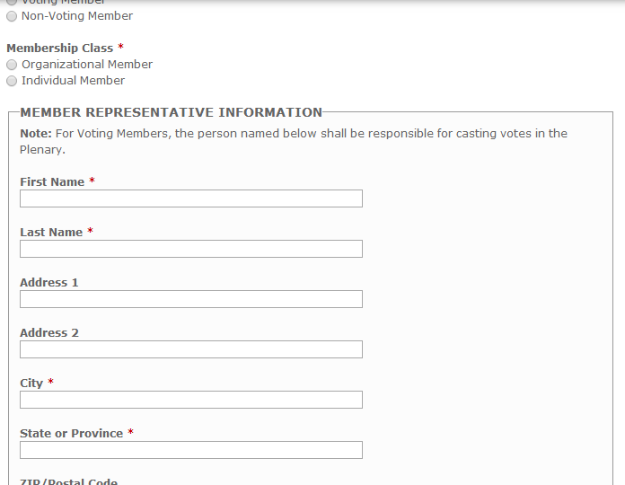
Joining the IDESG
www.idecosystem.org
Click Membership - Join
Notes:
If you haven’t already, to join the IDESG, first fill out the application on the IDESG website…

Slide 45

How to Get Involved
    Connect with Members.
    Join one of the email discussion lists -
    Post on a forum - Contribute to the Wiki and other projects.
    Learn and Develop.
    Read the Member E-Newsletter –
    Read about upcoming events on the Website - Attend online and in person.
    Run for a Leadership Position.
    Advocate.
    Tell your associates - Include IEDSG in your industry presentations, etc.
    Present Your Ideas.
    Submit an idea for group discussion.
    Share your own experience with your colleagues!
    Participate. Be a part of the solution!
Notes:
Now to the most important part, how to engage and get involved.

Slide 46
More Info
NSTIC Program Office
  http://www.nist.gov/nstic/npo.html
NSTIC Blog
  http://nstic.blogs.govdelivery.com/
IDESG
  https://www.idecosystem.org/

Slide 47
Thanks!

Slide 48
Meet the IDESG Leadership

Slide 49


IDESG Leadership
Management Council Chair
Peter Brown
Management Council Vice Chair
Jeremy Grant
NSTIC NPO Director

Slide 50


Management Council Delegates
1. Privacy & Civil Liberties
Adrian Gropper
2. Usability & Human Factors
Steve Bruck
BruckEdwards, Inc.

Slide 51


Management Council Delegates
3. Consumer Advocates
Jim Barnett
AARP
4. U.S. Federal Government
Deborah Gallagher
GSA

Slide 52

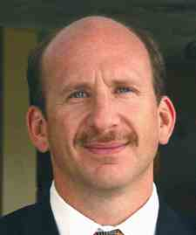
Management Council Delegates
5. U.S. State, Local, Tribal, and Territorial Government
Dave Burhop
Commonwealth of Virginia
Department of Motor Vehicles
6. Research, Development, Education & Innovation
Jack Suess
InCommon

Slide 53


Management Council Delegates
7. Identity & Attribute Providers
Matt Thompson
ID.me
8. Interoperability
Peter Alterman
SAFE-BioPharma Association

Slide 54
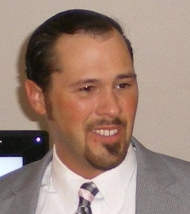

Management Council Delegates
9. Information Technology (IT) Infrastructure
Paul Laurent
Oracle Corporation
10. Regulated Industries
Mark Coderre
Aetna

Slide 55


Management Council Delegates
11. Small Business & Entrepreneurs
Kaliya Hamlin
12. Security
Neville Pattinson
Gemalto

Slide 56


Management Council Delegates
13. Relying Parties
Pete Pouridis
The Neiman Marcus Group
14. Unaffiliated Individuals:
James Zok

Slide 57


Management Council Delegates
Delegate at Large
Ian Glazer
Delegate at Large
Adam Madlin
Symantec
Notes:
Management Council At Large Delegates: Ian Glazer (Individual Member) and Adam Madlin (Symantec)

Slide 58


IDESG Leadership
Plenary Chair
Kim Little
Lexis Nexis Risk Solutions
Plenary Vice Chair
Andrew Hughes

