Slide 1
Kantara: From IRM to Context

Slide 2
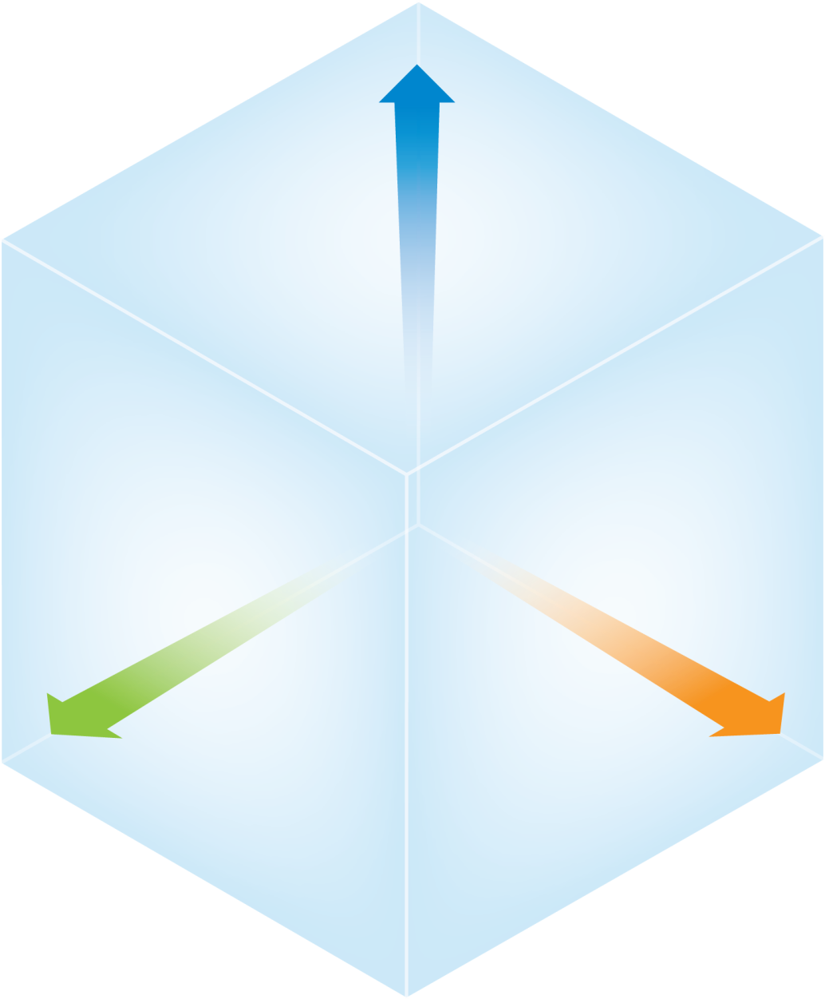
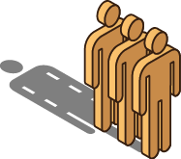
The World of Access Keeps Expanding
App sourcing and hosting
SasS apps
Apps in public clouds
Partner apps
Apps in private clouds
On-premise enterprise apps
Enterprise computers
Employees
Enterprise-issued devices
Contractors
Public computers
Customers
Partners
Personal devices
Members
App access
channels
User
populations
Notes:
This makes it impossible to authenticate and authorize all users across geographical and departmental borders for all applications, on all devices
New requirements for rich attribute sets for fine-grained authorization.
Create new demands for managing users internally and externally in terms of provisioning.

Slide 3
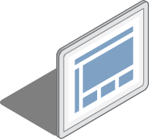
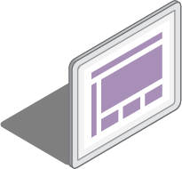
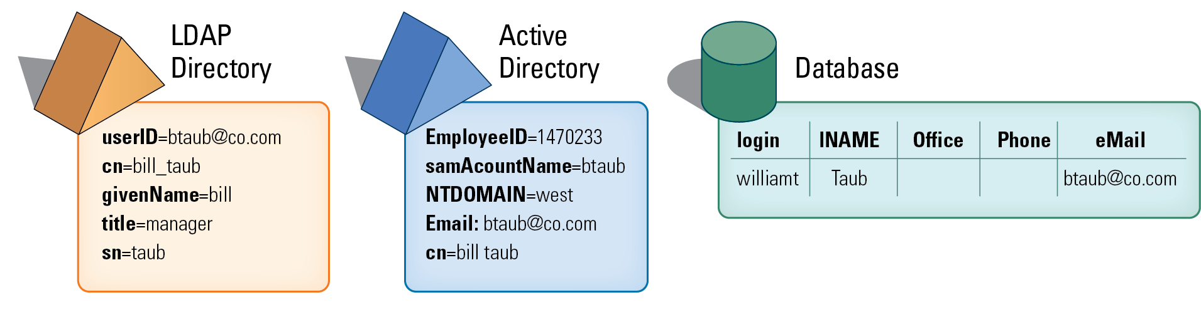
The solution is Federation, Implementation is the challenge
Federation Cloud Apps
Federation requires
A common Identity Provider (Idp)
Federated Access
(SAML/Open-Id Connect)
Federated Identity?
Internal Authentication and SSO ? Authorization
?
?
?
Enterprise Identity Data Sources
Implementation

Slide 4
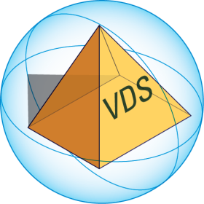
A Federated Identity Hub Manages Authentication and Attributes to Support the IdP
Federation Cloud Apps
IdP
(SAML/Open-Id Connect)
FID as reference authentication store
AD
Forest/Domain A
Identity Sources
Internal Enterprise Apps
AD
Forest/Domain B
Databases
Directories

Slide 5
FID for SP/RP & Cloud Apps Groups, Attributes & Profiles for Authorization
Federation Cloud Apps
RP,SP
(SAML (Groups/XACML), Oauth2)
IDP
(SAML (Groups/XACML), Oauth2)
FID as attributes store
AD
Forest/Domain A
Identity Sources
Internal Enterprise Apps
AD
Forest/Domain B
Databases
Directories

Slide 6
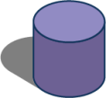
Federated Identity Service and Provisioning
Legacy Applications
(and respective stores)
FID
as reference store
Cloud Apps
Internal
Systems
External
Systems
LDAP/
SQL/
SPML
SPML
SCIM
AD
Sun LDAP

Slide 7
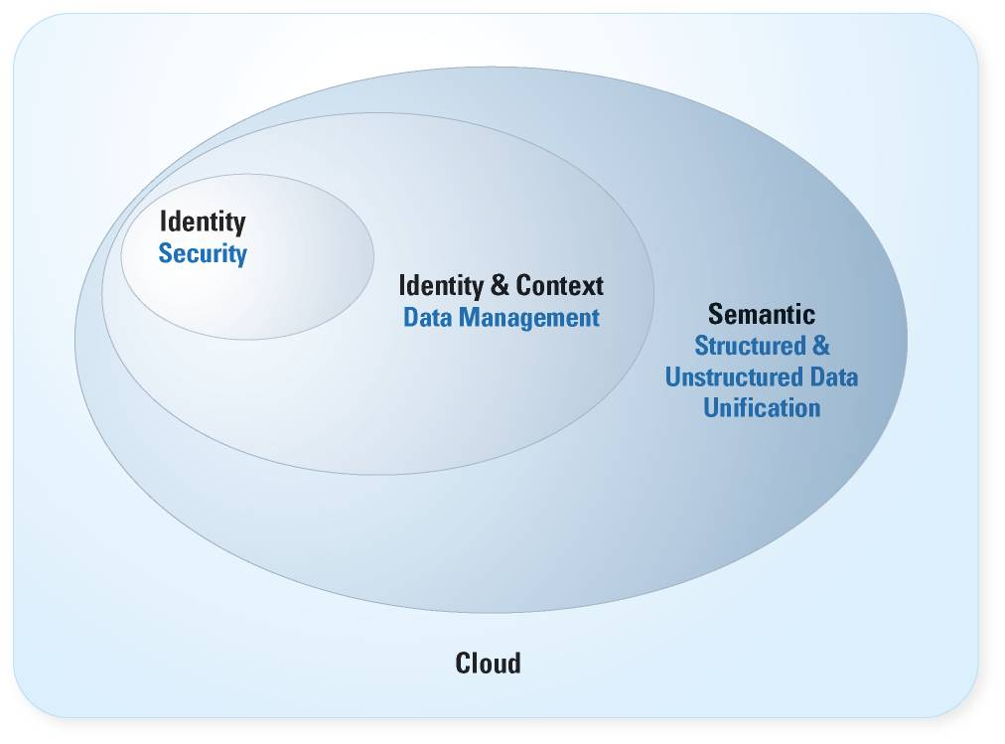
Roadmap: The Role of Identity and Context Virtualization in the Technology Food Chain

Slide 8
Besides consolidation what are the use cases? LDAP and Beyond

Slide 9
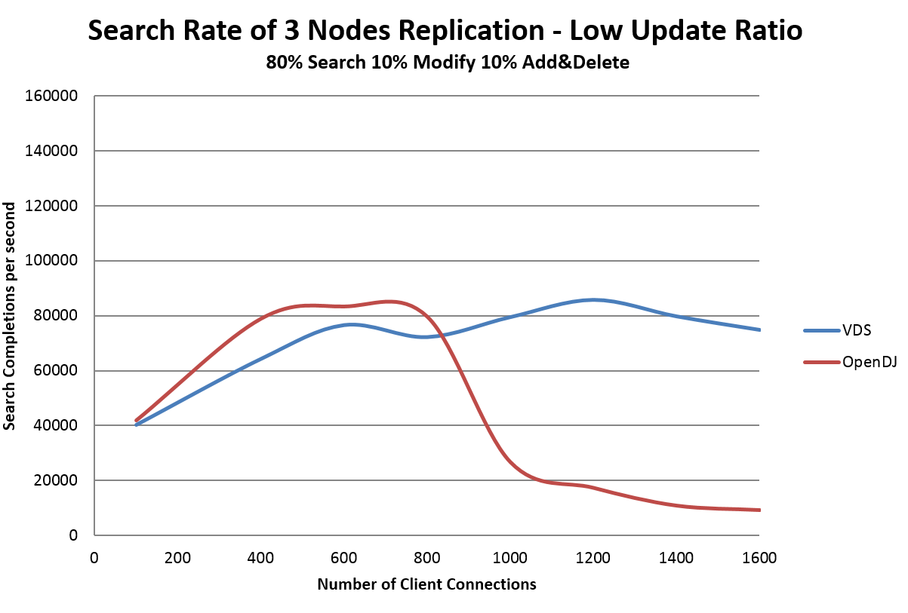
SiteMinder And WAM
Improved writing speed changes everything

Slide 10
Identity is key to security and acts as an integration point
Identity is essential to security because people are at the center of activities.
As such, identity is a key integration point for application.
But do we really still need a hierarchical system for storage?
Is the whole world already running on SQL (Relational model)
Is the whole world heading toward NoSQL?
Relational
Path
Graph
Directed Graph

Slide 11
But joins and distributed joins are expensive: HDAP as a profile cache
Write
Update
Faster
Relational
Slower
Graph/Hierarchy
Query
Search
Navigation/Traversal
Slower
Faster

Slide 12
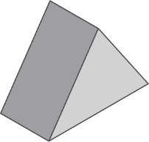
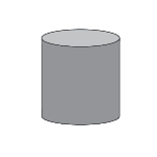
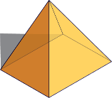
Architecture
Data Sources
Consumers
Source pushes changes in near time
Profile Integration Engine
App pulls changes on demand
Writes
LDAP
SQL
SOAP
REST
Profile Delivery Engine
Reads
SOAP
REST LDAP SQL
Consumer App
Source pushes changes in near time
PDE sends change notices near time
Integration Business Rules
Delivery Business Rules
Consumer App
Commit Context
Deliver Context
PDE syncs changes in near time
PIE pulls in changes daily
Consumer App
PIE pulls in changes near time
PDE pushes changes nightly
Consumer App
Integration through a Canonical Model
Context Model

Slide 13
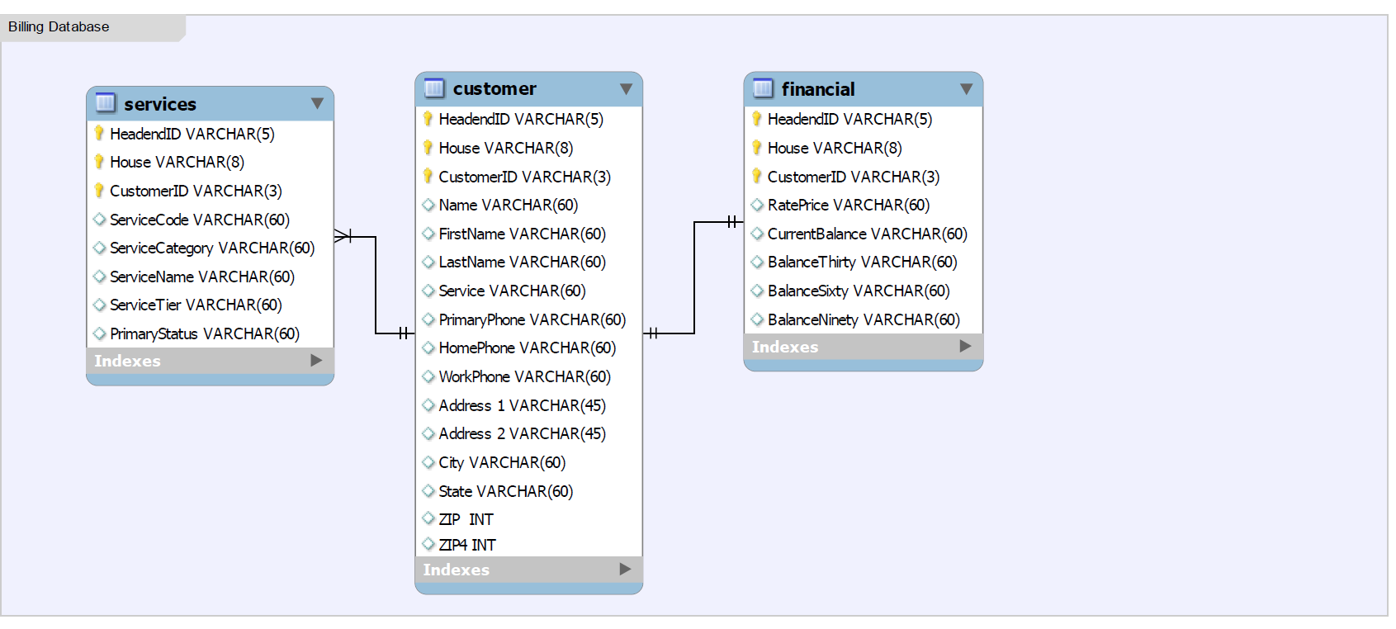
Representative Service Provider Back Office Data Model
Relationships:
Provisioning CustomerAccount match based on HeadendID + House + CustomerID
Serviceability Address match based on Address1, Address2, City, State, Zip, and Zip4

Slide 14
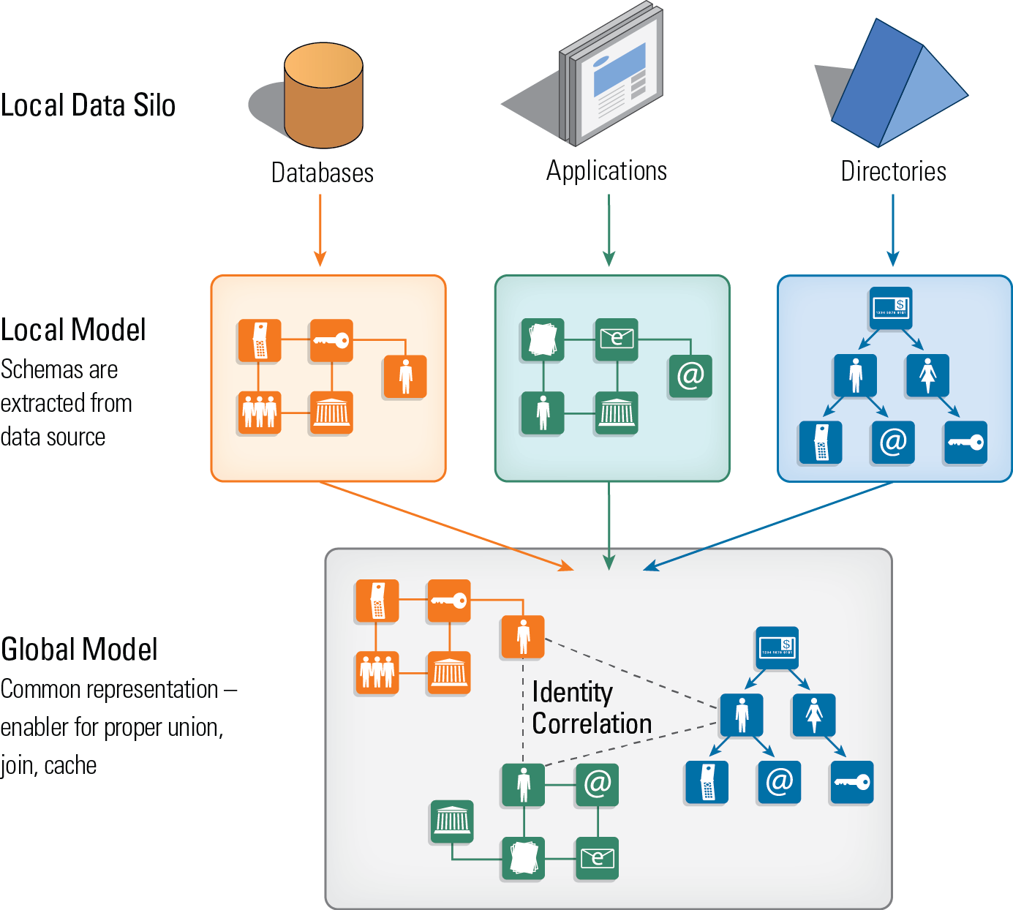
How to extract relationships and contexts out of silos for building user profiles
Notes:
14
14
To address the technical challenges of data management (union and join), we need a global data model that allows objects to be compared and extended according to application requirements. Everything is mapped into a common language.

Slide 15
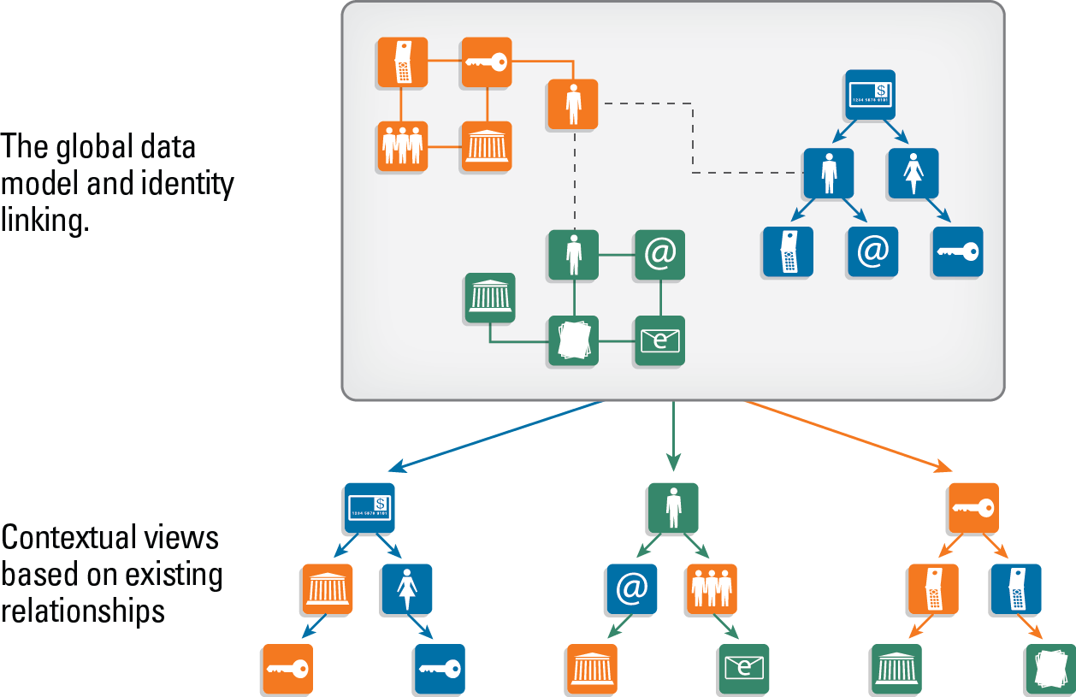
Joins are essential enablers for linking identity to attributes and context
Notes:
15
15
Different contextual views can be published; objects and data structure – according to new contexts that are needed, based on existing relationships.
Hierarchies are a type of “sentence” (think triples – subject, verb, object) – you can read as you move down the hierarchy

Slide 16
ADAP: a REST interface to LDAP/HDAP
LDAP is a good protocol, but it is not web based. The closest thing to a web service for LDAP is provided by DSML, which is XML based, and outdated. The new trend is to deliver information via a REST interface.
The usage of HDAP can be very broad. One crucial capability of LDAP is the ability to navigate and discover context about any given subject or identity. Navigating a directory is a form of graph and contextual discovery that allows you to have progressive disclosure of information. This is key in security, and elsewhere, but LDAP doesn't support the web service interface for delivering that information.
Putting all this capability that exists in LDAP (progressive disclosure) into a REST interface, opens LDAP to the web. To put ADAP on top of any LDAP.
Notes:
SCIM has a reduced and specific purpose, targeting just one category of info-- identity, and specifically for provisioning purposes.

Slide 17
New Use Case: Contextual Search

Slide 18
Webster’s Definition of “Context”
Latin Contextus: a joining together, origin pp of contexere “to weave
together.”
The parts of a sentence, paragraph, discourse immediately next to or surrounding a specified word or passage and determining its exact meaning [to quote a remark out of context] (Language Representation)
The whole situation, background, or environment relevant to a particular event, personality, creation, etc…(Perception)

Slide 19
Trees as a Representation of Sentences

Slide 20
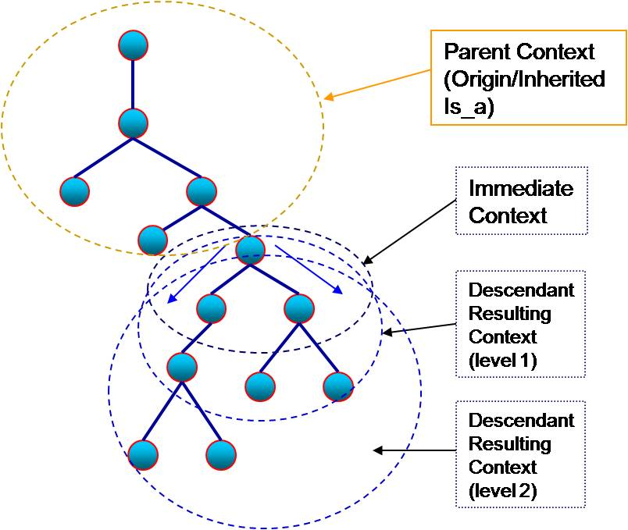
Trees as a Way to Represent Sentences and Context

Slide 21
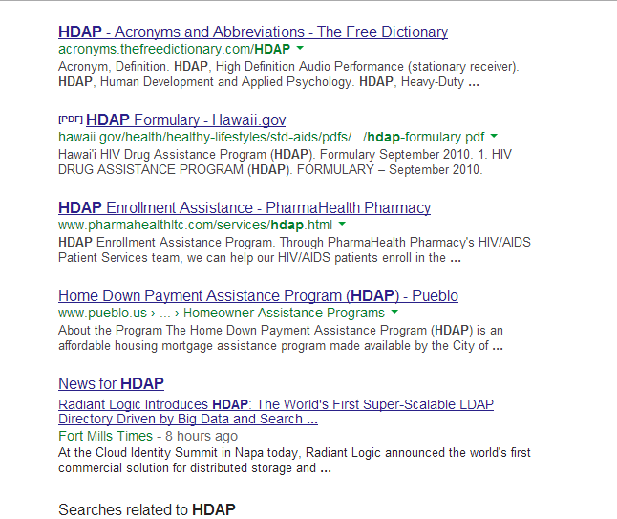
Searching for HDAP on Google

