Slide 1
Sandy Porter - Strategy Director Avoco Secure
Postcard from London
Achieving Substantial and/or High Assurance Consumer Identity is the trusted delivery layer for Digital Services
Use cases
© Avoco Secure 2017
All Rights Reserved

Slide 2
The Perfect Storm
PSD2, GDPR and AML4.
Open Bank Project.
New banking licenses in the UK.
Increasing difficulty in on boarding new customers.
Pressure to recheck existing customers / AML.

Slide 3
The Aims
Improved KYC and AML.
Reduce fraud.
Provide fast decisions on mortgage applications, pensions, account opening, lending, money transfers and payment authorisation.
Undertake the entire process online.
Improve the customers experience.
Securely share their data with customers and obtain consent.

Slide 4
The Ingredients
Creating persistent identities, that are validated or uplifted to the right trust levels for commerce.
Building relationships that deliver 'Identity with Assurance' as well as offering Data and Services Brokers, and Personal Data Management.
New ID standards, government created IDs in the private sector and Data.
Using existing data sources and adding new ones.
Education record
CRAs
Driver / Vehicle licenses
Passport Office
Tax records
Companies House
Bank internal data
Royal Mail data
Amazon account
Mobile phone accounts
Customers “own /controlled” data self asserted or independently verified.
eID

Slide 5
Use cases (1 of 3)
Pensions
Uk citizen can have up to 10 different pensions over a lifetime.
Draw them together.
Mortgages
Apply online
Form filling
Verify data and the user
Immediate decision
Account portability
Requirement to switch banks “as easily as an energy supplier”.
Share KYC.
Reverify customer with minimum impact.
Obtain consent to share the data.

Slide 6
Use Cases (2 of 3)
Applying for a credit card online or opening a bank account.
On boarding a new customer:
Fill in your online application.
Once you've finished, simply take one document to prove your identity, and one document to prove your current address to your local branch.
The advice given on a UK University website:
Many banks also have tight security measures, so that although some accounts can be open in 1-2 weeks, other banks may take up to 5 weeks, although you can usually deposit money immediately.
It is very important that you do not deposit all of your money when you open the account so that you have money for a few weeks in case of delays.
What is the success rate?
This could all be done in minutes online.

Slide 7
Use Cases (3 of 3)
AML/KYC a new young customer.
No transaction history.
Very poor data available.
Unverified digital footprint.
Passport, Education record which includes parent, Payment into the account by student loan company, Verify parent and young person’s IDs….
AML/KYC an existing customer.
Account may have existed for 40 years.
Customer is usually valuable.
No record of bank account in a CRA.
Small digital foot print.
Verify ID and data, Passport Office, DVLA, Royal Mail data, location awareness…

Slide 8
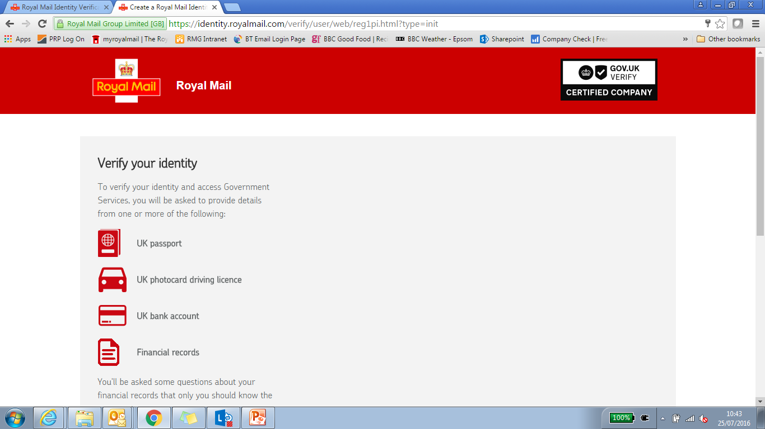
GOV.UK Verify – High Assurance Id
Verify is the UK Government Identity Assurance program to access government digital services.
Eight companies were selected through procurement to provide a service to LOA 2 level.
These companies proved IDAS based on new high assurance standards and are certified.
Trusted sources are used to verify users.

Slide 9
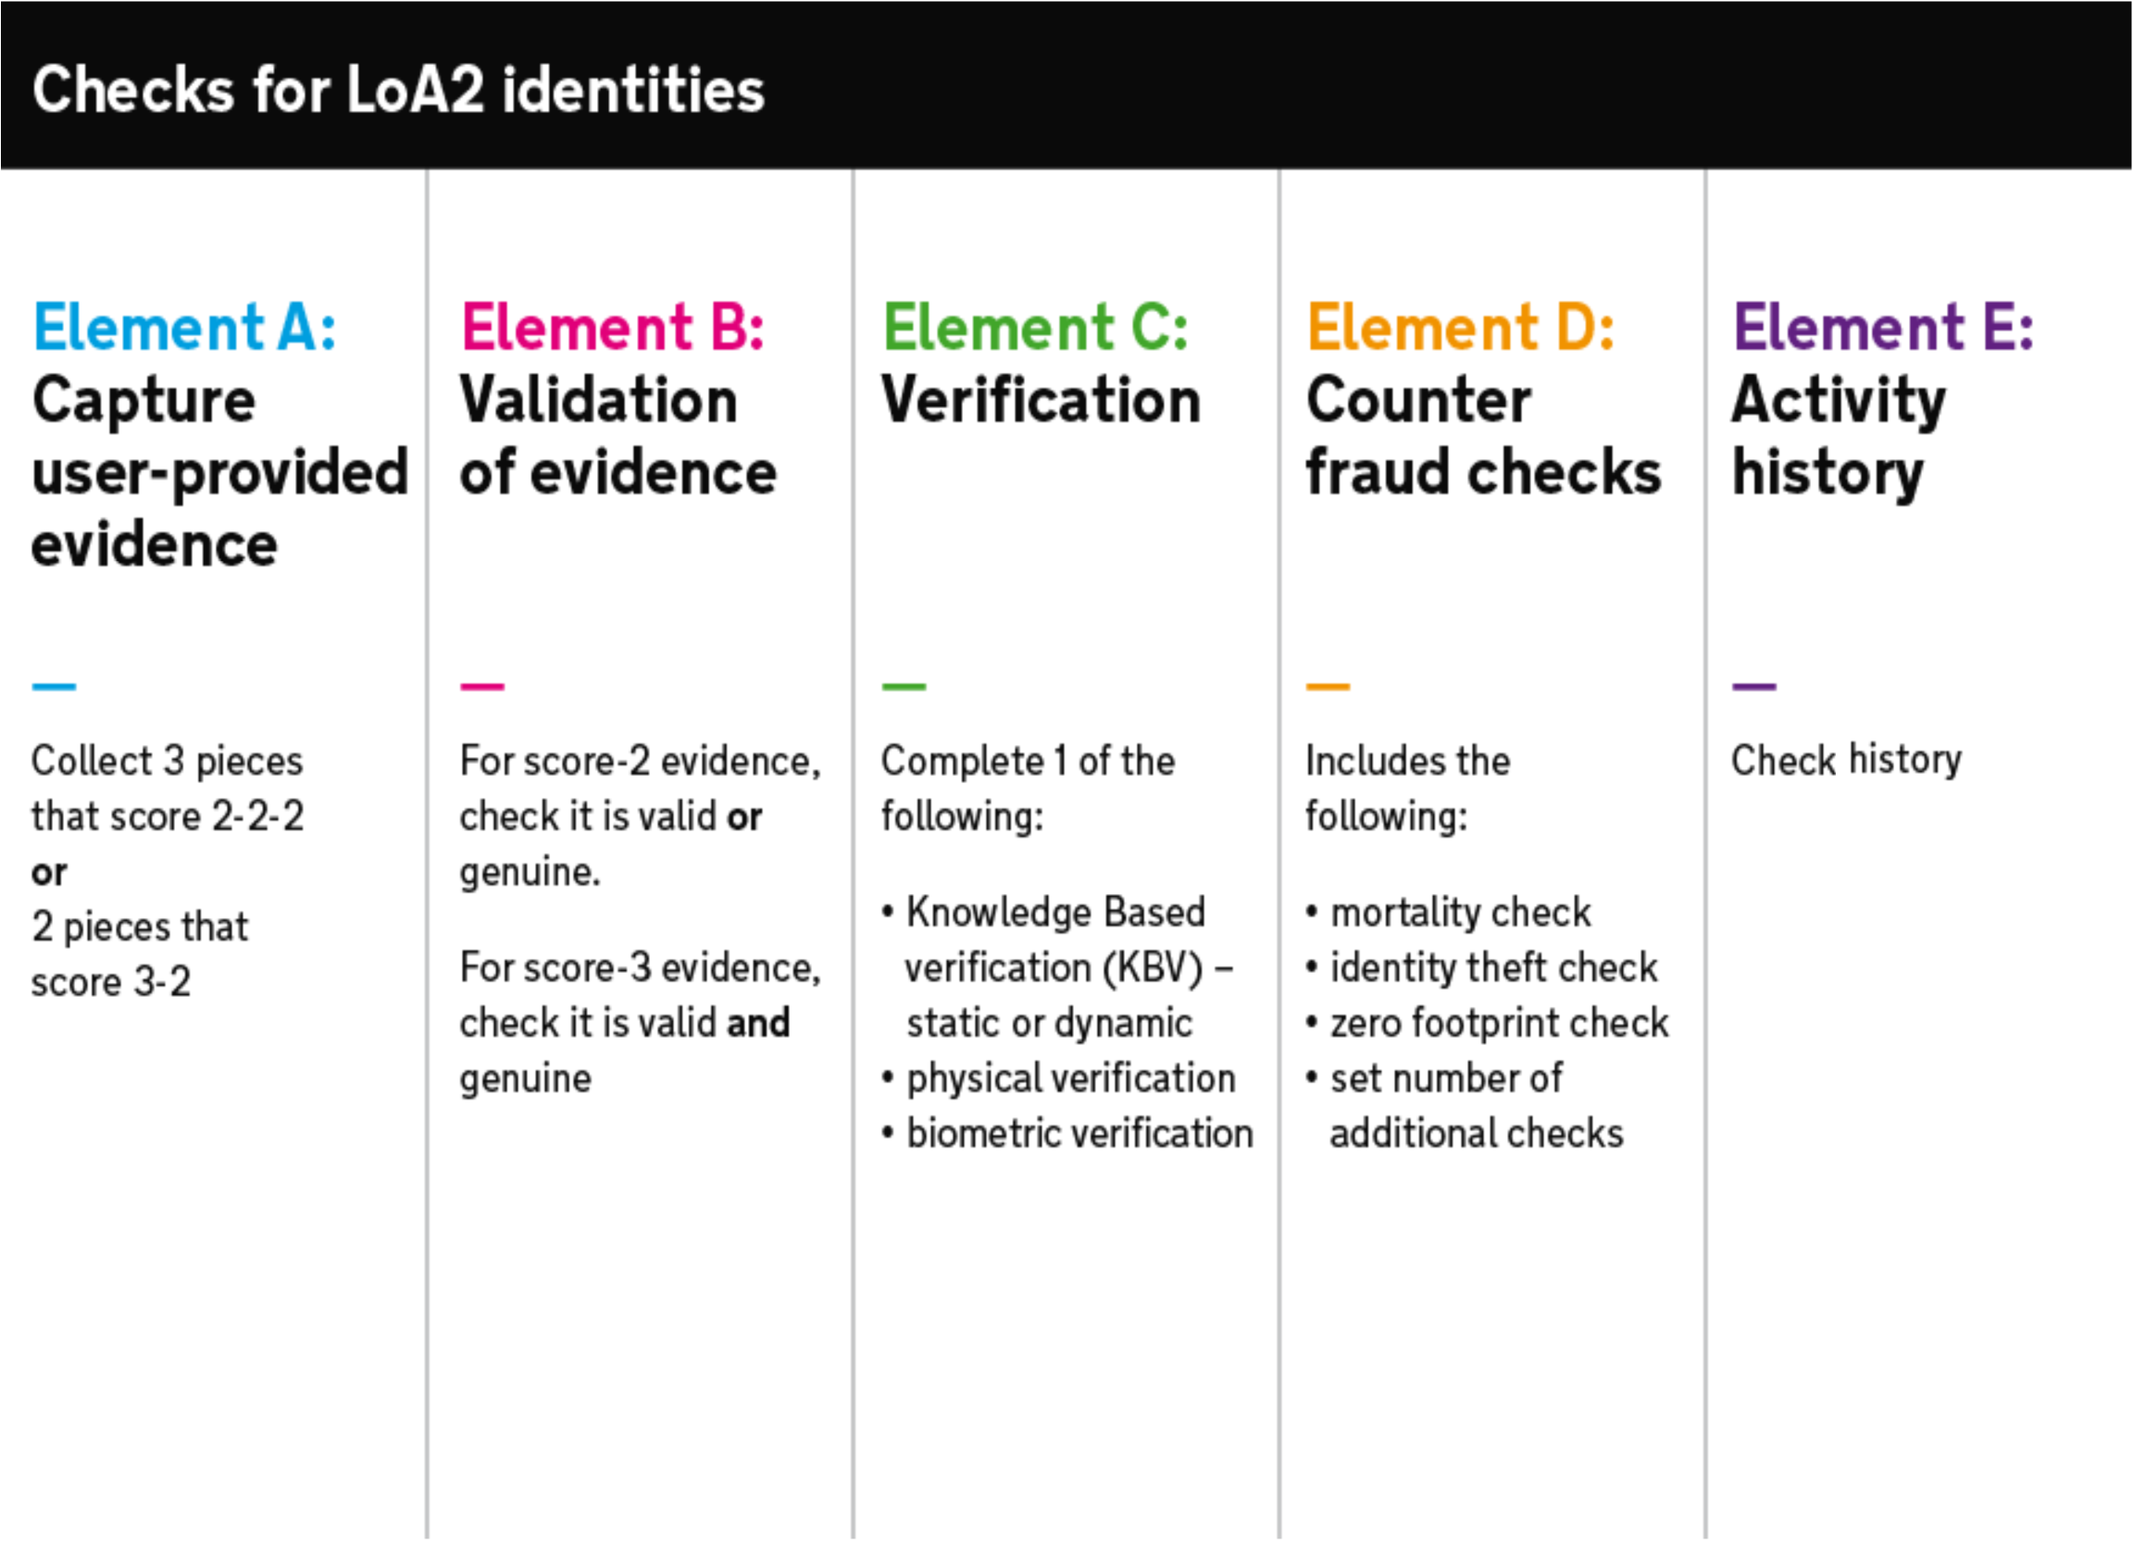
GOV.UK Verify validation – the ‘no identity card’ way
To register with an identity provider a user must provide their name, gender, address and date of birth. They may need to provide historical names and addresses if their details have changed recently.

Slide 10
Consumer High Assurance Identity
Creating persistent identities, that are validated or uplifted to the right trust levels for commerce, is key to services like online banking, insurance, legal…
Right level, to the right service, at the right time: ‘Flexible Assurance’
This is meet by building relationships that deliver 'Identity with Assurance' as well as offering Data and Services Brokers, and Personal Data Management.
Examples being, payments, age verification, passports, and data in accounts like Amazon, PayPal etc..
New dynamic authentication options linking device Id, location awareness, IOT etc…

Slide 11
Hub/Attribute Services
Hubs to provide verification services, uplifting of identities for consumer and government services.
Plugin mobile, business, education and other data sources.
Creation of a “golden record” with user consent to provide to create a new trusted ID.
Provide other services to users linked to their High Assurance Consumer Ids:
personal datastore (life management)
payments authorisation,
consent based marketing
AML checks
IoT control console managed through devices like Amazon Echo

Slide 12
Personal Data Management
User has access to a data management console and store self asserted and trusted attributes.
Allows citizen to update their details and manage credentials, within the context of business rules, e.g. re-verify certain changes are made.
Consent page on sending back attributes (showing who has requested what attributes) and can see transaction history.
Various privacy enhancements including the obfuscation of attributes and the return of true/false statements to questions such as over 18?
Like and preferences page to consent to share with services for consented targeted marketing
IoT control console with access via Amazon Echo and similar

Slide 13
High Assurance Identities increase value and trust
It is the secure and verified transfer of data that builds these trusted relationships.
The more data / information there is in the identity token or PDS, the more valuable it becomes for both the users and service providers. The higher the value the more trust needs to be generated.
No one gives access to their house, bank account, health records etc. to someone they don’t trust.
High Assurance ID plus Trusted Attribute Exchange plus Personal Data Management - in one - is happening now.

Slide 14
UK Pilots, Trials, Go-Live and Aims
On Thursday the first end to end live pilot was run consisting of:
Financial relying party
Verify IDs
Commercial IDs
Hubs
Uplift by attributes of IDs
PDS
Verify Sandbox is available for commercial hubs.
Target for commercial reuse of Verify IDs is mid 2017 onwards.
Hubs to enable the use of European and other national IDs.
This is why we need Trust frameworks and Standards!

Slide 15
Avoco Secure
High Assurance Consumer Identity is the trusted delivery layer for Digital Services
sandy.porter@avocosecure.com
+44 791 750 7636
www.avocoidentity.com
Avoco Secure Ltd ©2017

