Slide 1
Privacy Enhancing Mobile Credentials
Work Group Update Tuesday, April 5, 2022
John Wunderlich, Work Group Chair
“The opinions expressed are my own”

Slide 2
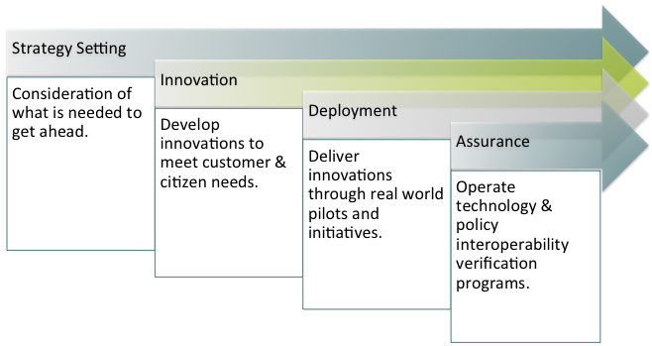
About the Kantara Initiative
The Kantara Initiative is an international ethics based, mission-led non profit industry ‘commons’. Kantara’s Mission is to grow and fulfill the market for trustworthy use of identity and personal data in pursuit of its Vision to see equitable and transparent exchange of identity and personal data for mutual value. Kantara’s members are spread across continents and countries around the globe.
PEMC Update

Slide 3
Role of Kantara in the Market:
Standardization facilitator, creator & operator of assessment programs for ‘Innovation’ communities
Phase | Invention ➜ |  |  | Innovation ➜ |  |  | Implementation
Activity | Generate new ideas |  |  | Standardization via consensus approaches |  |  | Commercialization
Organizations seeking standardization for interoperability | Small startups Inventors |  |  | Funded startups Established organizations |  |  | Funded startups Established organizations
 |  | Kantara’s Scope of Activity
Kantara Programs |  | Community Incubation | “Community Groups” |  |  | Conformity Assessment |  | Interoperability Testing
Kantara Community |  |  | DG |  | WG | ARB + IRB
Kantara Staff |  | PMO | Support Staff |  |  | PMO
Notes:
This slide shows a proposed life-cycle of a Kantara member or community.
These blocks are intentionally aligned vertically.
Community Incubation: active searching for potential community members. Providing a place to come together: Basic platform infrastructure, startup administration and organization
Discussion Groups and Working Groups: the platform for standardization effort and collaborative development of codes of practice and leading practices. Initial creation and ongoing maintenance of Conformity Assessment Criteria happens here.
Conformity Assessment and Interoperability Testing: Kantara operates these programs as a Conformity Assessment Body. Accreditation of assessors and testers, processing of conformity attestations, licensing of marks, monitoring status.
Kantara could be in the ‘business’ of actively attracting new communities and giving them a place to exist.
The community develops within a DG structure, publishing analysis, white papers and reports. If the community decides that they should create standards and leading practice material, they transition into a WG with the intention of feeding their outputs into a conformity assessment program.
This community pipeline allows any community to enter or leave at any stage. So mature communities can bring their leading practice documents in; and communities that don’t flourish can exit. At all stages the communities are regularly challenged to consider ‘graduating’ to the next stage.

Slide 4
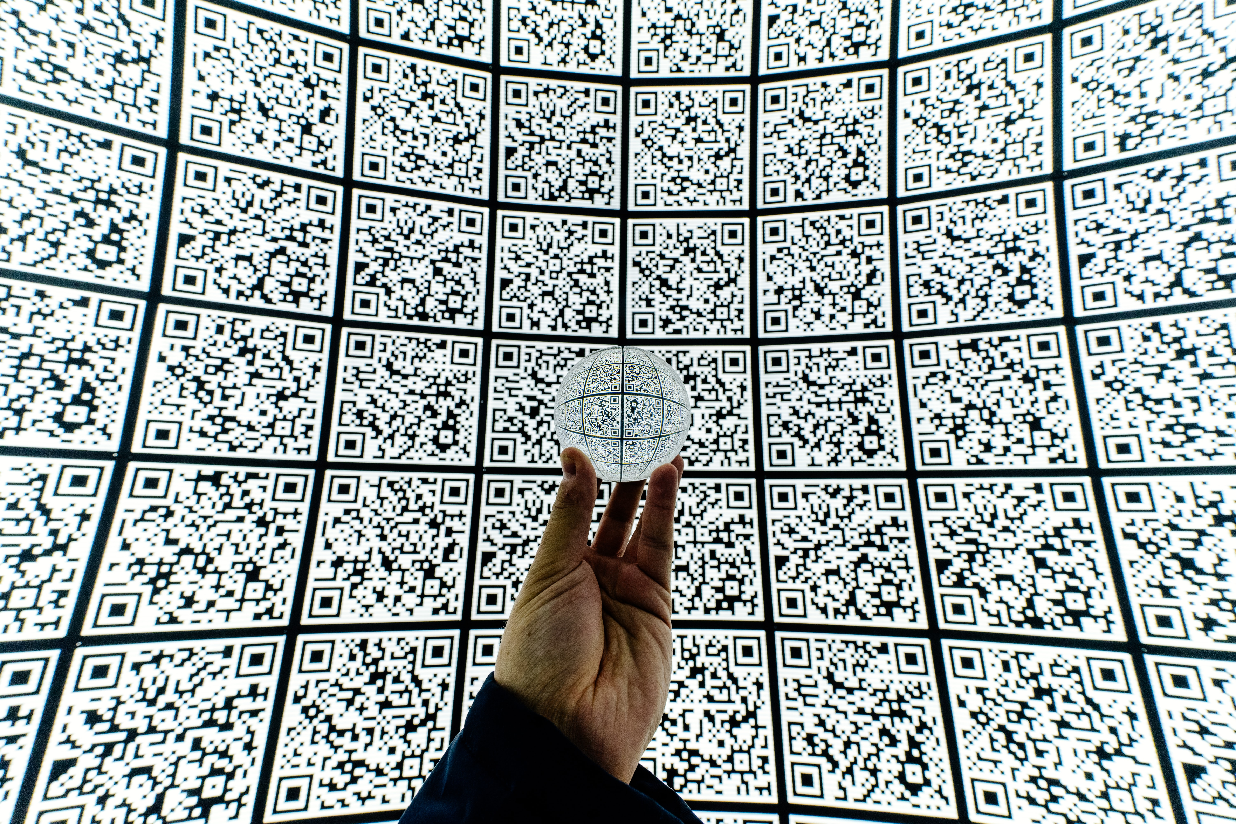
Privacy Enhancing Mobile Credentials Work Group
From the Work Group Charter
The purpose of the proposed work-group is to create a set of requirements and conformance criteria to protect the privacy of individuals holding or using mobile credentials such as mobile Driving Licenses. This includes, but is not restricted to, technology ecosystems based on ISO/IEC 18013-5 compliant mobile driving licenses. Existing standards can provide technical and transactional assurances of user choice and data minimization at the point of presentation of the credential, but do not provide assurances to the holders of mobile credentials that relying parties that may collect their identity attributes will use those attributes solely for the fulfillment of the purposes for which the mobile credential was presented. Failing to respect the consent of mobile credential holder or the legal authority of the verifier to collect the identity attributes could violate the privacy of the mobile credential holder.

Slide 5
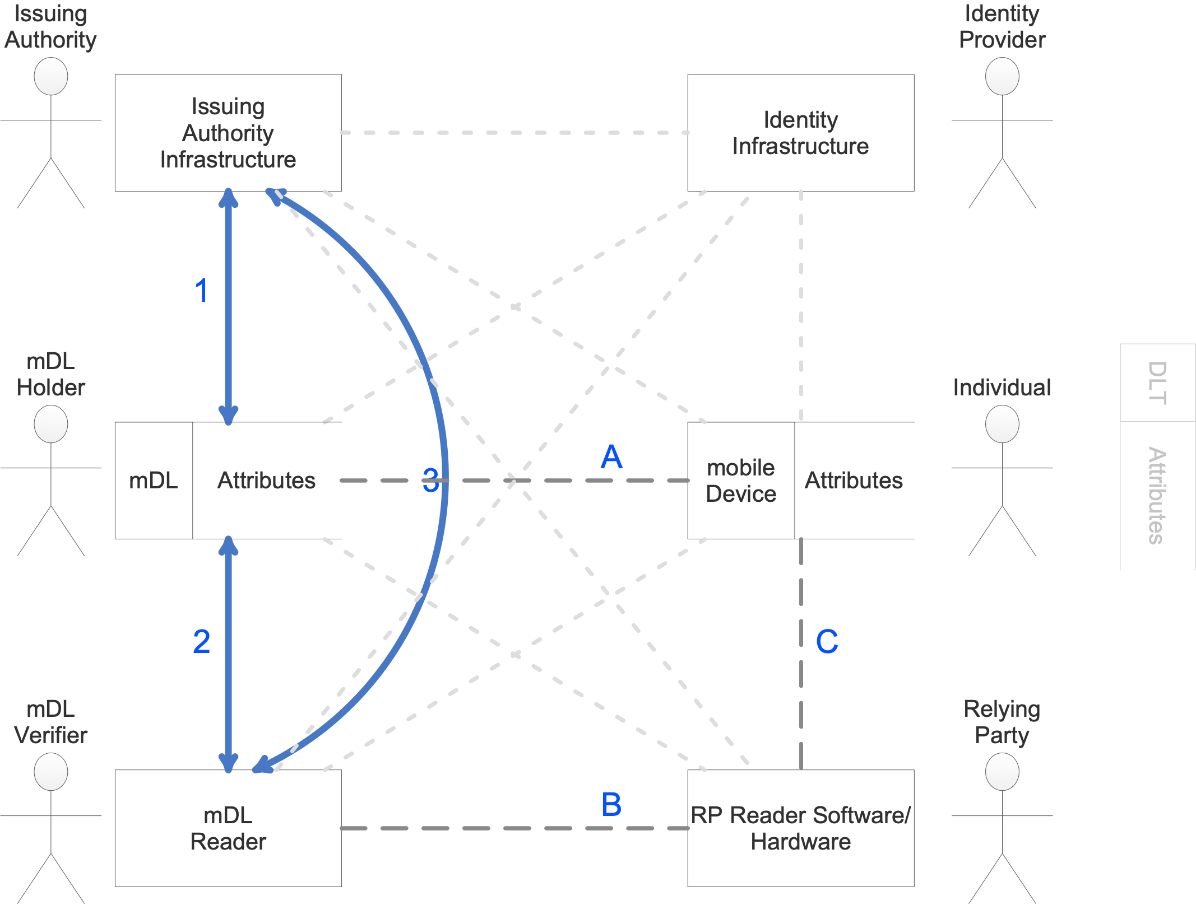
Prior Work: The Report on mobile Driving License Privacy
This report is based on protecting mDL data issued by IAs. While acknowledging that there may be theoretical connections between all these entities, this report focuses on those interfaces that have the potential to have real-world use cases involving IA issued mDLs. The numbered data flows: DF- 1, DF-2, and DF-3 are the interfaces defined in ISO/IEC 18013-5. The lettered data flows: DF-A, DF-B, and DF-C involve implementations involving Individuals and RPs that exchange mDL data in an undefined manner.

Slide 6
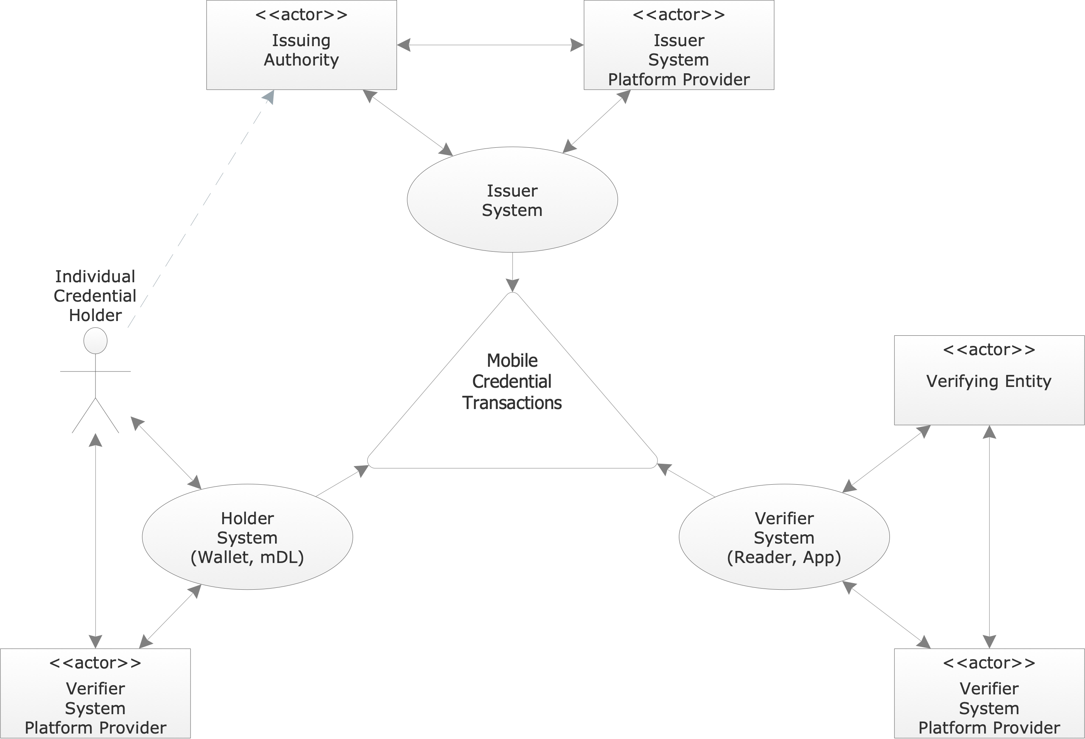
Current Work: A Draft Implementors Report
The intent of this draft report is to provide implementors of systems or solutions related to mobile credentials being used in what the mDL Community calls “Day 1” use cases, where the Individual Credential Holder presents their credential to a Verified System (or Relying Party) in the real world. This includes guidance for:
Issuers
Holders
Verifiers
On a personal note, for this ‘trust triangle’ to be privacy enhancing, it is Alice that trusts the actors in the system to meet or exceed her reasonable privacy expectations in the operational context of the transaction.

Slide 7
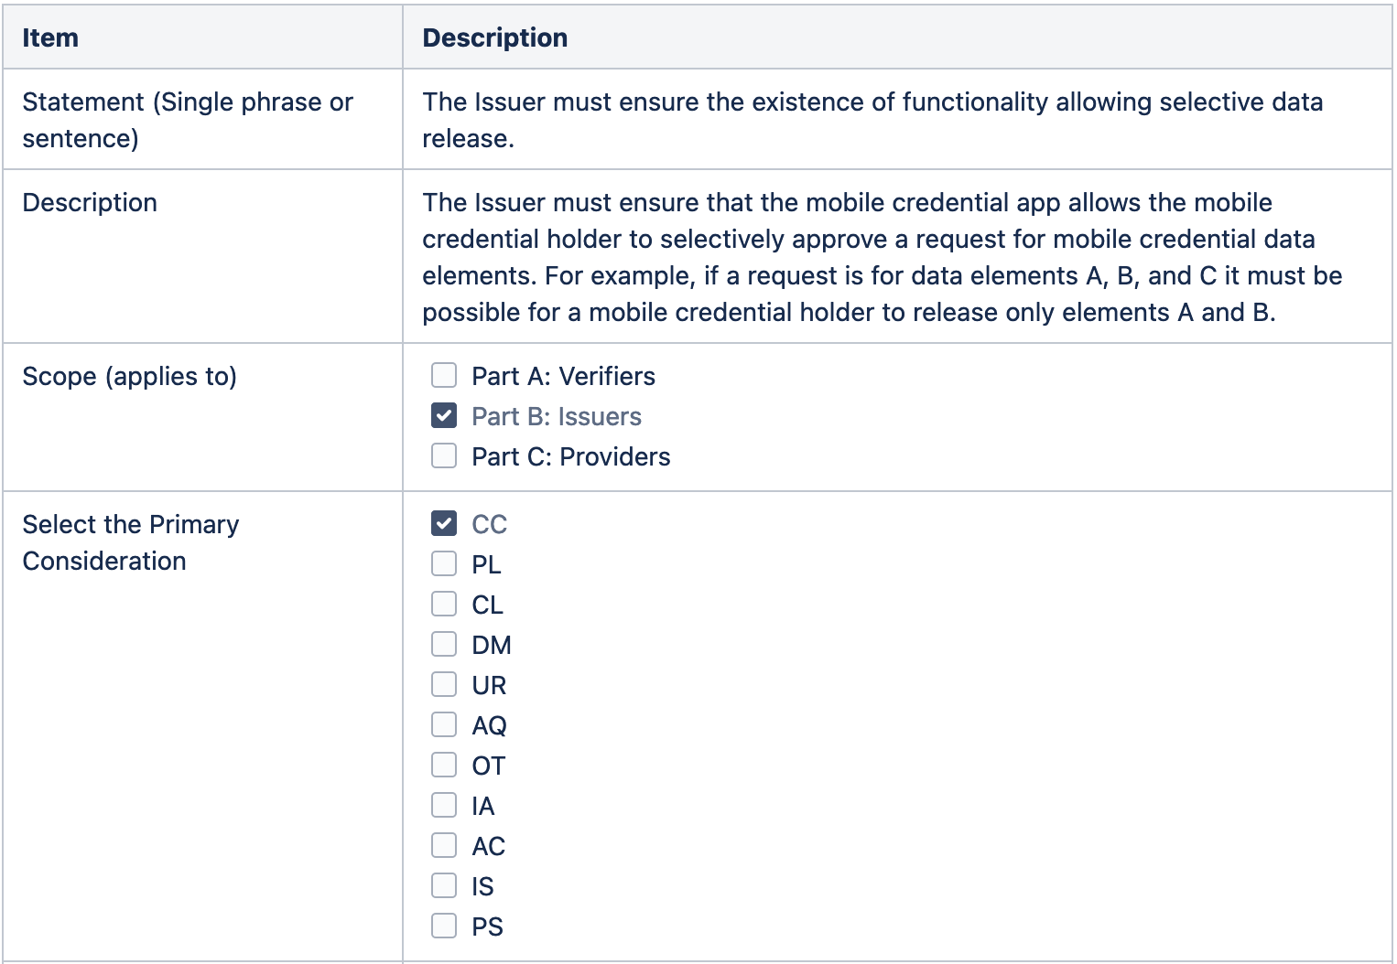
Information for Issuers
Sample Requirement
Guidance for Issuers to enhance Holder privacy can be put in three groups:
Guidance related to the provisioning process.
Guidance related to app/wallet functionality.
Guidance related to credential maintenance.
With respect to the collection of the information from the individual for purposes of the Issuer (such as a driving license issuer) establishing the credential, this is out of scope of this report.

Slide 8
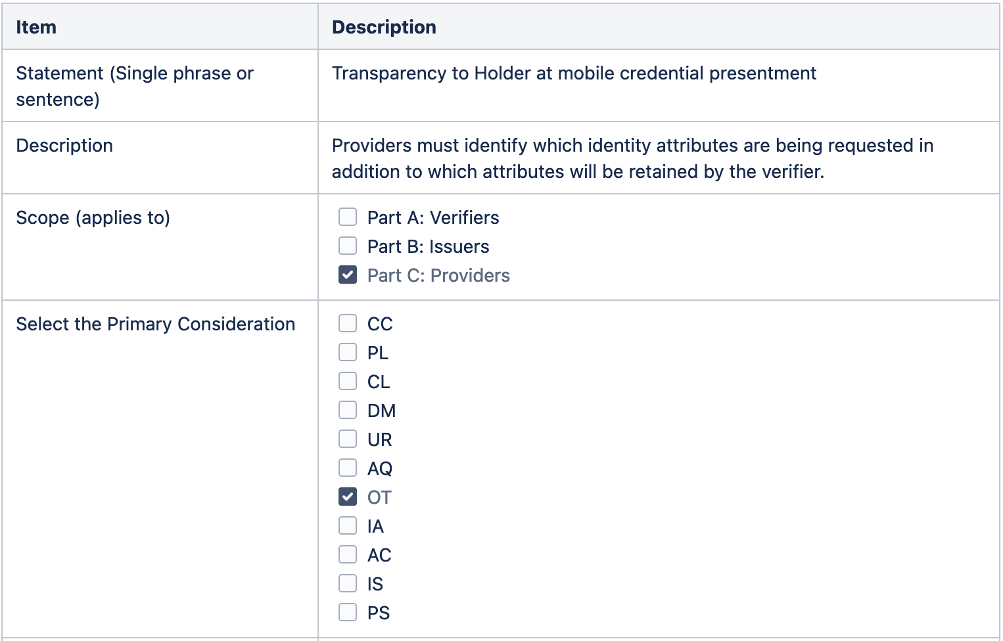
Information for Providers
Sample Requirement
Guidance for Providers to enhance Holder privacy includes:
Guidance to entities that produce applications or software (APIs) used by developers of mobile credential applications or wallets.
Guidance related to the operation of an application or wallet on a user’s device including presentation, data transfer, logging, and the user experience.
Guidance related to application or wallet maintenance.
NOTE: Entities that produce application or software for users will ensure that their systems or products can address all the relevant guidance material for verifiers in their systems.

Slide 9
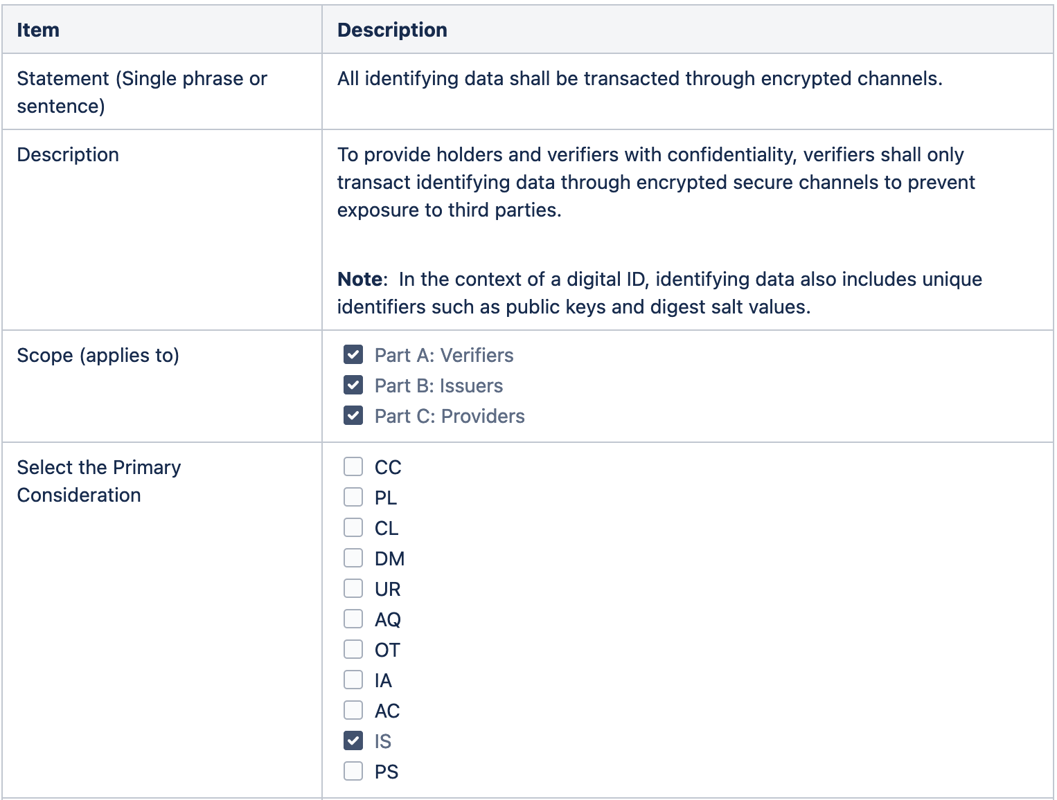
Information for Verifiers
Sample Requirement
Guidance for Verifiers to enhance Holder privacy includes:
Guidance to entities that provide applications or software (APIs) used by developers of mobile credential verifying software or hardware.
Guidance related to the operation of a verifying device and/or software including the collection, use, disclosure, retention, and disposal of digital ID data.
Guidance related to the maintenance of verifier systems, policies, and practices.
NOTE: Entities that produce application or software for users will ensure that their systems or products can address all the relevant guidance material for providers in their systems.

Slide 10
Join Us
Membership and sponsorship is open to all
Connect with our community of security leaders
Collaborate with peers
Gain insights
Gain access
Participate in the PEMC Work Group

Slide 11
Questions?

