Slide 1
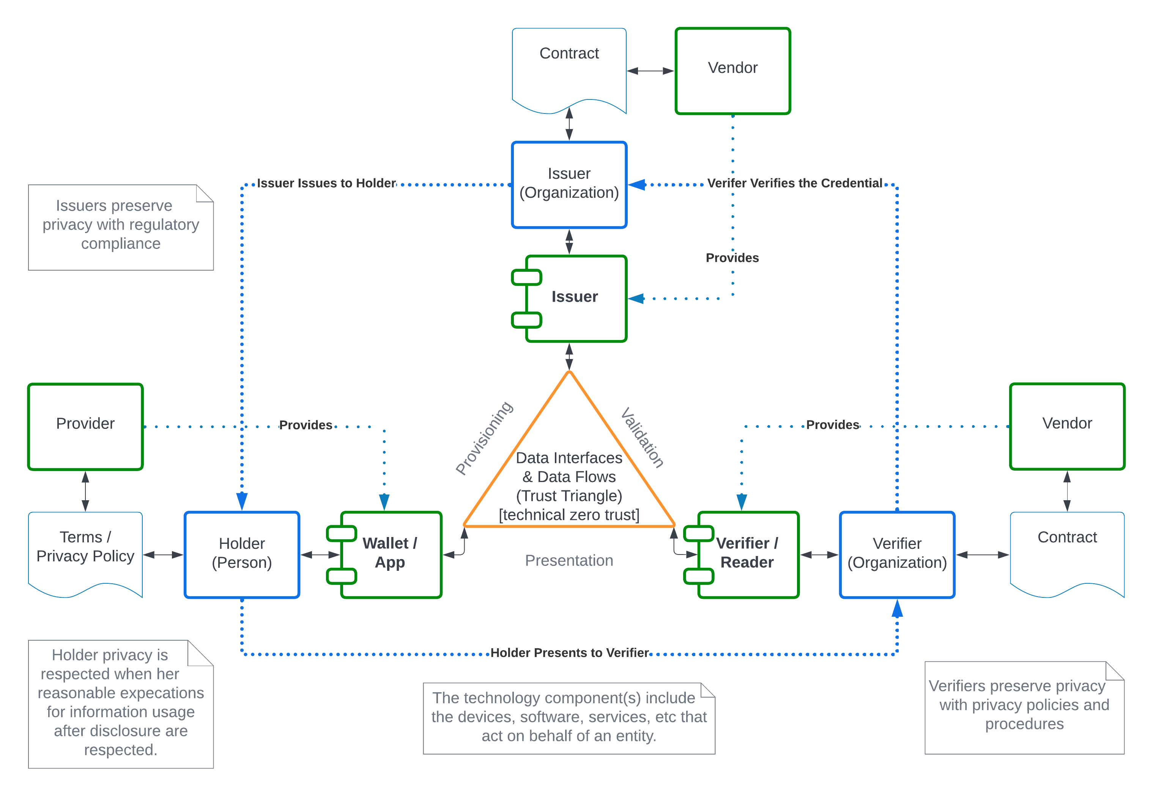
Privacy Enhancing Mobile Credentials (PEMC)
Work is progressing on the Early Implementors Report.
Planning to update Charter to reflect first year’s operation
The addition of a technical editor has helped moving the project forward.

