Slide 1
Advanced Notice and Consent Receipts Work Group
Interoperability for Decentralized Government Through Standards Based Receipts
January 2021
Sal D’Agostino, Vitor Jesus, Mark Lizar

Slide 2
goals
contribute to current standards efforts – notably ISO 27560
revisit and update CR v1.1 to v1.2
promote interoperability across sectors X communities X users
raise pains, needs and desires towards a post CR v1.2 spec
(ideas welcome)

Slide 3
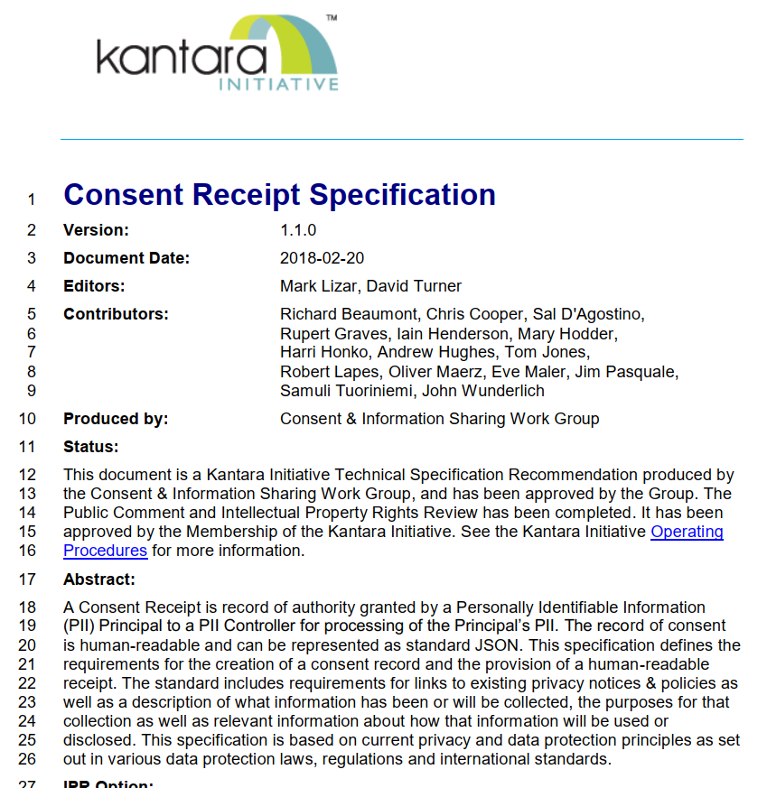
current v1.1
officially dated 2018 but it is the result of 10+ years of work
fairly biased towards to (then upcoming) EU’s GDPR
input to ISO 29184 and ISO 27560
still valid and applicable and only existing approach to addressing accountability & compliance (and transparency) to Data protection online

Slide 4
v1.2
evolving v1.1: with time, new regulations and practices, new requirements came up from different directions
Potential:
refinement of consent types?
clearer separation between notice and record?
uniformization of terms and vocabulary (often across sectors/jurisdictions)?
consent lifecycles from notice to disposal?
new business models and data ecosystems?
new focal points such as data portability and transborder flows?
broader scope such as re-sharing and 3rd parties?
(let us know)
regulators
end
users
industry
practitioners
interest groups

Slide 5
v1.1 → v1.2 → future
work plan
scope out v1.2 + future
while retro-compatible as much as possible
should be useful, usable, impactful
gather & structure feedback and comments
write-up and iterations
formal, normative proposal to Kantara
contribute to communities – ISO 27560 at the forefront immediate
promote interoperability

