Slide 1
IDPro Discuss Group May 2017 Update

Slide 2
Agenda
European Identity Conference recap
IDPro organizational update
Cloud Identity Summit look-ahead
Next steps

Slide 3
EIC Recap

Slide 4
There was cake
No, really there was
BoK presentation during the Kantara workshop
Huge thanks to Thorsten

Slide 5
Keynote promotion

Slide 6
Results
20 new Pledge signers
7 new DG participants
1 interested corporate Founding Member
1 interested organizational ally (Women in Identity)

Slide 7
IDPro Organizational Update

Slide 8
Letters of Intent
LOI demonstrates a commitment to IDPro
2 organizations have indicated willingness to sign a LOI
3 are working through budget approvals
More are considering the LOI

Slide 9
Updated Kantara Board
Discussed separating IDPro from Kantara
Discussed on-going relationships
Organizational
Legal
Content

Slide 10
Incorporating IDPro
Wheels are just beginning to turn
Goal is to form a 501(c)6 organization
Targeting mid-June

Slide 11
Post-incorporation steps
Ask Pledge signers if they want to receive communications from IDPro
Open the doors to Founding Individual and Corporate Memberships
Formalize IDPro governance
IDPro separation from Kantara
Formalize Kantara-IDPro relationship

Slide 12
CIS Look-Ahead

Slide 13
CIS content for IDPros
Day | Title | Time | Speakers
June 20 | Intelligent Identity starts with intelligent identity professionals | 9:30 | Sarah Squire and Colin Wallis
June 20 | Agile Project Management for Agile Identity | 10:40 | TBD
June 20 | Anatomy of a Rockstar Identity team | 2:30 | Sarah Squire
June 20 | Coaching as a Driver of Innovation | 3:05 | John Bruce
June 20 | The Intersection of Finance and Identity Management: Routing Your Way to Project Approval | 3:40 | David Lundell
June 20 | Knock, Knock: Identity is Here. Identity Who? Exactly. | 4:20 | Lance Peterman, Frank Villavicencio, Steve Hutchinson, Ian Glazer

Slide 14
IDPro Happy Hour
Tuesday June 20 6pm
Hotel bar
Informal get together
Final details TBD

Slide 15
IDPro Keynote
Thursday June 22 at 8:45
Goals:
Update the CIS family on IDPro
Recognize IDPro Pledge Signers
Recognize IDPro DG members
(Potentially) Recognize individual Founding Members
(Potentially) Recognize corporate Founding Members on stage
If you can, please attend the keynote and stand when asked to be recognized

Slide 16
Next Steps

Slide 17
Recruiting corporate Founding Members
If you think your org would be willing to become a founding member, please let Ian know in order to get a Letter of Intent
LOI includes:
Goals of IDPro
Summary of membership benefits
Membership fees

Slide 18
Corporate Membership Levels
Affiliate Level | Advocate Level | Champion Level
Brand recognition on website Individual membership for up to 5 people Access to all conference calls / WebEx meetings and presentations Access to curated content and tools Regular curated communications Job postings on the website for a per listing fee | Enhanced brand recognition on website, if desired Brand recognition at conference and seminars, if desired Brand placement in member communications, if desired Individual membership for 10 employees Access to all conference calls / WebEx meetings and presentations Opportunity to co-publish one, curated, article per annum to membership Access to curated content and tools Regular curated communications Unlimited job postings on the website | One Nomination Committee position Prominent Brand recognition on websites, if desired Prominent Brand recognition at conferences and seminars, if desired Brand placement in member communications, if desired Individual membership for up to 25 employees Access to all conference calls / WebEx meetings and presentations Opportunity to publish one, curated, article per annum to membership Access to curated content and tools Regular curated communications Unlimited job postings on the website

Slide 19
Individual Founding Memberships
Stay tuned
Will happen post-incorporation

Slide 20
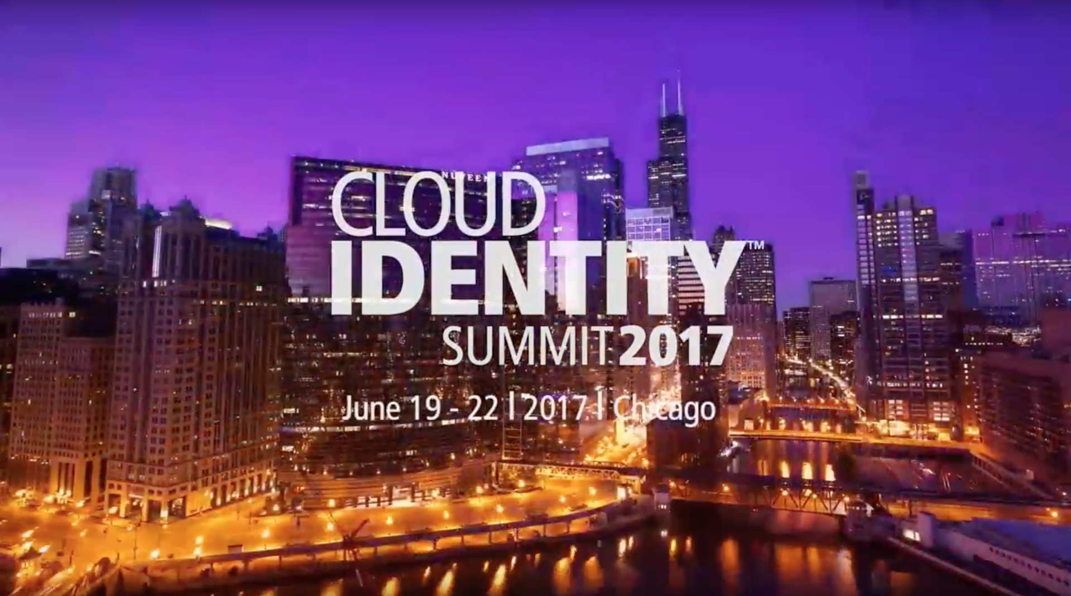

Slide 21
Thanks!

