Slide 1
Consent Management Solutions WG
Best Current Practices for Consent Management
WG meeting 14th November

Slide 2
Agenda
Call to order
Roll Call & Determination of quorum status
Agenda
Kantara Organization updates
WG Motions
Motion to approve < Draft notes>
A Practice for defining consent (and staying away) - iWelcome
Planning publication and date (EIC)
Upcoming conferences and events
All Other Business (AOB)
Adjourn

Slide 3
GDPR
PSD2
Consent is a User Controled Data Usage Policy
SSO & strong
authenti-cation
Scalability & 24/7 Data Mgmt Admin & Integration Frictionless customer experiences
User self-service
SSO & strong
authenti-cation
Identity
validation & proofing
Consent lifecycle mgt
User Mgt
Connect & Protect
Consumers & Workforces
Cloud Identity
(Social) registration
Service desk
User centric functionalities
Business centric functionalities
Provisioning
Marketing analytics & intelligence
Allowed to target
Multibranding & omnichannel
Attribute flexibility
KYC,
profiling & auditing
Allowed to store
It’s an Information Management topic
Allowed to use

Slide 4
Service Practise around data management
Workshop based
Customer journey and Digital Platform driven
Customer journey = via UI and consumer facing
Digital platform = via API and IT/Platform facing
It focussed on defining the data model, the use of the data (processing purpose) and the consumer control capabilities

Slide 5
Consent Workshop Practise - iWelcome
Step 1
Define the customer journey
Plot in the customer journey the information needed (minimal)
Add in the customer journey the information wanted (business)
Document in a information Inventory
Mandatory (minimal needed to provide the service)
Other legal basis (collection allowed, not mandatory)
Voluntary (consent needed)
Define the Privacy Policy/Notice based on 4.a and 4.b.

Slide 6
Consent Workshop Practise - iWelcome
Step 2
Describe the registration process and data collection
Describe how data is collected later in the journey and how
Define the needed data model to support, this will be towards the digital systems (API)
Define the self service to consumers (UI), visibility / transparency. All data will be in the data model already otherwise you are not following data minimalization.

Slide 7
Consent Workshop Practise - iWelcome
Step 3
Define the Processing Purposes for:
Mandatory
Other legal
Voluntary (consent)
Attach these processing purposes to the data items in the data model (we store that in the meta data of each data item)
Enable the data items with voluntary (consent) towards the consent-API
Decide on transparency on the 1.a and 1.b basis (1.c = legally defined)
Enable the UI for 1.a, 1.b and 1.c

Slide 8
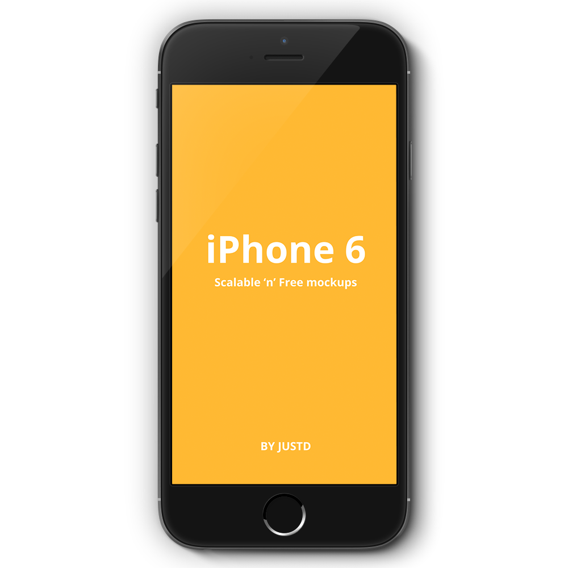
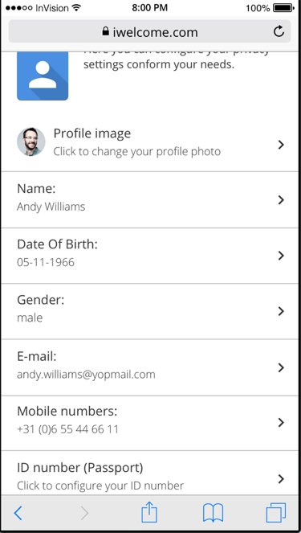
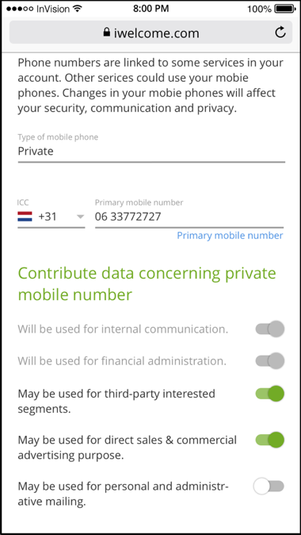
You can offer between 0-100%
TRANSPARANCY & CONTROL
for the Consumer

Slide 9
Thinking out loud
Can this services practise work with other legislation to define the different use of personal data. Can we extend it so it works for every platform that manages consent and document consent.
Can we plot things in privacy notice and the rest in consent notice?
Use processing purpose as the default handler for privacy notice and consent
Maybe extend consent receipt beyond consent… ?

Slide 10
Time Line towards EIC
Dec Jan Feb Mar Apr May
Staff teams to work
on content
Drafting and define and agree on definition of done
Deliver Iteration 1 (improvement) on content
Deliver Iteration 2 (improvement) on content
13 May
Mid Jan
Mid Feb
Start 1st of Dec
Mid Dec
WG review on progress and reflection
Deliver first draft
and start
co-team review
End Mar
End Mar

Slide 11
Work packages contribution asked
BP-I
Consent Definition
Order
PUB prep
Statement of principle or believe
BP-II
Publication Best Current Practices for Consent Management
Privacy Notice
BP-III
CR-I
Consent Need
Regulation

