Slide 1
Strong Mobile Authentication in Finland (MPKI, WPKI)
Special Discussion Topic
Kantara Initiative Telco Identity Working Group
Prepared by:
Keith Uber
Ubisecure Solutions Oy
10.3.2011

Slide 2
Agenda
National ID
Commercial Identity Providers in Finland
Mobile ID
History
Questions / Discussion

Slide 3
Finnish Personal Identification Number
National ID number
Widely used incorrectly for identification
Format YYMMDD?123X
Exposes both date of birth and gender
Notes:
http://fineid.fi/?site=10
http://fineid.fi/default.aspx?docid=4033
By the end of November, Citizen Certificates had been issued to a total of 341,800 people. Of these, 272,200 Citizen Certificates were valid

Slide 4
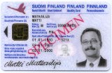
eID in Finland
eID card contains
name
optionally email address
SATU (electronic identification number)
Not mandatory
Price 51€
The SATU number can be converted to a personal identity number through a web services query to the population register
Notes:
http://fineid.fi/?site=10
http://fineid.fi/default.aspx?docid=4033
By the end of November, Citizen Certificates had been issued to a total of 341,800 people. Of these, 272,200 Citizen Certificates were valid

Slide 5
eID Statistics
End of November 2010
341,800 certificates issued to date
272,200 currently valid
Notes:
http://fineid.fi/?site=10
http://fineid.fi/default.aspx?docid=4033
By the end of November, Citizen Certificates had been issued to a total of 341,800 people. Of these, 272,200 Citizen Certificates were valid
Porvoo group
http://www.fineid.fi/default.aspx?id=539

Slide 6
Population Registry
Provides Web Service interface to population registry data to authorized parties (VTJKysely)
Interface provides
Citizen, building and real estate information
Over 80 different types of attributes available
Web service interface authentication at connection level using client certificates
Notes:
VTJKysely
http://vrk.fi/default.aspx?id=119
VTJKysely pricing (Finnish)
http://vrk.fi/default.aspx?id=114
Eg. User authentication 0.29e/transaction

Slide 7
Banks as Commercial IdPs for eGov
TUPAS is a joint bank specification for electronic authentication by the Federation of Finnish Financial Services
Proprietory protocol
User must be strongly authenticated
Typically PIN/TAN list
Banks provide limited financial liability
User approves and certifies the personal data released
Notes:
http://www.pankkiyhdistys.fi/
Federation of Finnish Financial Services
http://www.pankkiyhdistys.fi/modules/system/stdreq.aspx?P=2800&VID=default&SID=611271739978281&A=process%3aida.aspx%3acaller%3dopenDocument%3aprm1%3dwwwuser_fkl%3adocid%3d24902%3asec%3d%3aext%3d.pdf&S=1&C=61171
http://www.pankkiyhdistys.fi/modules/system/stdreq.aspx?P=2800&VID=default&SID=611271739978281&A=process%3aida.aspx%3acaller%3dopenDocument%3aprm1%3dwwwuser_fkl%3adocid%3d11270%3asec%3d%3aext%3d.pdf&S=1&C=61138
http://www.pankkiyhdistys.fi/modules/system/stdreq.aspx?P=2800&VID=default&SID=611271739978281&A=process%3aida.aspx%3acaller%3dopenDocument%3aprm1%3dwwwuser_fkl%3adocid%3d11302%3asec%3d%3aext%3d.pdf&S=1&C=61117
Act on Strong Electronic Identification and Electronic signatures [617/2009], Chapter 1 Section 2 Subsection 1)

Slide 8
Banks as Commercial IdPs
10+ banks
Commercial service
Contracts between SP and each bank required including typically
Establishment fees
Monthly fees
Transaction fees
Similar process to Verified By Visa etc
Notes:
http://www.pankkiyhdistys.fi/
Federation of Finnish Financial Services
http://www.pankkiyhdistys.fi/modules/system/stdreq.aspx?P=2800&VID=default&SID=611271739978281&A=process%3aida.aspx%3acaller%3dopenDocument%3aprm1%3dwwwuser_fkl%3adocid%3d24902%3asec%3d%3aext%3d.pdf&S=1&C=61171
http://www.pankkiyhdistys.fi/modules/system/stdreq.aspx?P=2800&VID=default&SID=611271739978281&A=process%3aida.aspx%3acaller%3dopenDocument%3aprm1%3dwwwuser_fkl%3adocid%3d11270%3asec%3d%3aext%3d.pdf&S=1&C=61138
http://www.pankkiyhdistys.fi/modules/system/stdreq.aspx?P=2800&VID=default&SID=611271739978281&A=process%3aida.aspx%3acaller%3dopenDocument%3aprm1%3dwwwuser_fkl%3adocid%3d11302%3asec%3d%3aext%3d.pdf&S=1&C=61117
Act on Strong Electronic Identification and Electronic signatures [617/2009], Chapter 1 Section 2 Subsection 1)

Slide 9
Familiar process
User accesses service provider
Selects a bank
Redirect, authenticates at bank
Redirect, returns to service

Slide 10
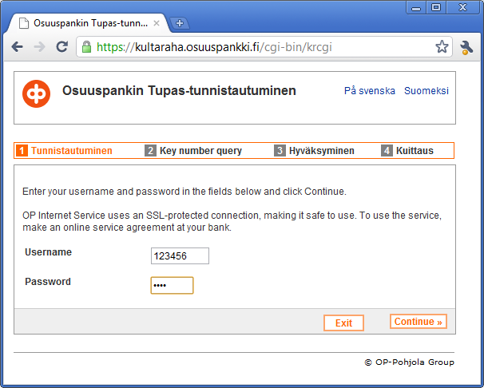
Bank authentication

Slide 11
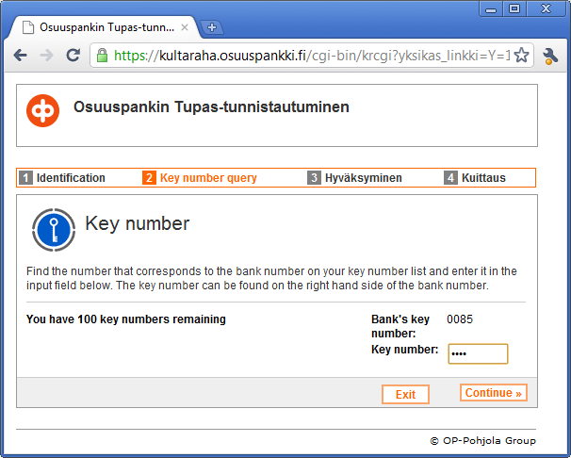
Indexed TAN

Slide 12
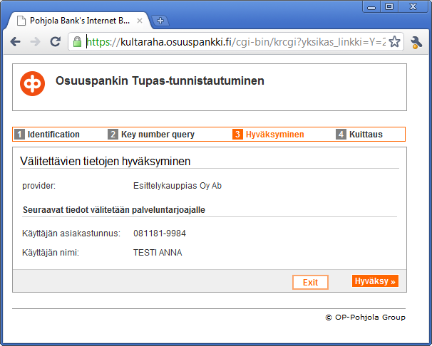
Attribute release consent

Slide 13
Telcos as Commercial IdPs for eGov
Commercial Wireless PKI (MPKI, WPKI) service launched 30.11.2010
Named ”Mobiilivarmenne” Mobile Certificate
http://www.mobiilivarmenne.fi/en/en_2.html
Supported by 3 out of 4 national telcos
Competing with TUPAS service
Notes:
www.mobiilivarmenne.fi
http://www.mobiilivarmenne.fi/en/index.html

Slide 14
Telcos as Commercial IdPs
Long history – previous studies and commercial trials commencing around 2003 to use national ID in the mobile had failed
New business model, purely commercial
Requires government-issued CA license with stringent auditing
Application embedded in SIM (application toolkit application)
Notes:
www.mobiilivarmenne.fi
http://www.mobiilivarmenne.fi/en/index.html

Slide 15
Two Profiles
Authentication
Signing (non-repudiation)
Unique PIN codes for each type
PIN codes distributed on SIM package behind scratch layer
User can change own PINs through SIM menu
Notes:
www.mobiilivarmenne.fi
http://www.mobiilivarmenne.fi/en/index.html

Slide 16
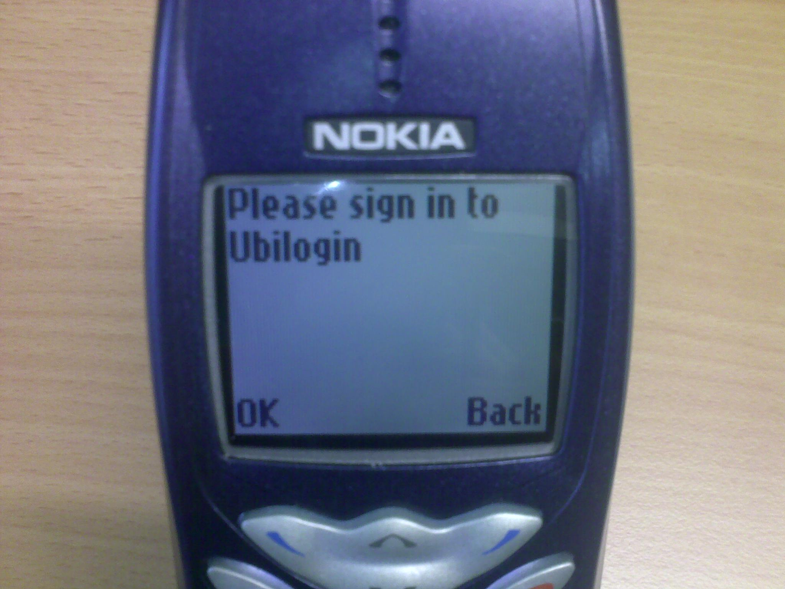
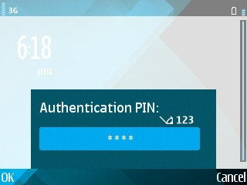
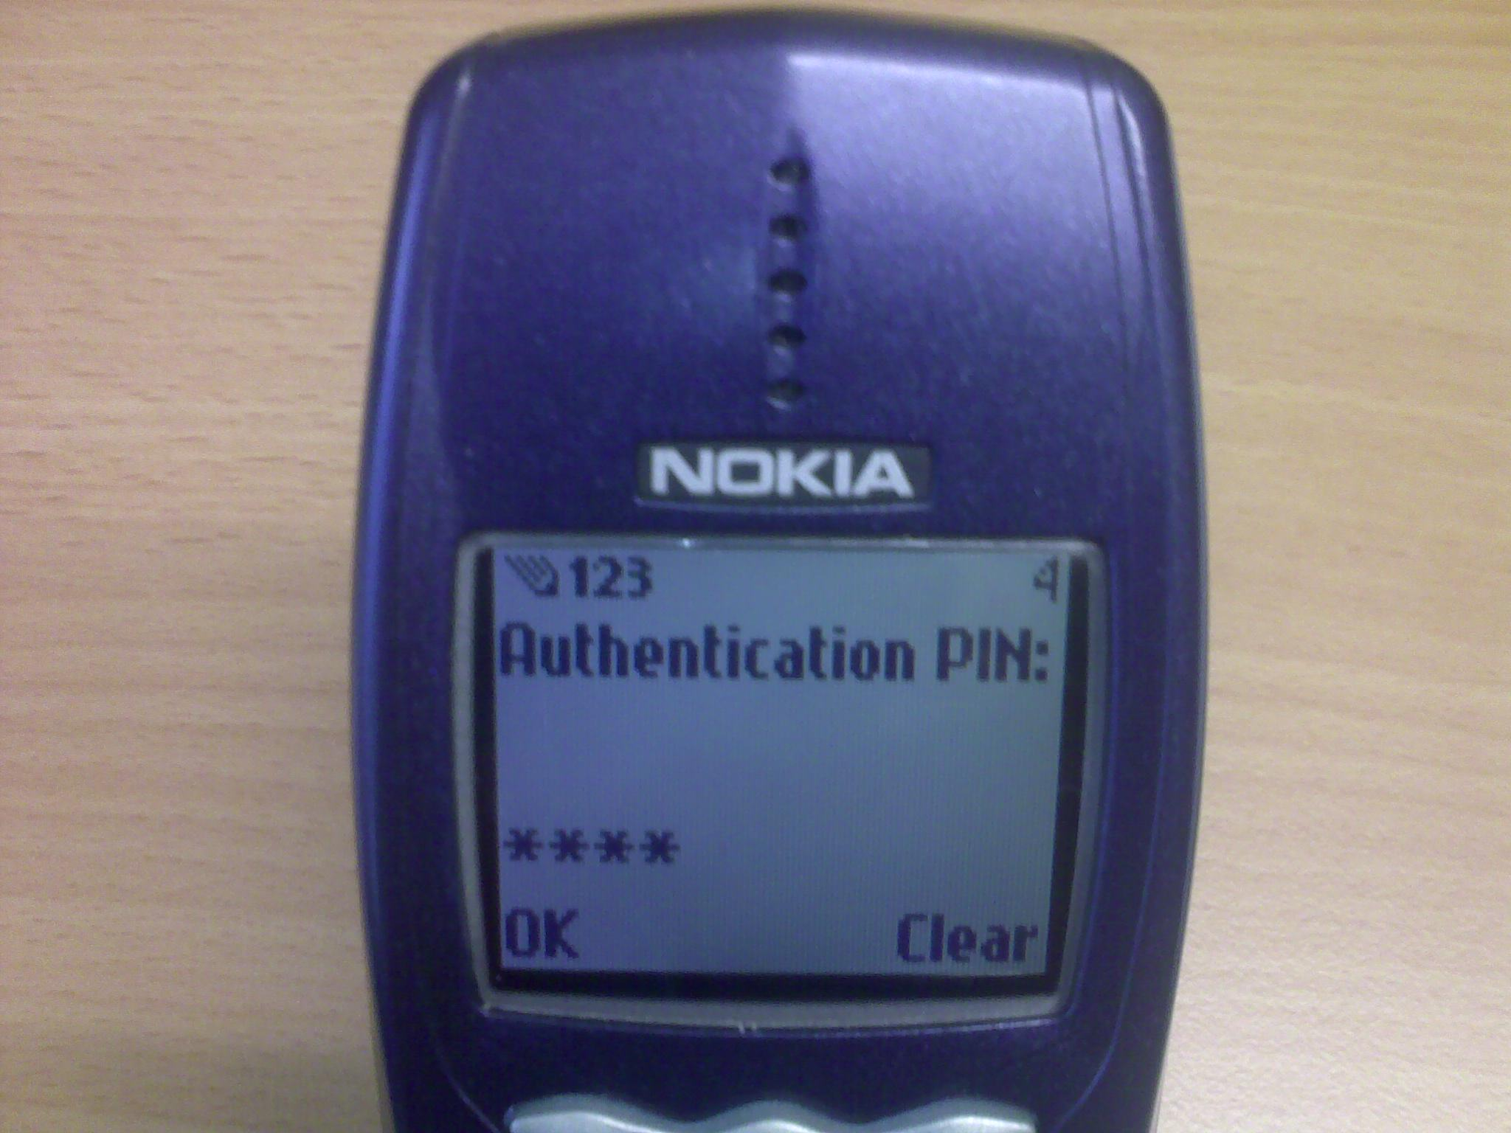
Old and new phones alike

Slide 17
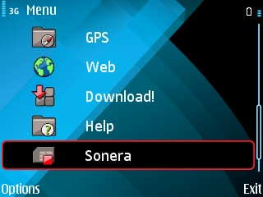
Changing PIN codes

Slide 18
Telcos as Commercial IdPs
Works while roaming (SMS based transport)
Pricing for end users
Elisa: 0.09 per transaction (Free until Nov 2011)
Other telco pricing unknown
Pricing for SP services
Unpublished
Expected adoption for C2G services in 2011
Notes:
www.mobiilivarmenne.fi
http://www.mobiilivarmenne.fi/en/index.html
http://www.elisa.fi/varmenne/
http://www.sonera.fi/puhelin+ja+liittyma/palvelut/huvi+ja+hyoty/sonera+id

Slide 19
Process Flow (A)
User accesses service provider application
Users enters a telephone number and optional anti-spam code
User verifies session identifier on phone matches what is on screen.
User presses OK to accept request
User enter PIN code
The request is signed on the phone and sent to the operator
Operator returns user identity and possible attributes
Access to the application is granted
User notified on phone of signing request
The request is sent to the operator
User reads any other binding text in the request.

Slide 20
Process Flow (B)
User accesses service provider application
Users enters username (and optionally password)
User verifies session identifier on phone matches what is on screen.
User presses OK to accept request
User enter PIN code
The request is signed on the phone and sent to the operator
Operator returns user identity and possible attributes
Access to the application is granted
User notified on phone of signing request
RP retrieves existing phone number and the request is sent to the operator
User reads any other binding text in the request.

Slide 21
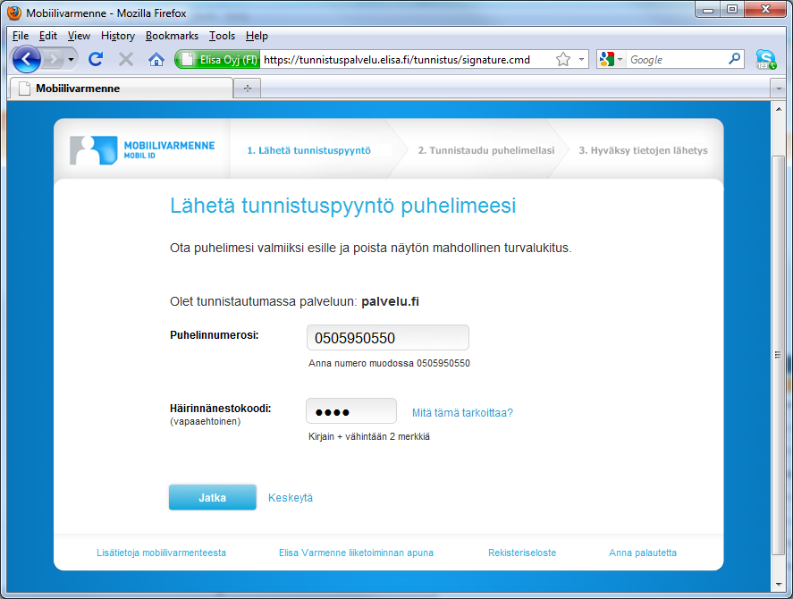

Slide 22
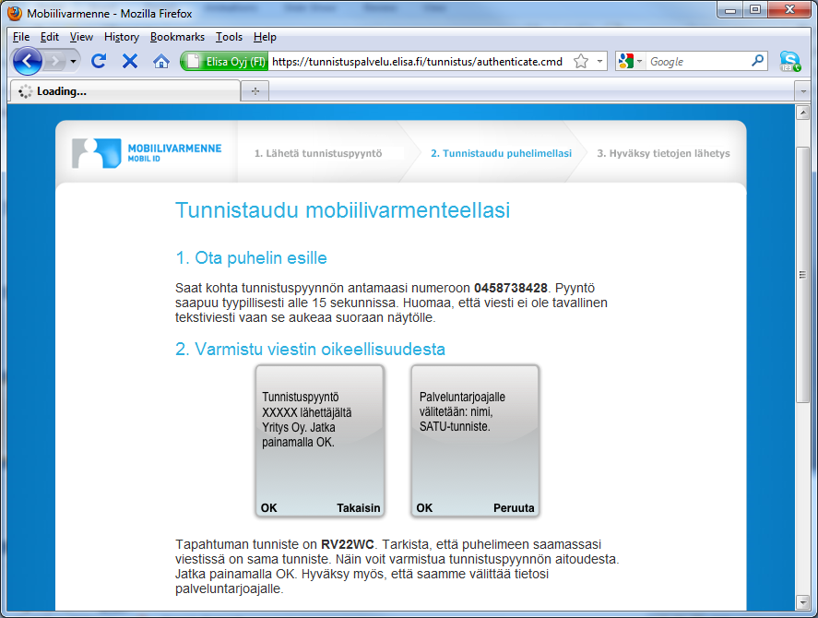

Slide 23
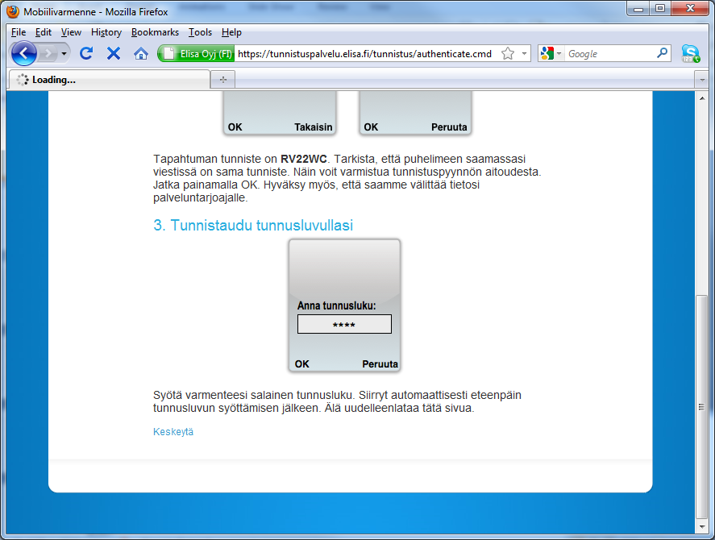

Slide 24
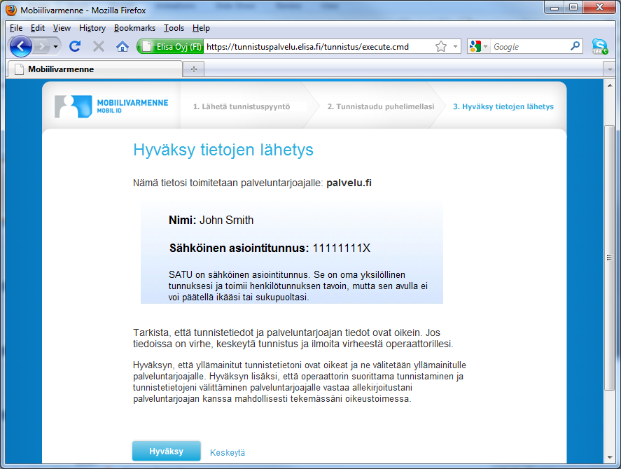

Slide 25
Standards
Ficom - Finnish Federation for Communications and Teleinformatics
ETSI MSS Mobile Signature Service
ETSI MSS
TS 102 204, TR 102 206, TS 102 207
Notes:
http://www.ficom.fi/linked/fi/ohjeita/MSS_FiCom_Soveltamisohje_v1.1.pdf
FiComsuositus
nojaa seuraaviin tekniikoihin.
ETSI
TS 102 204; TR 102 206; TS 102 207:
http://portal.etsi.org/docbox/EC_Files/ EC_Files/ts_102204v010104p.pdf
http://portal.etsi.org/docbox/EC_Files/ EC_Files/tr_102206v010103p.pdf
http://portal.etsi.org/docbox/EC_Files/ EC_Files/ts_102207v010103p.pdf
W3C
XML Schema Part 1; Part 2:
http://www.w3.org/TR/xmlschema1/
http://www.w3.org/TR/xmlschema2/
SOAP Version 1.2 Part 0: Primer; Part 1: Messaging Framework; Part 2: Adjuncts:
http://www.w3.org/TR/2003/RECsoap12part020030624/
http://www.w3.org/TR/2003/RECsoap12part120030624/
http://www.w3.org/TR/2003/RECsoap12part220030624/
WSDL 1.1:
http://www.w3.org/TR/wsdl
RSA Laboratories
PKCS#7: Cryptographic Message Syntax Standard:
http://www.rsasecurity.com/rsalabs

Slide 26
Service Provider Integration
Operator provided API
ETSI MSS interface
TUPAS Proxy (Emulate banking protocol)
Hosted by Service Provider
Operated by Telco
SAML IdP Proxy
Hosted by Service Provider
Operated by Telco
Notes:
www.mobiilivarmenne.fi
http://www.mobiilivarmenne.fi/en/index.html

Slide 27
Architecture

Slide 28
Architecture
SAML IdP Proxy
SAML2

Slide 29
Architecture
SAML Service Provider
SAML IdP Proxy
SAML2

Slide 30
Authentication during a call
System permits a telephone operator (or automated IVR system) to perform an authentication request during a voice call
Simtoolkit application does not interrupt call
Eg, obtaining blood test results from a clinic

Slide 31
Commercial Identity Providers
Banks
Telcos
Mobile Certificate
TUPAS
Government
eID Card

Slide 32
Summary
Commercial rollout of mobile certificates has begun
Standards-based architecture (ETSI MSS)
”Operator roaming” thanks to federation
One service agreement for relying party
Leveraging existing identity value
Ready market of existing services ready to adopt
Competitive identity market

Slide 33
Questions / Discussion

