Slide 1
PIDS
Patient ID Service
http://design.patientidservice.us/

Slide 2
Thank You
Kantara Initiative
Open ID Foundation of Japan, Nat Sakimura
HIAWG Members
Chairs: John Fraser, Pete Palmer, Rick Moore

Slide 3
http://design.patientidservice.us/

Slide 4
Patient ID Service (PIDS) Phase 1 -- Design
Research
Survey
Iterate Design
Final Presentation (we are here)
November 10, 2011 during HIAWG Conference Call 1:00 to 2:00 EST; http://kantarainitiative.org/confluence/display/healthidassurance/Home
Lay ground work for future phases

Slide 5
MARCH 3, 2011 1:00PM - 2:00PM Eastern Time Phone Conference Call
Kickoff Announcement
SAVE THE DATE
PATIENT IDENTITY SERVICE
PROJECT LAUNCH
A Key to Meaningful Use: Patient Identity and Authentication
Building on Current Technology to Enable "Meaningful Use" Transactions
Open Architecture for Citizen-Centered Solutions

Slide 6
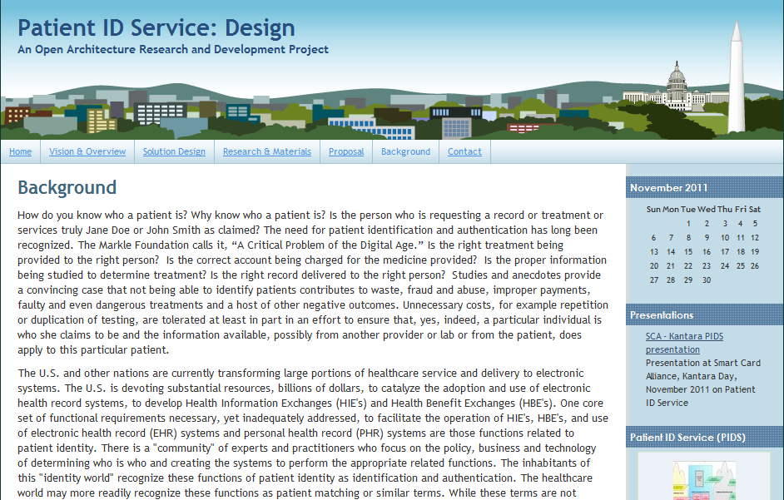

Slide 7
Background
SAFE BioPharma: http://www.safe-biopharma.org/
eAuthentication Initiative/eAuthentication Partnership
HSPD-12/OMB 11-11/FIPS 201/NIST SP 800-63/FICAM, etc.
Liberty Alliance – Kantara Initiative Identity Assurance Framework
HIMSS/GSA National eAuthentication White Paper: http://www.himss.org/content/files/GSAwhitepaper.pdf

Slide 8
Background
The Markle Foundation calls it, “A Critical Problem of the Digital Age.” CT2: Authentication of Consumers http://www.markle.org/sites/default/files/CT2.pdf
Health IT Standards Panel: Identity Credentials Management (ICM) subcommittee of Security, Privacy and Infrastructure Committee, http://www.hitsp.org/
National Strategy for Trusted Identities in Cyberspace, http://www.nist.gov/nstic/, http://www.nstic.us/

Slide 10
PIDS Overview
Leverage the work of the Kantara Initiative to solve national (international?) problem
Healthcare Identity Assurance Work Group & eCitizen Foundation, OpenID of Japan collaboration
Design, Implement, Publish, Share an Open Architecture for Patient Identity addressing Business, Legal, and Technical requirements
Develop at least three implementations of PIDS to demonstrate interoperability and obtain certification

Slide 11
PIDS Overview
Architecture to allow flexibility in choice of components that meet functional requirements.
Focus on use of existing business, legal and technology components to address immediate and short-term needs for patient identity functions.
Leverage existing credentials by providing functionality to attain Asusrance Level 3
Facilitate healthcare providers' meeting of "Meaningful Use" requirements and in the implementation of Health Information Exchanges, Electronic Health Record (EHR) or Personal Health Record (PHR) systems.
Deliver capabilities to patients to participate significantly in their own healthcare, access, and to the extent appropriate, control their personal health information.
Identify gaps are identified and new applications for the architecture and develop further efforts to address these needs.

Slide 12
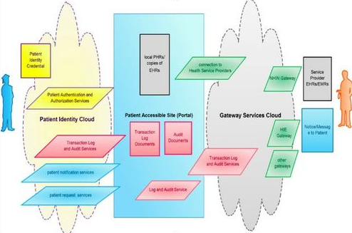
Context

Slide 13
Use Case
A student attending college out of state requires medical treatment. Information and records of prior treatment from her home state doctor will be helpful in the new case. The student chooses to request the prior records, receiving a copy, storing these in a personal health record and forwarding a copy to the new doctor.

Slide 14
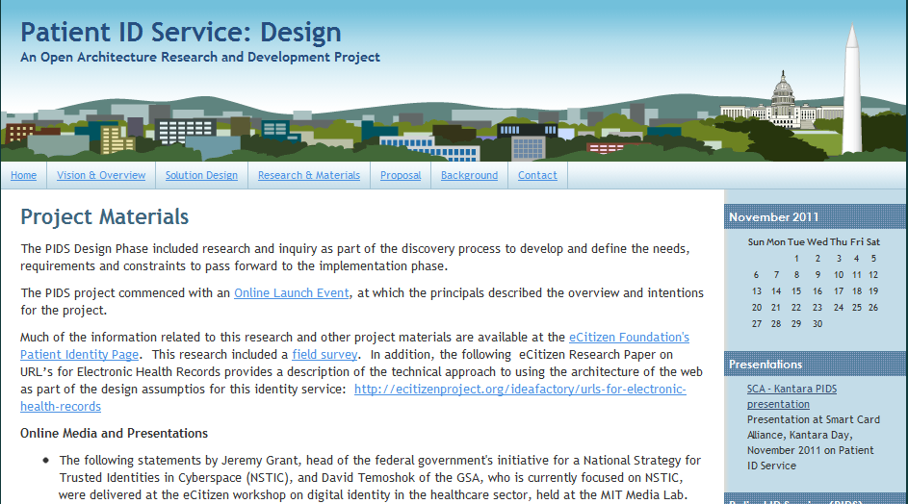

Slide 15
Survey and Research
Project Materials
The PIDS Design Phase included research and inquiry as part of the discovery process to develop and define the needs, requirements and constraints to pass forward to the implementation phase.
The PIDS project commenced with an Online Launch Event, at which the principals described the overview and intentions for the project.
Much of the information related to this research and other project materials are available at the eCitizen Foundation's Patient Identity Page. This research included a field survey. In addition, the following eCitizen Research Paper on URL’s for Electronic Health Records provides a description of the technical approach to using the architecture of the web as part of the design assumptions for this identity service: http://ecitizenproject.org/ideafactory/urls-for-electronic-health-records

Slide 16
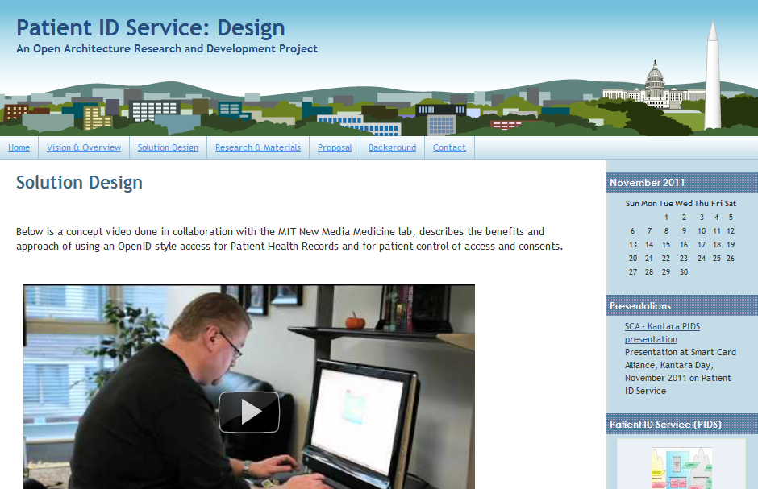

Slide 17
Solution -- Overview
Overview of Solution Design:
The design principles for the Patient ID Service are to create an open architecture, leveraging open standards, for a citizen-centered solution. As such, the proposed design puts the user - in this case a patient - in the driver’s seat. The PIDS design 1) empowers the user to configure important aspects of a personal identity account, 2) enables relying parties such as providers of patient portals, to accept the PIDS as a log- in for the patient, and 3) can be used by the patient to both organize their many health related identifiers and permissions as well as to access many different applications and services.

Slide 18
Solution – PIDS Enrollment
Outline of PIDS Sign-Up and Usage Process
Patient Creates a voluntary PIDS Account
Patient is issued PIDS OpenID Identifier, or External OpenID is bound to PIDS account
Patient inputs additional healthcare relevant identifiers into PIDS "wallet"
External Authentication Tokens are bound to PIDS account
Patient configures permissions for PIDS account
Patient logs in to Relying Party systems with PIDS credential
Relying Party challenges for a higher level of authentication (optional)
Patient generates reports from PIDS system (activity logs, linked accounts)

Slide 19
Solution – Technical Components
Technical Components
A simple account system with identity information from each account holding patient information, including first, last name, phone, address, etc.
A URI/URL for each Patient Account
SAML Service, such as Shibboleth, capable of sending and receiving assertions according to the NwHIN standards

Slide 20
Solution – Technical Components
PIDS Credential, Identifier and Token Capability
An OpenID service
An Advanced Credentialing and Token issuance or adoption service (enabling a patient to use, bind and/or link different identity tokens to their PIDS account), for example:
X.509v3 digital certificate
Registered Mobile Phone for voice and/or text and/or keypad-based verification
Registered Smart Phone for Mobile Phone functions plus application functions
RSA Data Security Key Fob
PIV, PIV-I or other variations of these Cards
Authentication as a Service account linkage, enabling the account credentials to be linked to KBA, crypto-based and other methods
Authorization as a Service account linkage, enabling the account credential to be linked to UACS/RBAC and XACML types of services
eSignature Service, enabling the use of credential to assent to or otherwise approve a document, signify consent or perform other related transactions
Credential Suspension/De-linking/De-binding and Termination Service
(option) Time Stamp Service and other real-time audit-friendly tools (e.g. GIS, HTTP logs, etc)
OpenID Connect and Oauth Services (as they come available)
Audit and Logging Service

Slide 21
OASIS TC
PIDS work will Identify Gaps
One such is Step Up Authentication
Working with OASIS “Trust Elevation Technical Committee”
Open Identity Attribute Exchange Summit
http://www.eventbrite.com/event/2266130056

Slide 22
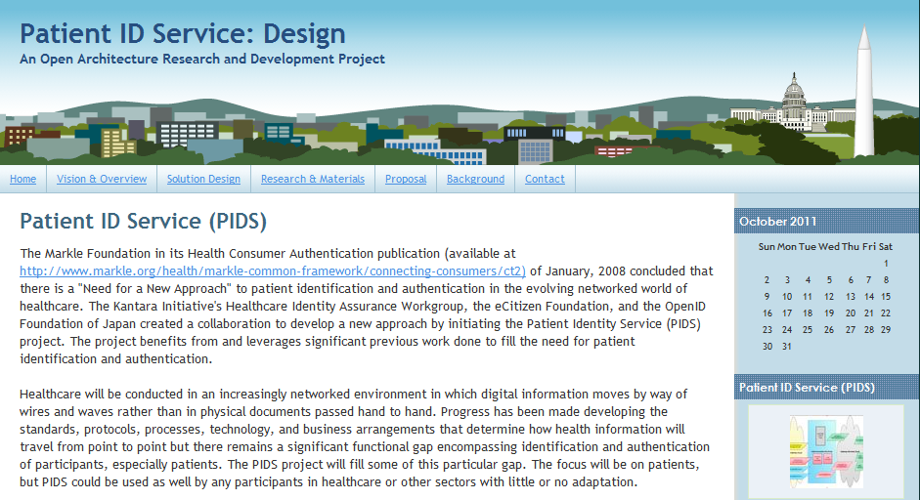
http://design.patientidservice.us/

Slide 23
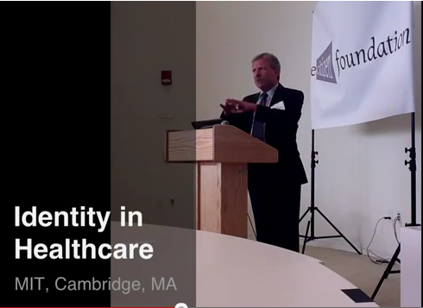
Identity in Healthcare--MIT

Slide 24
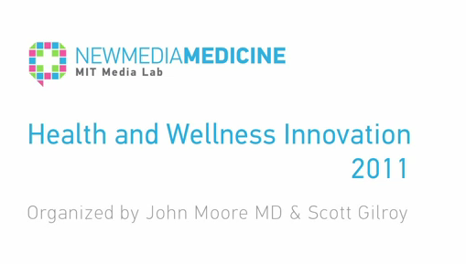
MIT New Media Medicine
MIT Interim Session Coding sprint for development of function components of use in PIDS

Slide 25
ONC Demonstration @ HIMSS

Slide 26
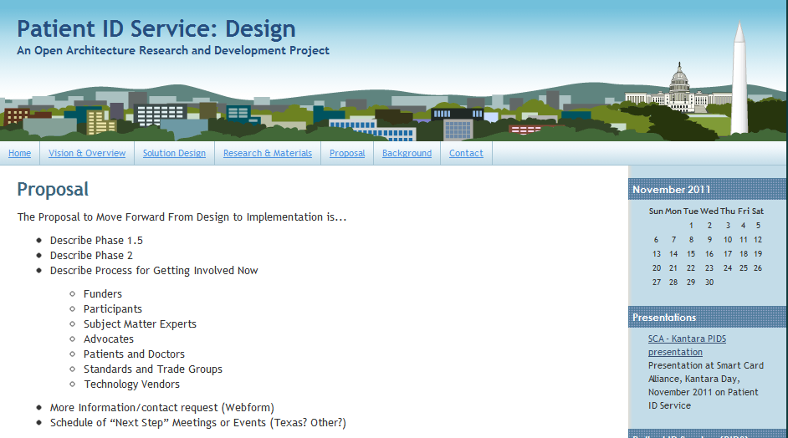
PIDS Phase 1.5 & 2.0

Slide 27
Patient ID Service (PIDS) Phase 1.5 -- Design
Engage Participants
Acquire Funding, Secure Resources
Develop project plan to address Policy, Operating Rules/Agreements, Technology
Publish work under open source license

Slide 28
PIDS Phase 2.0
Develop implementations
Write code, documentation, etc.
Certification
Promote project, develop community
Develop future roadmap

Slide 29
Contact
http://design.patientidservice.us/
pids@patientidservice.us
202-671-0173

