Slide 1
Enterprise -> Cloud
Outline
Enterprises have many apps outside their control
public cloud; business partner applications
Using standards-based SSO (SAML, OpenID Connect) they can authenticate users into those apps; and (at least in theory) apply coarse-grained access control (AC) at the point of token issuance
Additional AC can only be implemented and managed at the SP.
Issues
no way to control policy centrally means increased risk;
managing policy per-app is expensive and fragile
implementing a full XACML PEP at each SP is not viable: SPs would have to (probably) significantly refactor apps for new auth'z model

Slide 2
Basic Enterprise Use-case
resource
owner
manage
consent
control
resource
server
protect
authorization
server
negotiate
requesting
party
authorize
access
manage
client

Slide 3
Additional Notes
RO and AS are part of the same (logical) domain (AS could be externally hosted)
RP, Client and RS can be intra- or extra-domain
Bob might be an employee or a customer
Client might be a company-owned device, or BYOD, or an internet café browser
RS could be SaaS/BPO, or internal

Slide 4
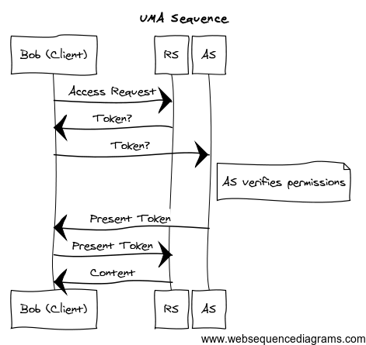
UMA Sequence (no PDP)
* Assumes Bob is already authenticated at the AS

Slide 5
Example 1
Current employees assigned to project ‘ConceptCar’ can download vehicle design mockups from external agency
Complex policy requires additional attributes from multiple sources
Is employee current? (HR system)
Is employee assigned to project (PLM system)
Is employee requesting download access (request)

Slide 6
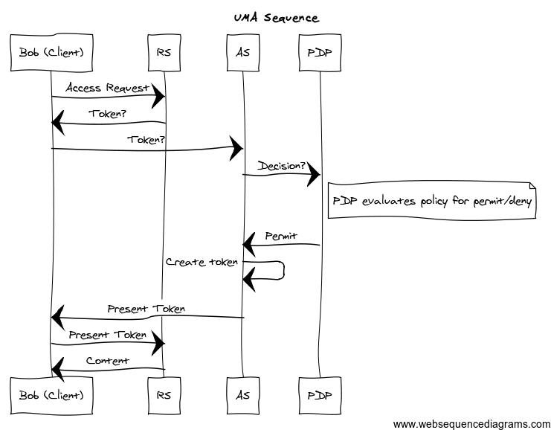
UMA Sequence (with PDP)
* Assumes Bob is already authenticated at the AS

Slide 7
Example 2
What if the AS needs to impose some (basic) obligations on the RS?
Current employees assigned to project ‘ConceptCar’ can download low-resolution vehicle design mockups from external agency. If only high-res is available, no download is permitted.

Slide 8
Requirements
Per the XACML model, the PDP would issue a ‘Permit with obligation’ (for low-res)
If the RS (i.e. PEP) cannot enforce this (for whatever reason), it should not issue

Slide 9
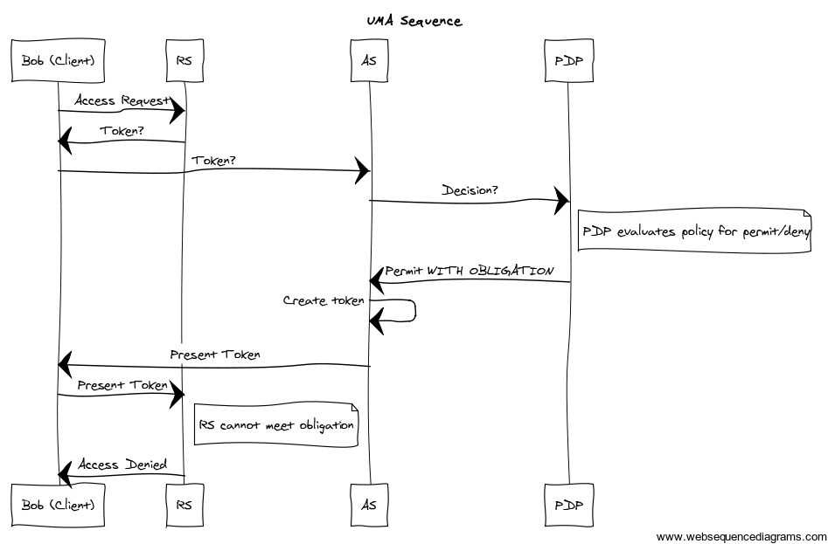
UMA Sequence with PDP+
* Assumes Bob is already authenticated at the AS

Slide 10
For Consideration
There are consumer and IoT use-cases that have similar extended/complex auth’z requirements
Is there value in adding options to the spec for:
The RPT to include scope of access and/or obligations
An UMA-valid RS to be able to at least process obligations
… in that it could simply ‘not be able to’ and then deny anything that presents an obligation
(Note: the RS can establish scopes and other capabilities during service registration)

