Slide 1
UMA’s relationship to distributed authorization concepts
19 October 2013
tinyurl.com/umawg
@UMAWG

Slide 2
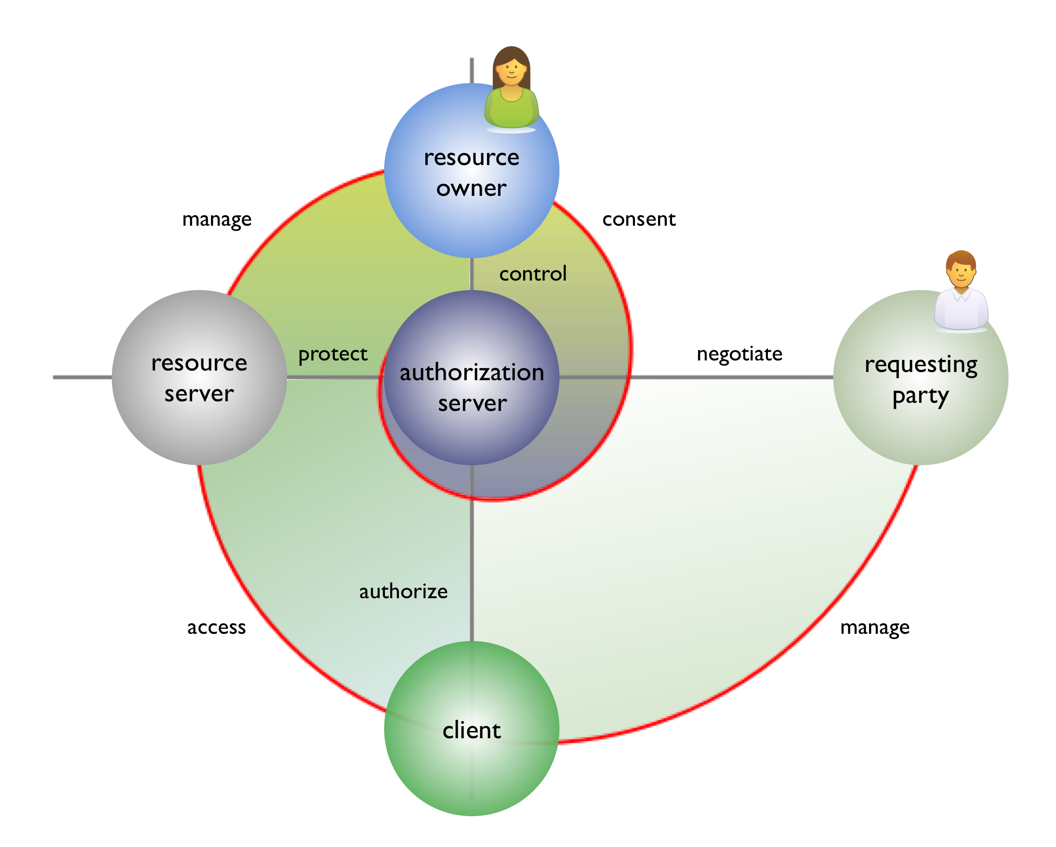
Basic terms and concepts in UMA
RO has discretionary access control rights over protected resources
AS is capable of being a full PDP
Responsible for policy characteristics (thus implicitly a PAP and PIP)
RS is capable of being a full PEP
Responsible for the “grain” of protected resource access
Interface is standardized in UMA
AS and RS are capable of being fully loosely coupled and multitenant
Client conveys an access token (requesting party token or RPT) to RS in the OAuth fashion
RqP and client together constitute an access requester
Require an access decision by some combination of AS and RS

Slide 3
Implications of AS-RS loose coupling and multitenancy
administer
policies
AS1
AS2
(RO1)
(RO2)
(other)
(RO2)
RS operators and AS operators may all be different parties
May need to operate at Internet scale, with mobile and other devices
protect
resources
RS1
RS2
(RO1)
(RO2)
(RO1)
(RO2)
manage
resources
RO1
RO2
RO1 uses AS1 to protect resources from more than one RS
RO2 uses more than one AS to protect its various resources

Slide 4
Opportunities for distribution of decision-making responsibility in UMA
100%
Balance depends on nature of authorization data associated with RPT
100%
0%
0%
RS
AS

Slide 5
Default distribution of decision-making responsibility in UMA
Mandatory-to-implement bearer RPT profile gives AS most power because AS and RS operators may differ
Conveys current permissions and requires RS to match to access attempt
100%
100%
Many other distribution schemes are possible through RPT profiling
Authorization data can be contained in RPT or retrieved by RPT introspection (“bearer” profile requires the latter)
0%
0%
RS
AS

Slide 6
Some additional options for decision-making responsibility
XACML-like (AS 100%): RPT conveys Permit/Deny decision
100%
100%
Sticky policy-like (AS <50%): RPT conveys operative policies in some format
0%
SSO-like (AS 0%): RPT conveys only claims gathered from the user
0%
RS
AS

Slide 7
Basic elements of policy expression and their authoritative sources
AS is exclusively authoritative for constraints on which access requesters can gain access, binding subj to verb/obj
AS and RO together are responsible for administering all relevant policies
RS is exclusively authoritative for protected resource sets (obj) and scopes of operation over them (verb)
It registers them with AS through a resource set registration API
subj
verb
obj
Without UMA, OAuth on its own only handles scopes; “resource sets” are implicit (come from API developer documentation)

Slide 8
Degree of interoperability of policy expression elements
Policy expression and evaluation are performed outside UMA
AS can serve as a client of other standard or proprietary PDPs, PIPs, and PAPs
Resource set registration API and format (modular spec called by UMA) enable interop and standardization of resource set types and of scopes
subj
verb
obj
XACML and several other specifications fully standardize all elements
OAuth scopes are specific to the API being protected; their expression is not standardized

Slide 9
Final observations
administer
policies
Not standardized by UMA
UMA can integrate with other solutions (XACML standard, procedural code…)
Each AS operator may choose a different solution (impacting multi-AS interop for one RO or RS)
AS1
AS2
(RO1)
(RO2)
(other)
(RO2)
protect
resources
Expression standardized by UMA
Each RS operator can define its own resource sets and scopes, or use ones defined by others
RS1
RS2
(RO1)
(RO2)
(RO1)
(RO2)
manage
resources
Each service has its own proprietary (or standard) API
RO1
RO2

