Slide 1
A Framework for Automatically Enforcing Privacy Policies
Jean Yang
MIT KIT / April 17, 2014
Notes:
Hello, my name is Jean Yang. Today, I am going talk about how to make it easier for programmers to enforce privacy policies.
TRANSITION: Privacy matters in the real world more and more as we’re putting more data online.

Slide 2
Privacy matters. People get it wrong.
Notes:
What’s more is that people often get it wrong.
Even Facebook, with privacy being so core to their model and with all of their programmer resources, has a leak every now and then. Here’s an example.
TRANSITION: It’s not surprising that programmers get this wrong.

Slide 3
Many possible points of failure.
Desired Policy
Implementation
Policy
Only friends can see GPS location.
getLocation(user)
Policy
findAllUsers(location)
Policy
findTopLocations()
Notes:
First of all, there are many points of failure.
Let’s consider what has to happen to enforce a policy that only my friends can see my GPS location.
We, the programmer has to enforce this policy at all points where the location is used. Not just in the function that gets a user’s location, but in functions that find all users at some given location or the most popular locations among users.
TRANSITION: What’s worse is that the policies are getting more complex.

Slide 4
Increasingly complex policies.
Desired Policy
Only friends can see GPS location.
who are local
within next five hours
Notes:
For instance, we could have a policy that says only friends who are local can see my GPS location within the next five hours.
TRANSITION: Some people might say that developer education solve this problem.

Slide 5
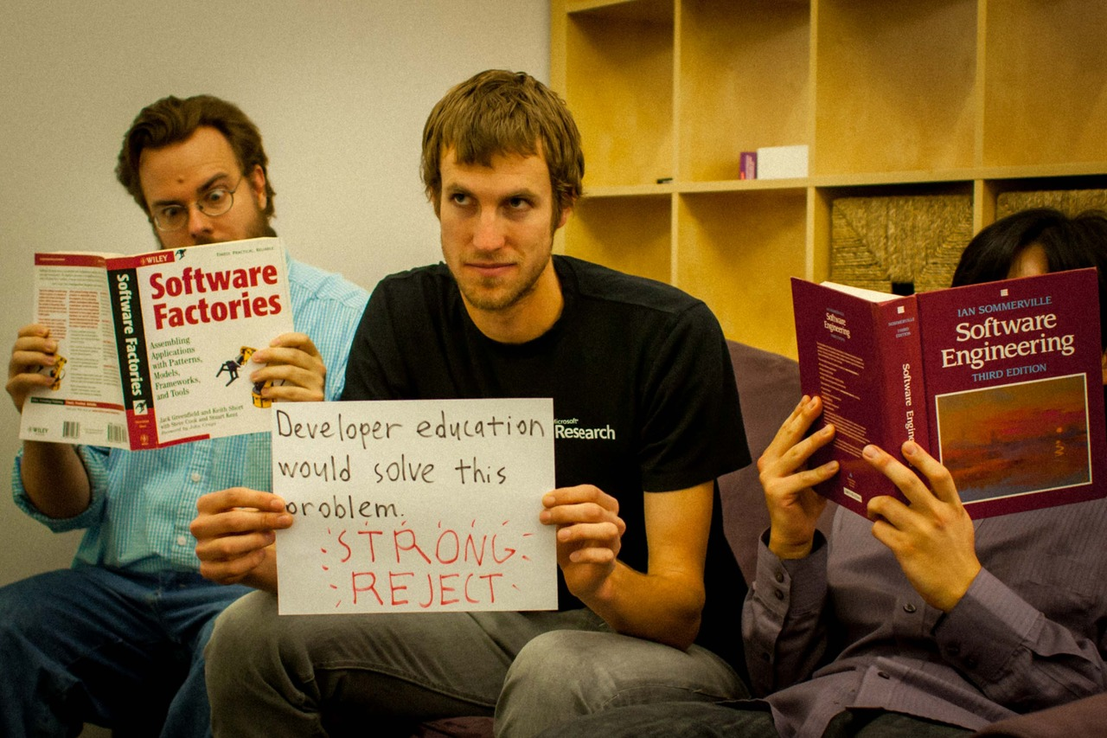
Notes:
But the thing is, developers know how to enforce policies.
The problem is that they have to enforce the same policy over and over again across the program. And if there’s one thing we know in software engineering, it’s that is error-prone.
TRANSITION: Let’s think a little bit about how to fix this.

Slide 6
Easier if we separate policies from other functionality.
Policy Implementation
Other Implementation
Only friends can see GPS location.
getLocation(user)
findAllUsers(location)
findTopLocations()
Notes:
If we only have to worry about the policy and nothing else, it’s not that complicated.
Similarly, if we only had to worry about the other functionality without the policies, it’s also much simpler.
Now what we need is a way to put the policies back together with the functionality to get the right results.
A tricky part, though, is that handling sensitive values through computations involves integrating with the language semantics.
TRANSITION: Because of this information flow issue, we propose a language-level approach.

Slide 7
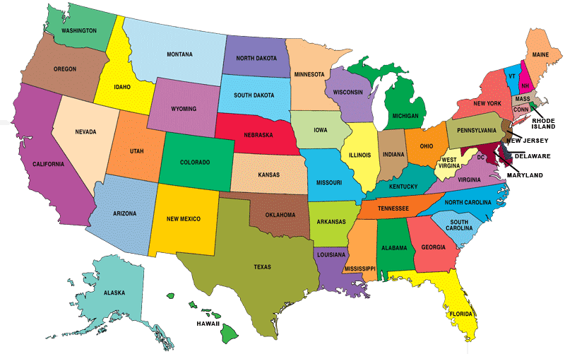
The Jeeves Language
⟨ | ⟩
k
Associated with
policies.
findAllUsers(MIT)
You have no friends in this location.
Notes:
I’ve been working on the Jeeves programming language.
The key idea in Jeeves is that the programmer can define different views of a piece of data and rely on the runtime to use the appropriate view for the situation.
[Be more concrete before animating things in.]
Important that people can see a version of the data that does not violate the policies.
These views are associated with a label, to which the programmer may attach policies. The policies can talk about program values and the output channel.
The programs can be policy-agnostic, which means that the programmer does not have to know what the specific policies are.
The runtime simultaneously executes the program on the different views and shows different results to different viewers based on the permissions.
When Andrey, my host, tries to see who is at Microsoft Research Cambridge, he might see that his coworker Byron and I are here.
When my groupmate Rishabh tries to perform the same search, he may see that nobody is there.
TRANSITION: Let us now look more specifically at Jeeves syntax.

Slide 8
Sensitive Values
{ low, high }
label a
val loc = ⟨gpsCoords | country(gpsCoords)⟩_{a}
High value.
Low value.
Label.
Policies
restrict a: λoc.(isNear(oc, jean))
Label.
Output channel.
Predicate.
Core Functionality
val msg = “Jean’s location is ” + asStr(loc)
Contextual Enforcement
print {fuming} msg “Jean’s location is N 42°, W 71°.”
print {rishabh} msg “Jean’s location is in the United States.”
Notes:
First, the programmer can make labels that may be associated with sensitive values.
Sensitive values have a high-confidentiality facet and a low-confidentiality facet, guarded by the label.
If the label’s value is high, then the value acts as the high-confidentiality facet. Otherwise, the value acts as the low-confidentiality facet.
The runtime assigns values to the labels based on policies that the programmer provides.
Policies take a label and a function describing restrictions on the label. The function takes an output channel and returns a predicate determining when the label is allowed to be high.
The Jeeves runtime collects these policies to determine which views of sensitive values should be shown.
The Jeeves programmer can use sensitive interchangeably with other values.
For instance, here we create a string “msg” that is the concatenation of the sensitive location with the string “Alice is at.”
Effectful computations such as print require a context to determine what the output should be.
To evaluate this, the runtime finds an assignment for the labels that satisfies the policies and then uses this assignment to project out the appropriate result.
Printing in the context of user alice should yield the string “Alice is at MIT,” while printing on the context of user bob should yield the string “Alice is at school.”
** QUESTIONS? ***
TRANSITION: Let’s take a closer look at policies.

Slide 9
Jeeves Execution
Storing policies
Faceted execution
label a
=
restrict a: λoc.true
⟨3 | 0⟩ _{a}
3
Policies
a → λoc.true
⟨true | false⟩ _{a}
Constraints
print {…} …
true ⇒ a = low
false
Notes:
To evaluate sensitive values, the runtime performs faceted execution, evaluating the high and low facets and putting the results back together.
The runtime also handles implicit flows by evaluating both sides of a conditional.
After evaluation, we get trees of faceted values, where each facet is guarded by a label.
Policies determine the values of the labels.
The runtime stores mappings of labels to policies in order to eventually assign values to the labels.
Once the runtime gets an output channel, it creates a system of constraints from the labels in order to find a satisfying assignment.
Once it gets a satisfying assignment to the labels, the runtime projects values out of the facets in order to produce the value to output.
*** QUESTIONS? ***
TRANSITION: You may now be wondering…

Slide 10
Classical Security
Lattice of access levels.
Level 3:
top secret.
Level 2:
highly classified.
Level 1:
privileged information.
Notes:
In classical security, people typically define a lattice of access levels.
A higher access level corresponds to a higher security level. For instance…
TRANSITION: To view an output, the viewer must have an access level corresponding to the highest level of any value used to compute the output.

Slide 11
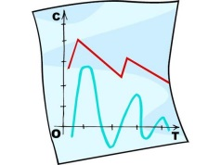
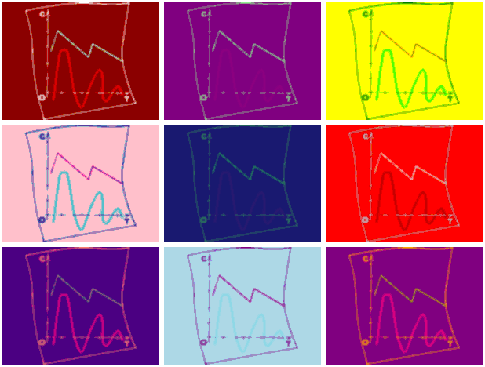
Classical Security
+
Level 3
Level 0
Level 3
Viewers must have access for the highest level.
Notes:
In this model of classical information flow, the access level of a value is the highest level of the values that were used to compute it.
For instance, if we took this classified information and combined it with this Andy Warhol painting to make an Andy Warhol classified information, only the NSA could see it.
The program would not produce any results for anyone else.
TRANSITION: Jeeves is different in that the program always produces results.

Slide 12
Jeeves Security
⟨ | ⟩
+
p
Notes:
In Jeeves, the property is not whether the viewer can see an output, but what output the viewer can see.
Instead of associating a value with an access level, the programmer provides a different value for different access levels.
When anyone except for the NSA tries to view the top secret information, they get to see an Andy Warholed version of “Access Denied.”
TRANSITION: Thus the non-interference guarantee in Jeeves talks about which value is output rather than the access level of the outputs.

Slide 13
Implementation
Overload operators for faceted evaluation.
Store policies in runtime environment
=
mkLabel
restrict
⟨3 | 42⟩ _{a}
3
Policy environment
⟨true | false⟩ _{a}
Use an SMT solver as a model finder.
print
false
Notes:
We have implementations in both Scala and Python.
In the implementations, we overload operators for faceted evaluation. We store policies in the runtime environment.
We use the Z3 SMT solver to find a satisfying assignment to the labels and then we project out the appropriate facet based on the label assignments.
TRANSITION: We have been looking at extending these runtime implementations into web frameworks.

Slide 14
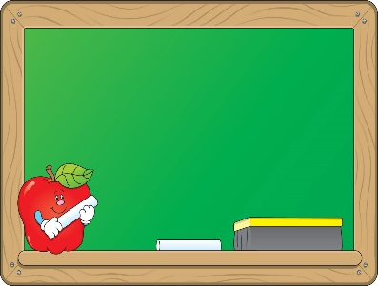
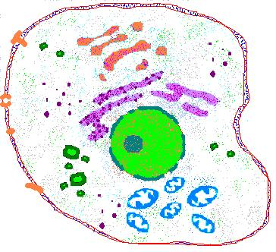
Case Studies in Progress
Course manager
Conference management system
Protein signaling
Fitness tracking (with Fuming)

Slide 15
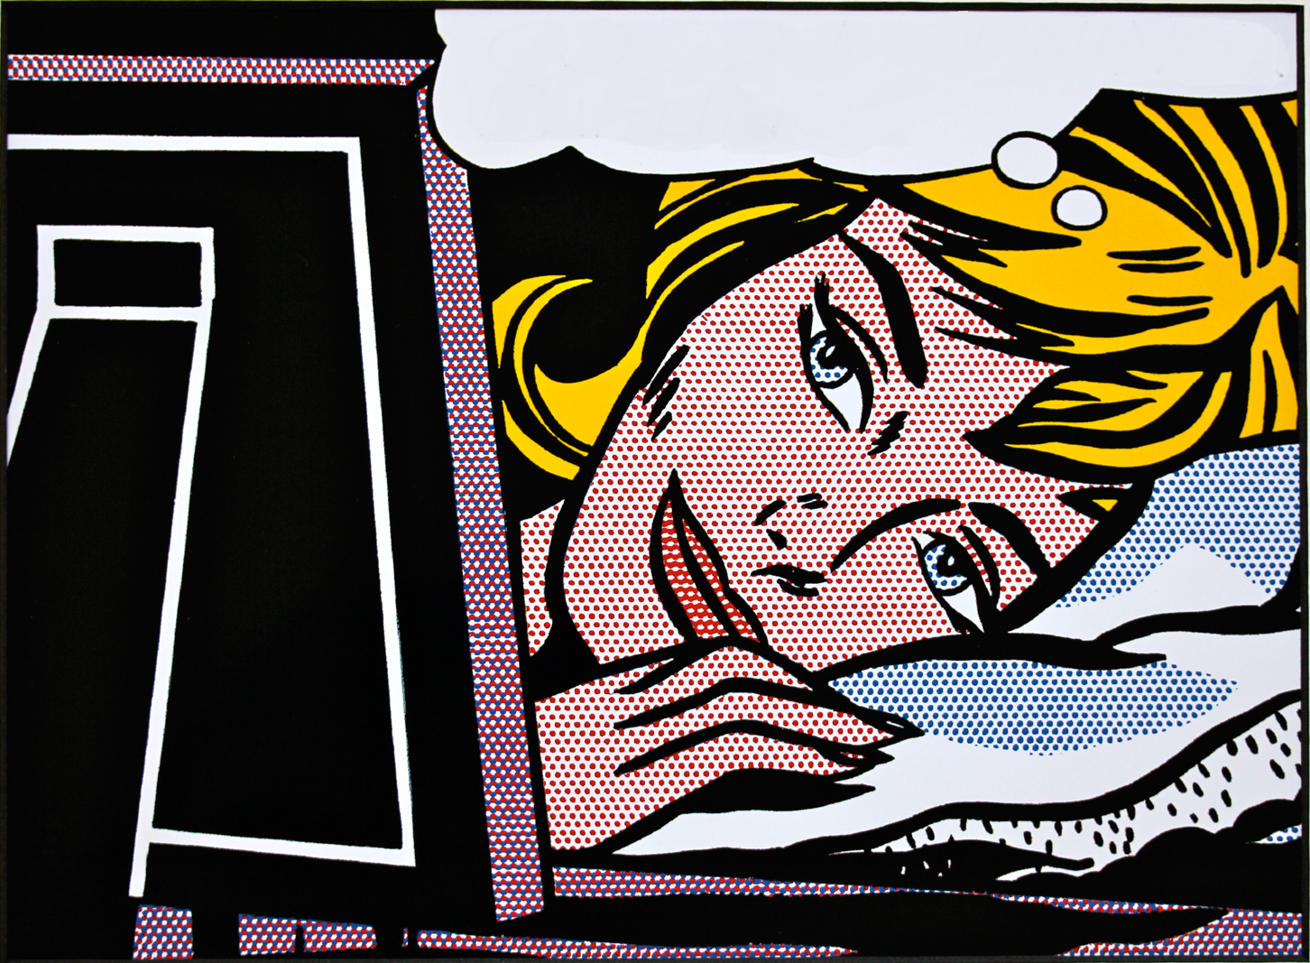
FINALLY.. I CAN FOCUS ON FUNCTIONALITY!
Notes:
This allows the programmer to focus on program functionality, resting assured that the Jeeves system is correctly enforcing the policies.

Slide 16
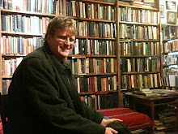
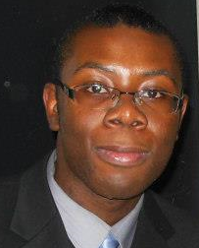
Jeeves Team
Armando Solar-Lezama
Travis
Hance
Cormac Flanagan
Thomas Austin
Benjamin
Shaibu

Slide 17
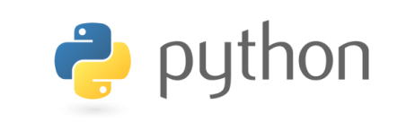
This Talk
⟨ | ⟩
You have no friends in this location.
Jeeves programming
model
Theoretical guarantees
Implementation strategies
Case studies
Join us!
jeeveslang.org
Notes:
In this talk, I have described how we are building towards a web framework for automatically enforcing privacy policies.
Programmer can specify different views of sensitive values.
The system is responsible for displaying different values to different people.
It is exciting that language technology allows us to think about automating global concerns such as informational flow policies. I am looking forward to thinking about what other ways we can make programmers’ lives easier.

