Slide 1
User-Managed Access
UMA Work Group
@UMAWG
tinyurl.com/umawg | tinyurl.com/umafaq
29 Oct 2013

Slide 2
The “data price” for online service is too high: typing…
Provisioning by hand
Provisioning by value
Oversharing
Lying!

Slide 3
The “data price” for online service is too high: connecting…
Meaningless consent to unfavorable terms
Painful, inconsistent, and messy access management
Oblivious oversharing

Slide 4

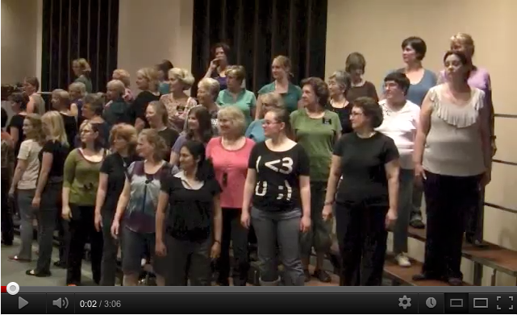
The “data price” for online service is too high: private URLs…
Handy but insecure
Unsuitable for really sensitive data

Slide 5
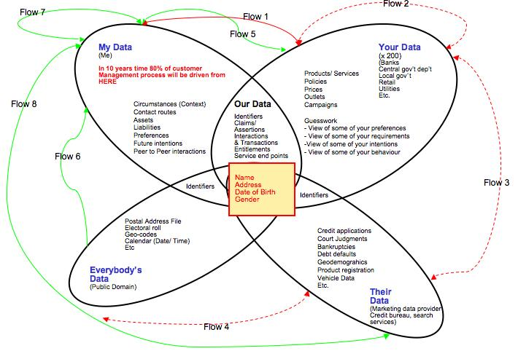
Most data “sharing” today is back-channel and unconsented
Image source: http://informationanswers.com/?p=283
Notes:
Image source: http://informationanswers.com/?p=283

Slide 6
Privacy is about context, control, choice and respect – so UMA enables a “digital footprint control console”
Web 2.0 access control
is inconsistent and unsophisticated
To share with others, you have to list them literally
You have to keep rebuilding your “circles” in new apps
You can’t advertise content without giving it away
You can’t get a global view of who accessed what
You can unify access control under a single app
Your access policies can test for claims like “over 18”
You can reuse the same policies with multiple sites
You can control access to stuff with public URLs
You can manage and revoke access from one place

Slide 7
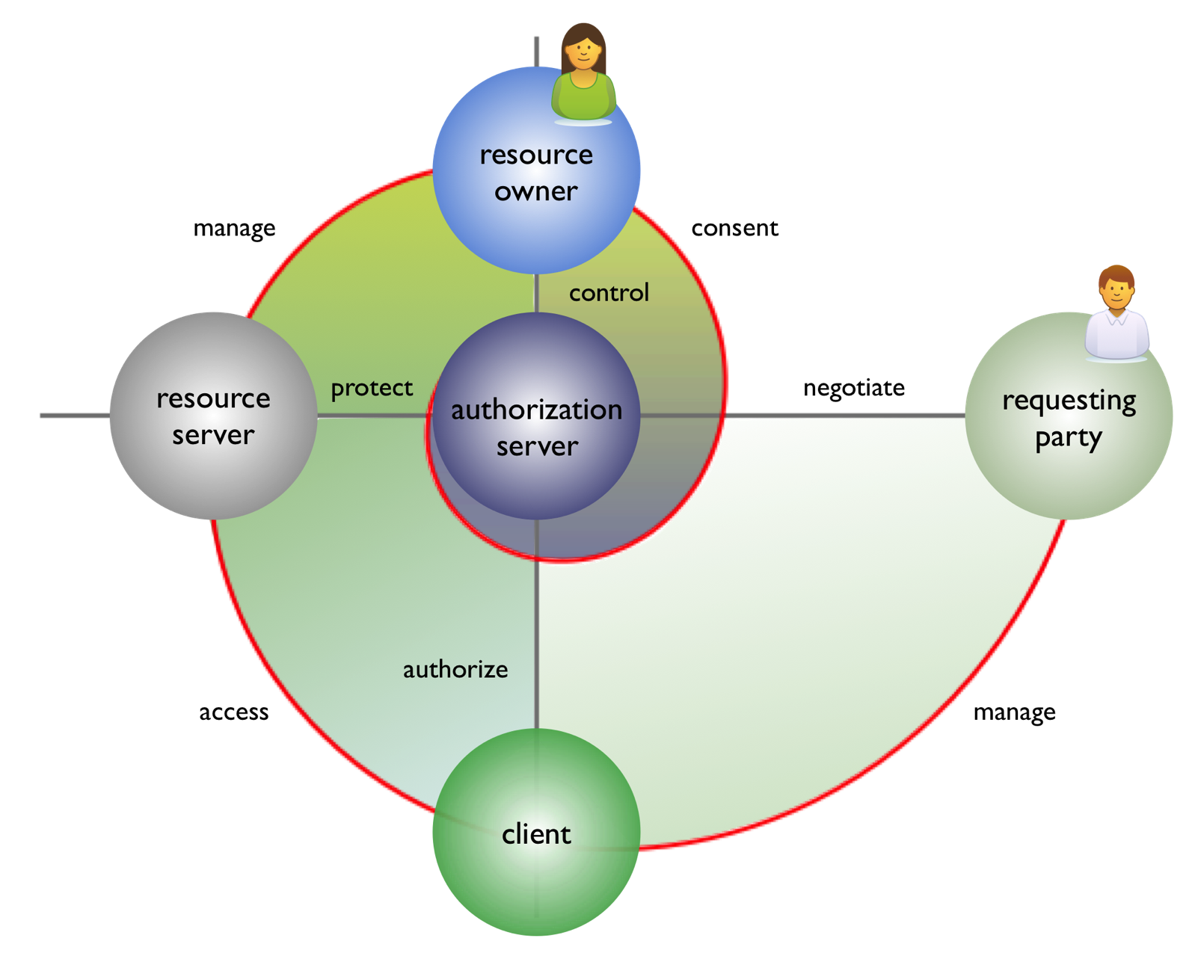
UMA turns online sharing into a privacy-by-design solution

Slide 8
UMA turns online sharing into a privacy-by-design solution
Historical
Municipal
Financial
Vocational
Artistic
Social
Geolocation
Computational
Genealogical
Biological
Legal
...

Slide 9
UMA turns online sharing into a privacy-by-design solution
I want to share this stuff selectively
Among my own apps
With family and friends
With organizations
I want to protect this stuff from being seen by everyone in the world

Slide 10
UMA turns online sharing into a privacy-by-design solution
I want to control access proactively, not just feel forced to consent over and over

Slide 11
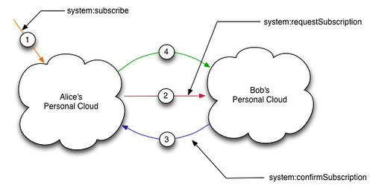
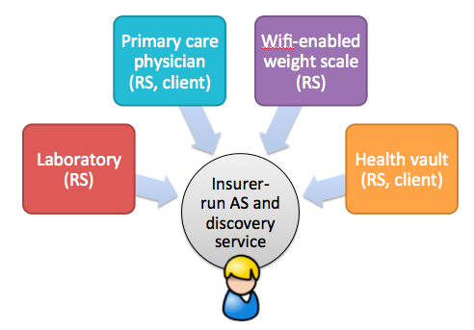
Key use caseshttp://kantarainitiative.org/confluence/display/uma/Case+Studies
Subscribing to a friend’s personal cloud
Sharing accessibility attributes (“GPII”)
E-transcript sharing (“HEAR”)
Patient-centric health data access
Enterprise “access management 2.0”

Slide 12
Enterprise use cases bring WAM into the API economy
Scopes are entirely proprietary and non-interoperable
Access management and policies are done on a pairwise, per-service basis
You create and standardize machine-readable scope descriptions
You can centralize scope mgmt at one AS and reuse policies
The RO is the enterprise itself
The policy administrator is an “RO agent”
The AS is a PAP and (pseudo) PDP that can serve as a PIP client
Notes:
Think of how we share calendars today:
We share them with both ourselves using different identities, and other people and companies
Calendars are so volatile that we really want to share them as “feeds”, not as static piles of data

Slide 13
Potential ecosystem: “social access control” (à la social sign-in)
Most dynamic; Alice-to-Bob sharing is the key differentiator
AS
RS
AS
RS
AS
Few, large, IdP-assoc/PDS
Some with onboard RS apps
RS
RS
C
RS
RS
C
Work with popular AS+IdPs
May outsource local authz
C
C
C
C
C
C
Third-party apps UMA-enabled
Benefits
High-quality, centralized consumer authz
Challenges
Disruptive change to biz models
Trust and assurance
API interoperability

Slide 14
Potential ecosystem: “walled garden PDS’s”
Likely highly static partnerships; Alice-to-Alice/Bob/org sharing
AS
RS
AS
RS
C
AS
NSTIC-ish banks and telcos
In-house apps
RS
RS
C
RS
C
Part of existing third-party ecosystem
C
Few truly independent apps
Benefits
Today’s back-channel user data is put under user control/monitoring
“Outward” trust growth
Challenges
Tight binding to the owner of the garden

Slide 15
Potential ecosystem: “patient-centric health vaults”
Static partnering will center on payers as 900-lb gorillas; highly vertical
AS
RS
AS
RS
AS
Payers (insurance, governments) and HISPs
RS
RS
C
RS
RS
C
Healthcare providers
Quantified self apps
C
C
C
C
C
C
“Mint for patients and caregivers”
Benefits
Proactive, trackable consent directives
Blue Button-like delivery of data
Challenges
Sclerotic IT practices
Serious security, privacy, and discoverability needs

Slide 16
Protocol vs. value-add: the basics
Apps can outsource reusable high-quality access control
Your access policies can test for claims like “over 18”
You can delegate constrained access to autonomous others
You can control access to stuff with public URLs
You can manage and revoke access from one place
You create and standardize machine-readable scope descriptions
You can centralize scope mgmt at one AS and reuse policies
Protocol + likely AS/RS agreements
Protocol + policy/claim support in AS UX and functionality
Protocol + policy/claim support in AS UX and functionality
Protocol + “personal discovery” features
AS UX and functionality
Profiling
Protocol

Slide 17
Potential ecosystem: “distributed authz for business” (access management 2.0)
AliceCo-to-Employee/Contractor/PartnerBob sharing
AS
AS
AS
C
AS
RS
Firms have own AS, like IdP
May have internal apps
RS
RS
C
RS
RS
C
SaaS, PaaS, IaaS
“Claims-based SSO”
C
C
C
C
C
C
Third-party apps UMA-enabled
Benefits
Centralized scope mgmt across web, mobile
Less dependent on a “big bang”
Challenges
Legacy apps and WAM practices

Slide 18
UMA is a profile of OAuth, with bits added for interop and scale
resource owner
resource server
authorization server
protected resources
(unnamed till now)
client

Slide 19
UMA solves for 1) individual choice and
2) fully modular cloud services
App-specific API
RPT
requesting party token
UMA-enabled client

Slide 20
UMA solves for 1) individual choice and
2) fully modular cloud services
includes resource registration API and token introspection API
PAT
Protection client
Protection API
protection API token

Slide 21
UMA solves for 1) individual choice and
2) fully modular cloud services
Authorization API
AAT
authorization API token
Authorization client
supports OpenID Connect-based claims-gathering for authz

Slide 22




Key implementations http://kantarainitiative.org/confluence/display/uma/UMA+Implementations
SMARTAM.net (running authorization service from Cloud Identity UK)
Puma (Python libraries for RS- and client-enabling web apps) from ditto
Fraunhofer AISEC open-source implementation in Java
Gluu OX open-source implementation for Access Management 2.0 use cases

Slide 23
Next steps
UMA has several independent implementations, some available as open source
UMA interop activities are ongoing
Work is under way with legal experts on “access federation” trust frameworks
Case studies, FAQ, and more are available
Get involved!
  Follow @UMAWG
  Become an UMAnitarian (it’s free!)
  Join the UMA-dev mailing list
Visit tinyurl.com/umawg for all the info you need

Slide 24
Questions?
Thank you
@UMAWG
tinyurl.com/umawg | tinyurl.com/umafaq

Slide 25
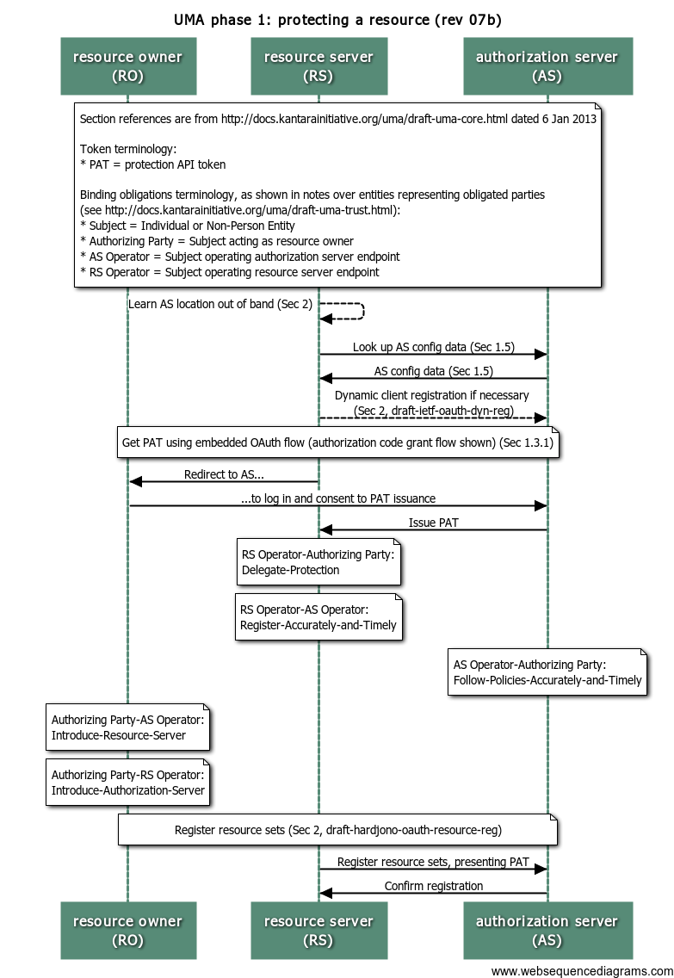
Phase 1: protect a resource

Slide 26
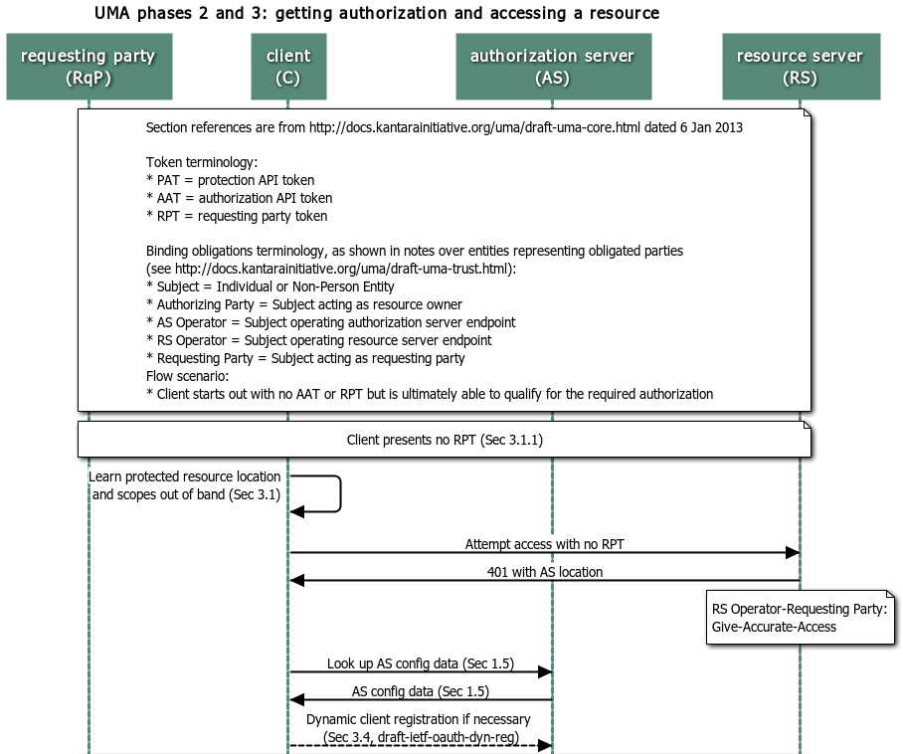
Phases 2 and 3: get authorization and access resource
1 of 3

Slide 27
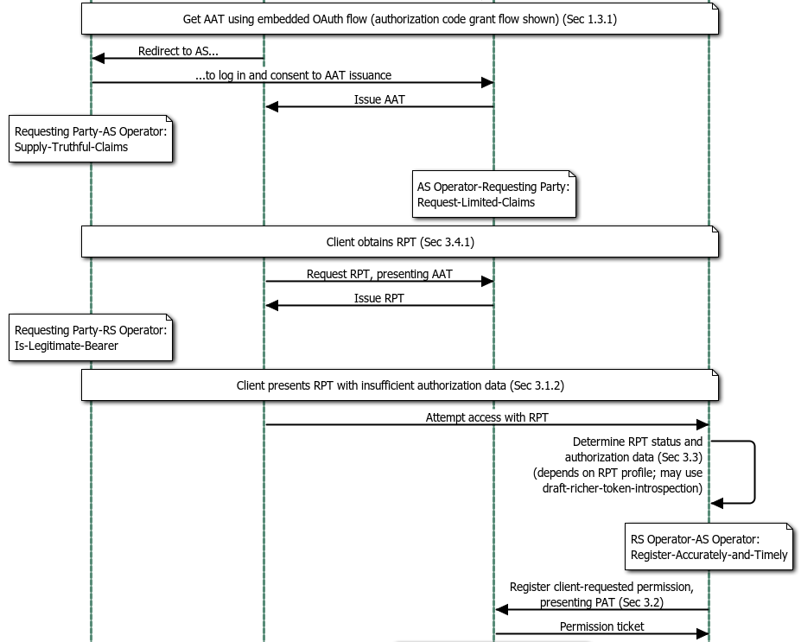
Phases 2 and 3: get authorization and access resource
2 of 3

Slide 28
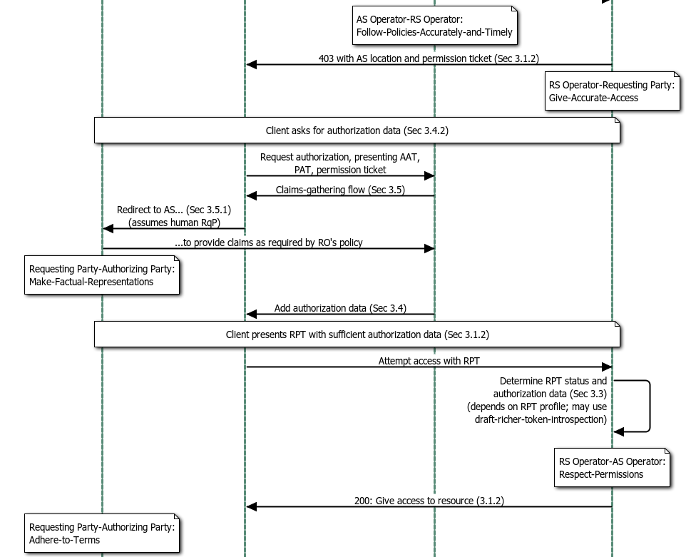
Phases 2 and 3: get authorization and access resource
1 of 3

Slide 29
Spec call tree for the UMA profile of OAuth
UMA core
OAuth 2
OpenID Connect
Token introspection
OAuth resource set registration
Dynamic client registration
UMA binding obligations
hostmeta
UMA native spec
Required external component
Optional external component
Individual IETF I-D

